Slide 1
Driving Demand of
Wild Alaska Pollock
6.0

Slide 2
Our Approach
Objectives
Methodology
Understand the general population and Fish Eaters’ key habits and behaviors with fish
Identify shifts in attitudes and perceptions of Wild Alaska Pollock and other fish
Uncover drivers of demand for Wild Alaska Pollock
Explore the importance of fish sustainability
Understand perception of Surimi Seafood
Uncover the impacts of inflation and consumers purchasing habits
Understand how to effectively engage consumers from a communications and marketing perspective
An online survey was fielded in the United States among a nationally-representative sample of adults aged 18 years or older between July 9th – 22nd, 2024. This report reflects findings from the general population (n=1,031), a statistically significant sample to allow for segmentation among gender, age, region, race/ethnicity, education and income.
Following this, a drivers of demand analysis using predictive analytics methods was conducted to understand which fish attributes are most likely to drive Wild Alaska Pollock demand overall.
In addition to Wild Alaska Pollock, the following comparisons were included in this analysis:
Salmon Pacific Hake / Whiting
Cod Halibut
Tilapia Tuna
Haddock Catfish
Sole / Flounder Rock fish

Slide 3
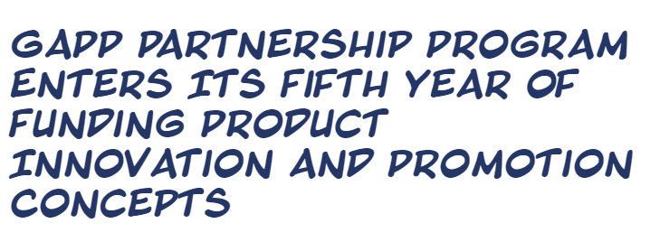
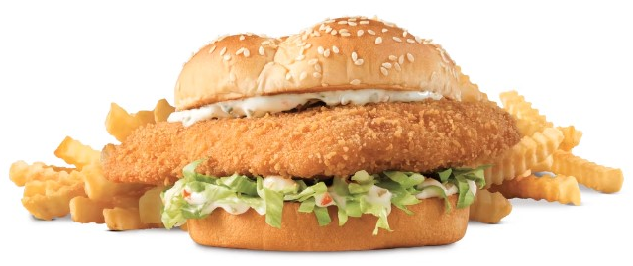
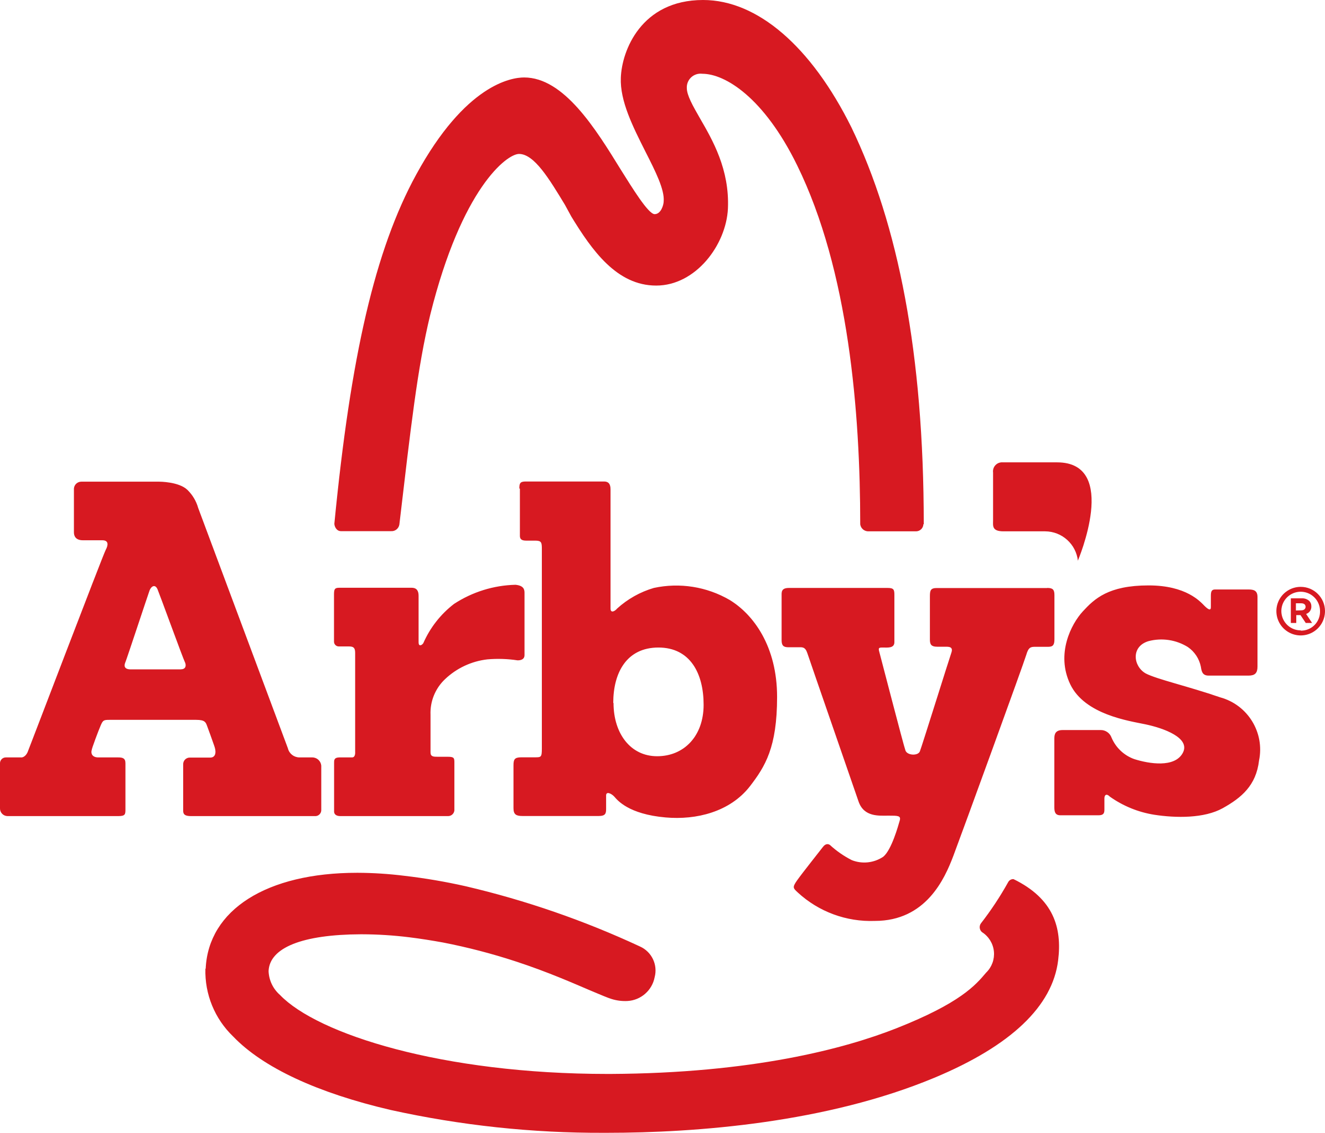
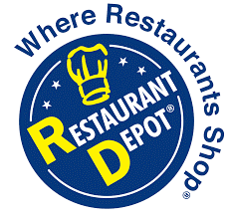
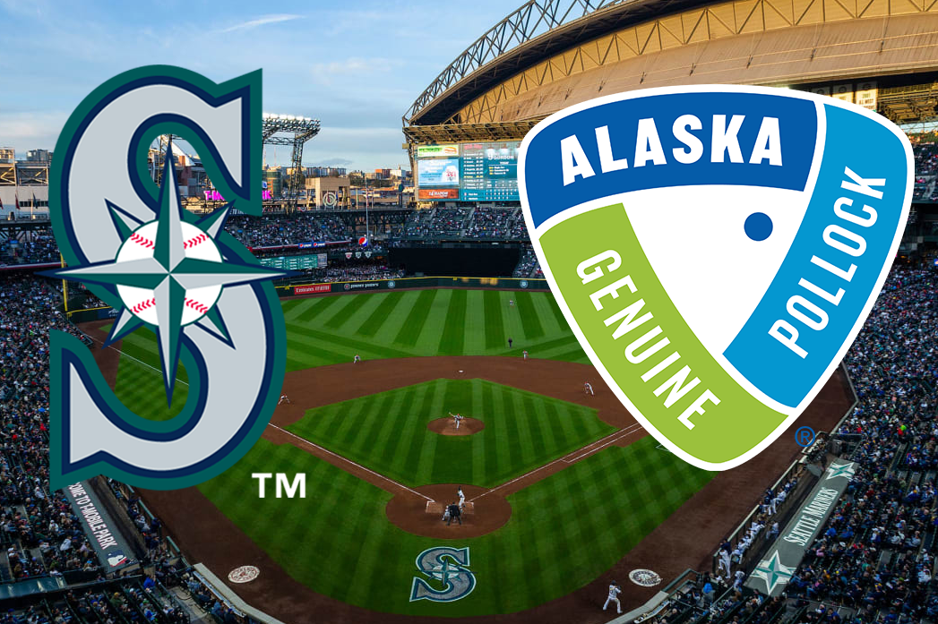
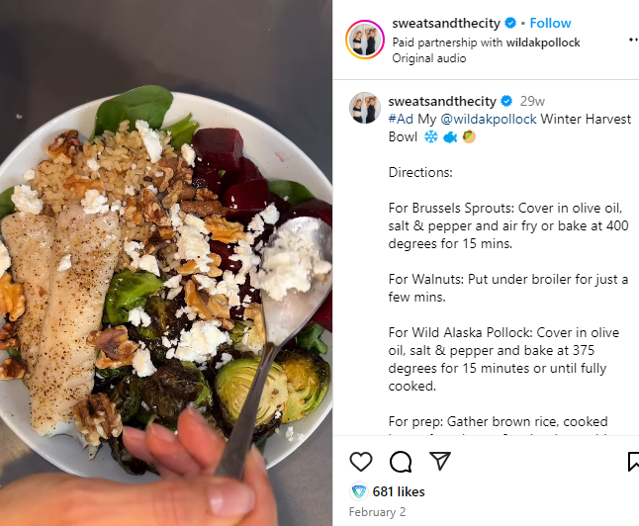
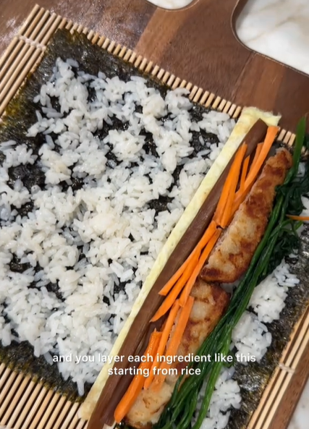
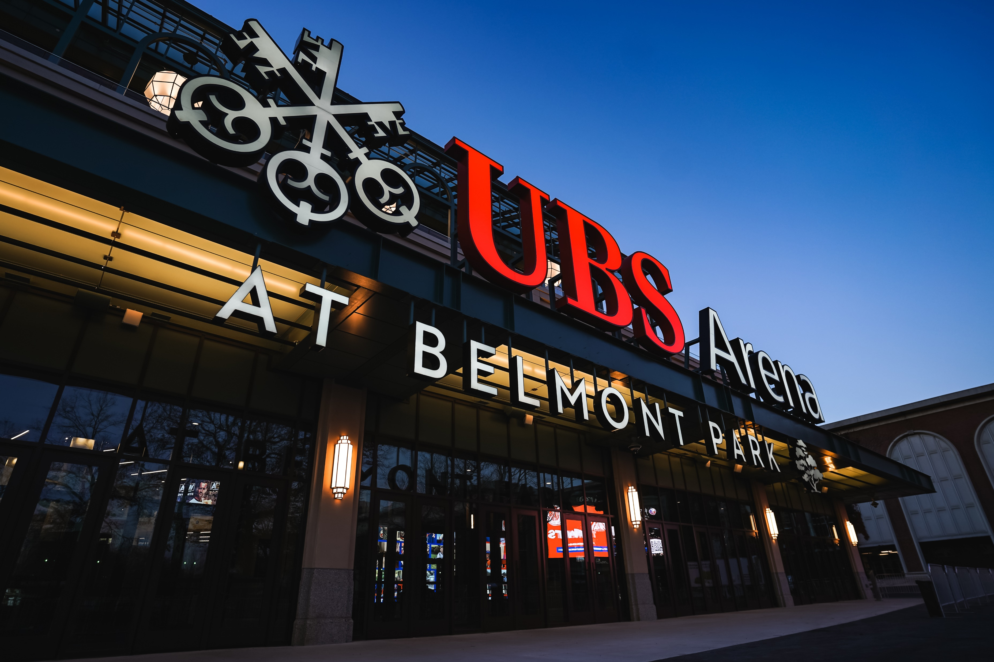
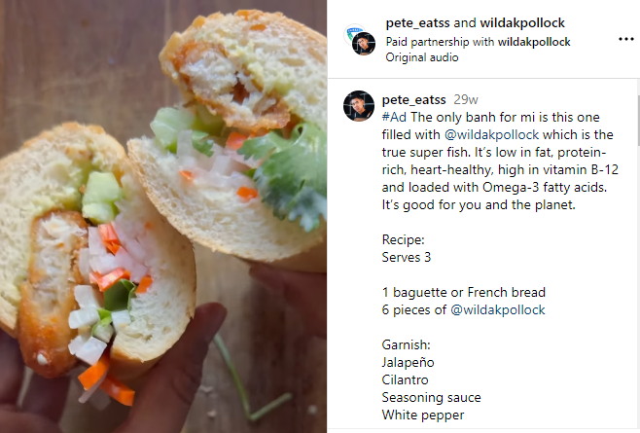
Build awareness & demand for Wild Alaska Pollock and protect the industry’s reputation
COMMUNICATIONS OBJECTIVE
WHAT WE EXECUTED THIS YEAR
PARTNERSHIP PROGRAM
SPORTS PARTNERSHIPS
INFLUENCER CAMPAIGN
Notes:
This year marked the 5th anniversary of GAPP’s Partnership Program. In those 5 years, we’ve had 100 different partnerships encompassing $50M in marketing spend to increase the visibility of Wild Alaska Pollock products in restaurants, grocery stores, on pack and elsewhere. These partnerships are what is getting Wild Alaska Pollock to be more front & center among consumers—Arby’s is a great example of this with its Wild Alaska Pollock fish sandwich during lent. This drove a lot of visibility for our fish during the Lent season, getting it in the hands of more consumers.
It’s important that we continue to drive visibility for our fish, particularly among the hard-to-reach Millennial consumer. Last year we featured Millennial Fish Eaters as a priority audience for the industry and we continue to see that younger consumers are less open to fish generally. We need to continue to prioritize this audience and expose them to Wild Alaska Pollock products to drive them down the purchase funnel. We’ll share more on that audience throughout our presentation today.
Other ways we’ve worked to get Wild Alaska Pollock more front & center among consumers include our sports arena partnerships, both here in Seattle and in New York, as well as our influencer partnerships that drive home the versatility and ease that our fish provides.

Slide 4
Performance KPIs
Notes:
LAUREN

Slide 5
Total familiarity of Wild Alaska Pollock is the highest recorded since tracking began in 2019
Those who know a lot about Wild Alaska Pollock have a stronger perception of it (72%)
Q1. How much would you say you know about the following fish? Base: Total 2024 (n=1031); 2023 (n=1032); 2022 (n=1023); 2021 (n=1066); 2020 (n=1244); 2019 (n=1026)
N6. Based on everything you know about Wild Alaska Pollock, what is your overall opinion of it? Base: Those aware of Wild Alaska Pollock 2024 (n=594); 2023 (n=559); 2022 (n=573); 2021 (n=576); 2020 (n=610)
Notes:
LAUREN
We’ve increased total familiarity with Wild Alaska Pollock by 6 percentage points since we started tracking familiarity back in 2019. We specifically saw an increase in familiarity among Millennials (up 10ppts), low income (up 10ppt) and those who think fish sustainability is important (up 5ppt) compared to last year.
The last spike in familiarity we had was in 2022—which is also a year where we had a very active influencer campaign, with one of the waves launching right before the survey was fielded.
Similarly, we saw that positive opinion of Wild Alaska Pollock is up this year, by 3 percentage points. While positive opinion is up—there’s opportunity to continue pushing consumers down the purchase funnel as growth in familiarity is outpacing positive opinion. We see that the more people know about Wild Alaska Pollock, the more positive opinion they have of it. 72% of those who know a lot about Wild Alaska Pollock have an excellence or very good opinion of it vs. 48% who know “some” and 26% who know “a little”.

Slide 6
Wild Alaska Pollock continues to outpace Haddock on familiarity, positive opinion and intent to eat
Wild Alaska Pollock is closing the gap with Cod and Tilapia on positive opinion and intent to eat.
Wild Alaska Pollock
Haddock
Cod
Tilapia
Total familiarity (know a lot / some / a little)
Strong familiarity (know a lot)
Positive opinion (excellent / very good)
Intend to eat (next 30 days) (likely / extremely likely)
Q1. How much would you say you know about the following types of fish? Base: Total (n=1031)
N6. Based on everything you know about [type of fish], what is your overall opinion of it? Base: Those aware of Wild Alaska Pollock (n=594); Haddock (n=573); Tilapia (n=867); Cod (n=868)
N8. How likely are you to eat [...] in the coming month? Base: Those aware of Wild Alaska Pollock (n=594); Haddock (n=573); Tilapia (n=867); Cod (n=868)
Notes:
LAUREN
We look to other, more established white fish species as a point of reference for how we’re growing credibility for Wild Alaska Pollock. Last year, for the first time, Wild Alaska Pollock outpaced Haddock on familiarity, positive opinion and intent to eat. We’ve continued to maintain that position this year.
This year, we also are starting to close the gap between Wild Alaska Pollock and Cod & Tilapia on positive opinion and intent to eat.
For positive opinion, Wild Alaska Pollock is 10 percentage points behind Cod and 2 percentage points behind Tilapia. Last year we were 12 percentage points and 7 percentage points behind on each.
For intent to eat, Wild Alaska Pollock is 9 percentage points behind Cod and 7 percentage points behind Tilapia. Last year we were 10 percentage points and 11 percentage points behind on each.

Slide 7
GAPP communications priorities are aligned with what’s top of mind for consumers
Notes:
MARY ELIZABETH

Slide 8
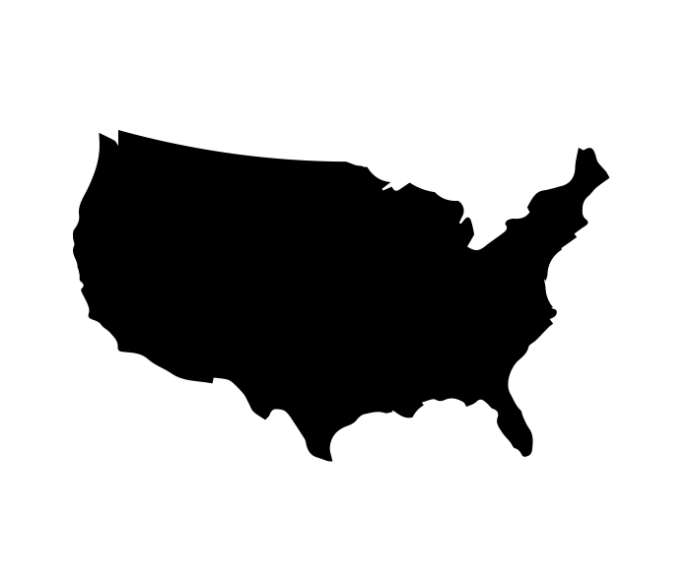
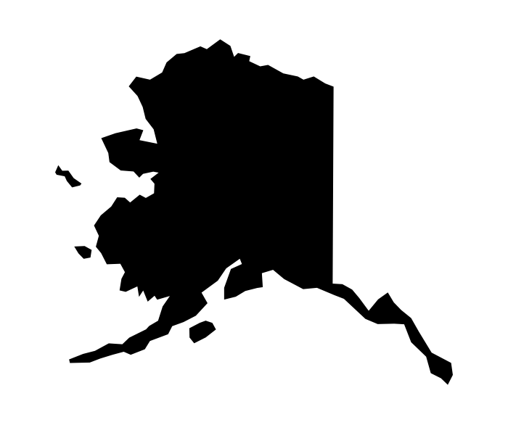
Origin of fish remains a consumer priority and demand driver
Advanced analysis shows “product of the United States” is a driver of purchase consideration.
Likelihood to purchase fish from
Overall fish importance score
(among Fish Eaters; T3B Summary)
56%
Product of the U.S.
(vs. 54% in 2023,
58% in 2022)
35%
Product of Alaska
(vs. 35% in 2023,
39% in 2022)
F10. When purchasing fish, how likely would you be to purchase fish from the following countries? Base: Fish Eaters (n=704)
Q8. Below is a list of attributes that people may use to describe fish. For each, please rate how important that attribute is to you when purchasing and/or ordering fish? T3B Summary (8-10) Base: 2024 Fish Eaters (n=704); 2023 Fish Eaters (n=598); 2022 Fish Eaters (n=640)
Notes:
MARY ELIZABETH
Origin story is one of the key attributes the Wild Alaska Pollock industry has worked to communicate. It’s in the name itself (“wild Alaska”)! Particularly this year, GAPP supported a significant policy change as the Biden administration closed a loophole that previously allowed lower-quality Russian-harvested seafood to reach U.S. consumers, safeguarding demand for domestically sourced seafood.
We continue to see the importance of this work in the consumer data. Likelihood to purchase fish from the United States continues to be significantly higher than other countries. We also see that fish eaters think it’s important that the fish they purchase be a product of the U.S. and for a third of fish eaters, it’s important that their fish be a product of Alaska specifically.

Slide 9
Sustainability remains important to consumers
Sustainability importance
(somewhat / very important)
Attributes that are important when eating sustainably
(somewhat / very important, Top 4)
66%
of Fish Eaters say sustainability is important when purchasing/ordering fish
(vs. 69% in 2023,
69% in 2022)
78%
Safe for the ocean
73%
Ensuring supply for future generations
70%
Wild-caught
69%
Fishery management
Advanced analysis shows “wild-caught” is a driver of purchase intent.
N37: How important is sustainability to you when purchasing/ordering fish? Base: Fish Eaters 2024 (n=704); 2023 (n=598); 2022 (n=640)
N38. When it comes to purchasing/ordering fish, how important are the following aspects of sustainability to you? Base: Fish Eaters 2024 (n=704)
Notes:
MARY ELIZABETH
Similarly, the industry has emphasized the unique sustainability story of Wild Alaska Pollock over the last few years and this remains a priority among fish eaters.
Two-thirds of fish eaters say sustainability is important when purchasing or ordering fish. But we know sustainability can mean a lot of different things to different people. For fish eaters, it means being safe for the ocean, ensuring supply for future generations, wild-caught and fishery management.
Wild Caught continues to be a term that works really hard for us. It not only refers to the origin of the fish, but consumers think this term indicates sustainability as well. Through advanced statistical analysis we were able to see that it’s not only important to consumes, but it’s a statistical driver of purchase intent.

Slide 10
Sustainable management messaging makes fish eaters feel good about Wild Alaska Pollock
It is imperative that we preserve the sustainable management of Alaska’s pollock fishery to protect both our oceans and our economic interests.
Believable
55%
PERCEPTION
Positive Impact on Perception of Wild Alaska Pollock Fishermen
58%
F7. How believable do you feel each of the following statements are? Base: Fish Eaters (n=704)
F8. How do each of the following statements impact your perception of Wild Alaska Pollock fishermen? Base: Fish Eaters (n=704)
F9. How do each of the following statements impact your: 1) Intent to purchase Wild Alaska Pollock 2) Intent to eat Wild Alaska Pollock? Base: Fish Eaters (n=704)
Notes:
MARY ELIZABETH
We also tested some messaging this year which reinforced the impact that sustainability has on consumers when it comes to fish purchases.
Our message about sustainability [READ MESSAGE] drove the highest ratings for believability and having a positive impact on perceptions of Wild Alaska Pollock fishermen. Leading us to believe that sustainable management messaging helps fish eaters feel good about Wild Alaska Pollock.
But then how do we drive them further down the funnel to purchase?

Slide 11
While talking about economic impacts at the local level drives purchase
It is imperative that we preserve the sustainable management of Alaska’s pollock fishery to protect both our oceans and our economic interests.
Believable
55%
PERCEPTION
Positive Impact on Perception of Wild Alaska Pollock Fishermen
58%
The Alaska pollock fishery provides vital economic support for Alaska’s rural communities, including shoreside processing jobs, port and support business employment, and tax revenue.
More Likely to Purchase Wild Alaska Pollock
59%
The Alaska pollock fishery is a vital and valued economic partner for 65 coastal Alaska communities. Through the CDQ program, we help support education, training, and employment opportunities, as well as investments to improve infrastructure.
PURCHASE
More Likely to Eat Wild Alaska Pollock
56%
F7. How believable do you feel each of the following statements are? Base: Fish Eaters (n=704)
F8. How do each of the following statements impact your perception of Wild Alaska Pollock fishermen? Base: Fish Eaters (n=704)
F9. How do each of the following statements impact your: 1) Intent to purchase Wild Alaska Pollock 2) Intent to eat Wild Alaska Pollock? Base: Fish Eaters (n=704)
Notes:
MARY ELIZABETH
Messages tested around economic support [READ MESSAGE] and the CDQ program [READ MESSAGE] had the highest impact on intent to purchase Wild Alaska Pollock and intent to eat Wild Alaska Pollock.
This further supports our earlier point on provenance as well. Telling more of Wild Alaska Pollock’s origin story, drives fish eaters to purchase and eat Wild Alaska Pollock more often.
Therefore, we get their attention and their hearts with sustainability and then we capture their wallets and stomachs with provenance and community storytelling.

Slide 12
Opportunities
Notes:
LAUREN
Now we’re going to talk through some opportunities to continue to drive familiarity among fish eaters and drive them down the purchase funnel.

Slide 13
Consumers are becoming more price sensitive, and fish has an inherent connotation as expensive.
74%
Have noticed a price increase in fish
Fish eaters are looking for affordability, but price remains a barrier for Wild Alaska Pollock purchases
Important fish attributes for Fish Eaters
(T3B on 10-pt scale)
#4 behind beef, dairy & chicken
27%
Say price keeps them from purchasing Wild Alaska Pollock more often
27%*
Say the price increase in fish is greater than other animal proteins
*among those who have noticed a fish price increase
H1. Which of the following products, if any, have you noticed a price increase in over the last year? Base: Fish Eaters (n=704)
H2. How does the price increase you’ve noticed in fish compare to price increases in other animal proteins? Base: Fish Eaters Who Noticed A Price Increase in Fish Over the Last Year (n=520)
Q8. Below is a list of attributes that people may use to describe fish. For each, please rate how important that attribute is to you when purchasing and/or ordering fish? Base: Fish Eaters 2024 (n=704)
Q25. Overall, what prevents you from consuming Wild Alaska Pollock or consuming it more often? Base: Fish Eaters aware of Wild Alaska Pollock 2024 (n=460)
Notes:
LAUREN
As such, fish eaters are turning to frozen fish options that they view as more affordable. Over one-fourth of fish eaters who have noticed a price increase in fish over the last year are turning to frozen fish options.
We also see that frozen Wild Alaska Pollock is the most popular form among fish eaters with 45% often purchasing it from the frozen aisle at grocery stores and 35% likely to purchase it from the frozen aisle.
We’re also seeing this trend towards frozen in the market overall. According to 210 Analytics, frozen pollock was the third top bestselling frozen seafood in July and the only product of the top 5 to see increases in both dollar sales (+7.1%) and volume (6.9%), signaling a growing interest in the product. Frozen pollock outpaced both frozen tilapia and cod.

Slide 14
Embrace the “frozen-ness” of Wild Alaska Pollock
COST IMPLICATIONS
Impact of inflation on fish purchasing habits
Top 5
Likelihood to purchase/eat frozen Wild Alaska Pollock
45%
#1 Setting
of fish eaters often purchase Wild Alaska Pollock at a grocery store or market, frozen (T3B)
H3. How have your fish purchasing habits changed because of inflation? Base: Those Who Noticed A Price Increase in Fish Over the Last Year (n=698)
S9. How often do you eat [I purchase it at a grocery store or market, frozen] in the following settings? Base: Fish Eaters Aware of Wild Alaska Pollock (n=460)
Q5. How likely are you to eat [From the frozen aisle at the grocery store or market] from the following settings? Base: Fish Eaters Aware of Wild Alaska Pollock (n=460
Notes:
LAUREN
The first opportunity we found surrounds the frozen-ness of Wild Alaska Pollock.
Inflation has been an issue facing consumers for several years now and it’s having an impact on their food purchasing behaviors. Consumers are becoming even more price sensitive and fish has an inherent connotation as expensive.
Three-fourths of consumers have noticed a price increase in fish over the last year—with beef, dairy and chicken the only animal products outpacing fish. Among those who have noticed a price increase in fish, a quarter believe that fish prices have increased more than other animal proteins.
Amid these rising prices, fish eaters are prioritizing affordability and value in their fish purchases. We also continue to see price as a barrier for one-fourth of consumers from eating or purchasing Wild Alaska Pollock more often.

Slide 15
Emphasize ease in messaging and recipe content
EASE OF PREPARATION
Top important fish attributes
(T3B on 10-pt scale)
Inspiration for Fish Eaters to try a particular recipe
61%
Easy to prepare
+2ppts YoY
40%
Quick preparation time
#2 Reason
Q8. Below is a list of attributes that people may use to describe fish. For each, please rate how important that attribute is to you when purchasing and/or ordering fish? Fish Eaters 2024 (n=704); 2023 (n=598)
N29. What inspires you to try a particular recipe? Base: Fish Eaters 2024 (n=704); 2023 (n=598)
Notes:
LAUREN
To drive trial of Wild Alaska Pollock, it’s important that the recipes and content we’re sharing emphasize the ease of the product. This can also play into the frozen-ness of the fish as many frozen forms require minimal preparation.
We see that consumers are emphasizing preparation ease in their fish purchase behaviors and they look for quick preparation time when deciding to try a particular recipe.

Slide 16
Increase visibility in grocery stores to drive education
GROCERY STORE VISIBILITY
Top ways fish eaters learn about
Wild Alaska Pollock:
34% | Grocery stores (34% in 2023)
33% | Family and friends (27% in 2023)
26% | Cooking shows (28% in 2023)
20% | Sit-down restaurant (18% in 2023)
15% | Fast-food restaurant (15% in 2023)
13% | Advertisements and commercials (15% in 2023)
10% | Social media (14% in 2023)
8% | News (13% in 2023)
Retail partnerships can help Wild Alaska Pollock products be more top of mind for grocery shoppers.
Q2. How did you learn about Wild Alaska Pollock? Base: Fish Eaters aware of Wild Alaska Pollock 2024 (n=460); 2023 (n=394)
Q26. What prevents you from purchasing and/or ordering Wild Alaska Pollock? Fish Eaters 2024 (n=704); 2023 (n=598); 2022 (n=640); 2021 (n=669); 2020 (n=764); 2019 (n=850)
Notes:
MARY ELIZABETH
We see a lot of opportunity with grocery stores to drive visibility of Wild Alaska Pollock. We continue to see that grocery stores are the #1 place fish eaters learn about Wild Alaska Pollock but lack of visibility within grocery stores remains a barrier.
While GAPP partnered with HEB through the partnership program on a retail media partnership, there’s opportunity to do more in-store retail partnerships to drive Wild Alaska Pollock to be top of mind for shoppers as they grocery shop.

Slide 17
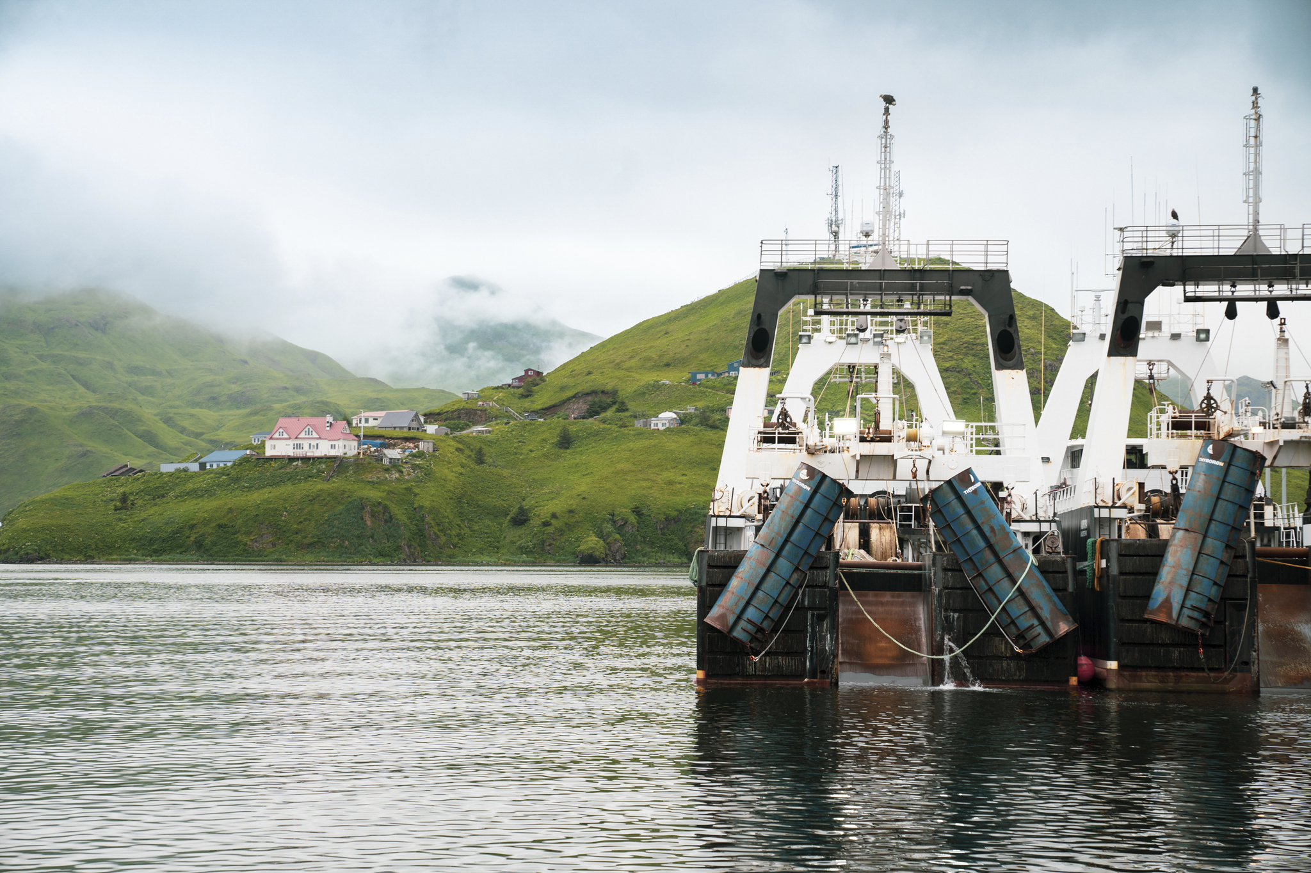
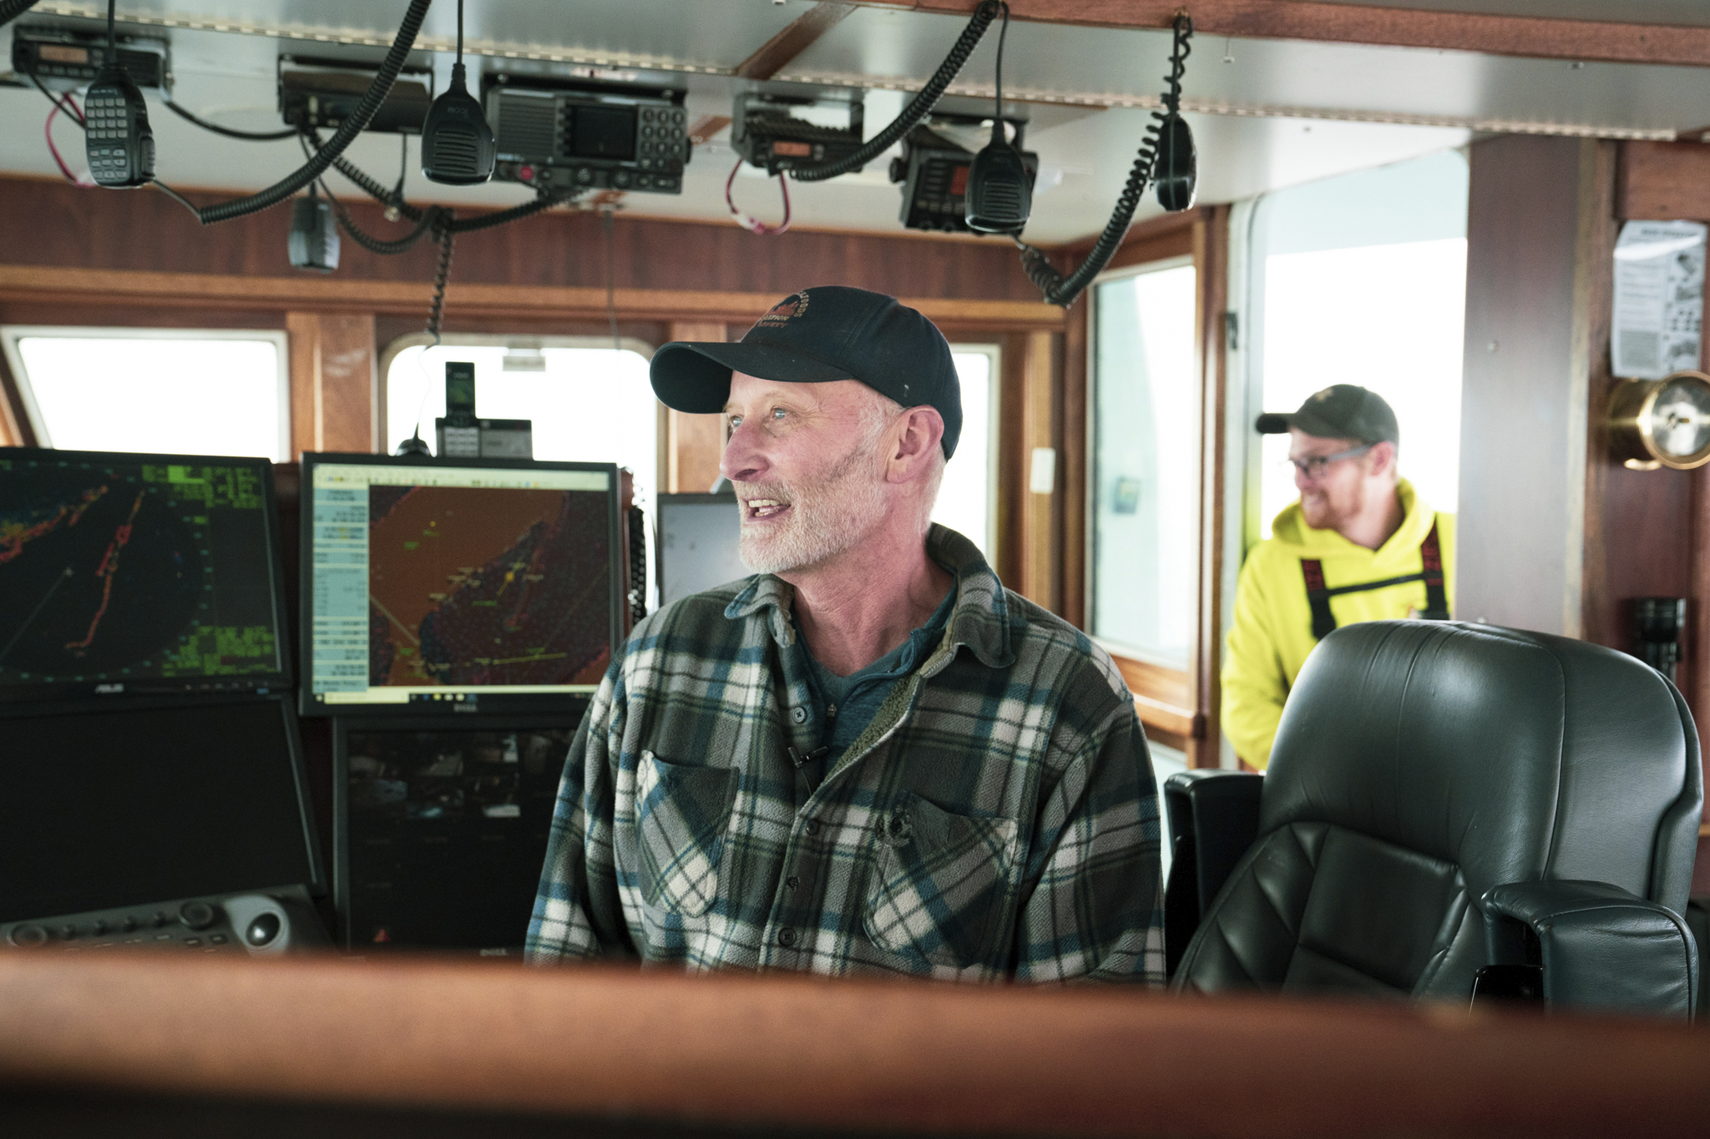
Create documentary style content and media to boost awareness and build trust
TRUSTED SOURCES
Sources Fish Eaters trust when it comes to news and information about fish – Top 7
5 ppt
5 ppt
Example: Pollock People Campaign
Arrows indicate a statistically significant change compared to 2023. Green indicates an increase, red indicates a decrease, and no arrow indicates no change
N30. Which of the following sources do you trust when it comes to news and information about fish? Base: Fish Eaters 2024 (n=704); 2023 (n=598)
stat. sig. lower
stat. sig. higher
Notes:
MARY ELIZABETH
While family & friends and fishers remain the top sources fish eaters trust when it comes to news & info about fish, we saw an increase in trust of documentaries compared to last year. This is likely driven by the increase in food documentaries that have been released over the last year and we particularly see younger consumers leaning more on documentaries. There’s opportunity to lean into this style of content, both branded and unbranded, to drive trust with our fish eating audience.
We also saw an increase in trust of news stories. We should be telling the Wild Alaska Pollock story—whether it’s messaging around sustainability, provenance, value or ease via earned media that reaches a fish eating audience.
Food52 reference

Slide 18
Continue engaging Millennial Fish Eaters to drive them down the purchase funnel
TARGET CONSUMERS
stat. sig. lower
stat. sig. higher
The more Millennial Fish Eaters know about Wild Alaska Pollock, the more they like it– 65% who know a lot have an excellent/very good opinion of it vs. those who know some (38%) or only a little (31%).
Arrows indicate a statistically significant change compared to 2023. Green indicates an increase, red indicates a decrease, and no arrow indicates no change
Q1. How much would you say you know about the following fish? Base: Millennial Fish Eaters 2024 (n=221); 2023 (n=210)
N6. Based on everything you know about Wild Alaska Pollock, what is your overall opinion of it? Base: Millennial Fish Eaters Aware of Wild Alaska Pollock 2024 (n=154); 2023 (n=140)
Notes:
MARY ELIZABETH
Last year we identified Millennial fish eaters as an opportunity audience to prioritize. Over the last year, we’ve seen that more Millennial Fish Eaters are familiar with Wild Alaska Pollock, but their perception of the fish has decreased—indicating opportunity to continue to push them down the purchase funnel.
We know generally that Millennials and younger consumers are less open to fish than older generations. To keep demand strong, we need to continue to make our fish relevant to Millennials. We should be considering funding campaigns that specifically target this audience. And how can we do that?
We’ve started to prioritize this audience and we’re getting them into the top of the funnel, particularly with the work Jon has done with GAPP’s TikTok presence. GAPP has gone through a significant transformation of our social presence, growing our reach on TikTok to 1.2M. note Jon’s TikTok content. And 72% of GAPP’s TikTok followers are under the age of 30, proving that this content is reaching this priority Millennial audience and starting to penetrate with the ever-popular Gen Z audience as well.

Slide 19
To engage Millennial Fish Eaters, focus on:
stat. sig. lower
stat. sig. higher
Sustainability
Social channels & recipe inspiration
New flavors, affordability & frozen-ness
Inspiration to Try New Recipes
#1 | New flavors | 44%
#2 | Affordable ingredients | 41%
74%
Say sustainability is important to them when purchasing fish
(vs. 59% of Gen Z, 64% of Gen X and 62% of Boomers)
10 ppt
38%
(vs 27% of all fish eaters)
noticed the price of fish increase more than other animal proteins
of Millennial fish eaters often purchase Wild Alaska Pollock at a grocery store or market, frozen (T3B)
55%
#1 Setting
Compared to total fish eaters
Compared to total fish eaters
N37. How important is sustainability to you when purchasing/ordering fish? Base: Millennial Fish Eaters 2024 (n=221)
N30. Which of the following sources do you trust when it comes to news and information about fish? Base: Millennial Fish Eaters 2024 (n=221); 2023 (n=210)
N29. What inspires you to try a particular recipe? Base: Millennial Fish Eaters 2024 (n=221)
H2. How does the price increase you’ve noticed in fish compare to price increases in other animal proteins? Base: Millennial Fish Eaters Who Noticed A Price Increase in Fish Over the Last Year (n=162)
S9. How often do you eat [I purchase it at a grocery store or market, frozen] in the following settings? Base: Millennial Fish Eaters Aware of Wild Alaska Pollock (n=154)
Notes:
MARY ELIZABETH
We know that Millennials in general have prioritized sustainability more than older generations and that remains true when it comes to Fish specifically. Three-fourths of Millennial Fish Eaters say sustainability is important to their fish purchases, compared to around two-thirds of those older than them. While messaging around sustainability is important to fish eaters generally, it’ll be especially important to emphasize this among Millennials.
We also need to reach them on channels they’re active on. Millennials are more active on social media and following influencers for recipe inspiration. They’re also more likely to turn to recipe websites and food blogs.
Finally—messaging around new flavors and affordability will be key. As we think about recipes we feature or cuisines we highlight in partnerships, flavor will be something we should prioritize. Value messaging and the frozen nature of the fish will especially resonate with this audience as it’s the number 2 attribute that drives recipe trial and this audience is more likely to say they’ve noticed the price of fish increase more than other animal proteins.

Slide 20
What this means for the Wild Alaska Pollock industry
#1
Keep the Wild Alaska Pollock name front & center—the name alone hits on two consumer priorities of provenance and sustainability.
#2
Embrace the “frozen-ness” of the fish to appeal to price conscious consumers.
#3
Prioritize “ease” in messaging and recipe content to drive product trial.
#4
Partner with retailers to help Wild Alaska Pollock be more top of mind.
#5
Drive documentary style content and media visibility to boost awareness and build trust.
#6
Continue to drive Millennial Fish Eaters down the purchase funnel via sustainability, affordability, flavors and ease messaging.
Notes:
MARY ELIZABETH

Slide 21
Surimi Seafood
Notes:
LAUREN
Now diving into Surimi Seafood. For those that remember, we started including Surimi Seafood in our annual tracker a few years ago to track how consumers perceive and engage with this product.

Slide 22
Surimi Seafood leads in positive opinion ahead of Imitation Crab, despite lower familiarity
Total familiarity
(know a lot / know some / know a little)
Positive opinion
(excellent / very good/ good)
24%
of Fish Eaters aware of Imitation Crab or Surimi Seafood are aware that they are interchangeable terms
Arrows indicate a statistically significant change compared to 2023. Green indicates an increase, red indicates a decrease, and no arrow indicates no change
W5. How much would you say you know about each of the following? Base: Fish Eater 2024 (n=704); 2023 (n=598); 2022 (n=640)
W6. What is your overall opinion of the following products? Base: Fish Eater aware of Surimi Seafood 2024 (n=188); 2023 (n=164); 2022 (n=192) Base Fish Eater aware of Imitation Crab 2024 (n=529); 2023 (n=446); 2022 (n=433)
W7. Were you aware that surimi seafood and imitation crab are interchangeable terms to describe the same product? Base: Fish Eater aware of Surimi Seafood or Imitation Crab 2024 (n=542); 2023 (n=454)
Notes:
LAUREN
We continue to see that while imitation crab leads on total familiarity among fish eaters, Surimi Seafood has a MUCH more positive opinion among them. This continues to reinforce the importance of leaning into the Surimi Seafood name. We also see that only a fourth of fish eaters are aware that Surimi Seafood and imitation crab are interchangeable terms. Proving there’s continued room for education and growth.

Slide 23
Fish Eaters view Surimi Seafood as convenient, affordable and versatile
Millennial Fish Eaters (72%) are more likely to describe Surimi as quick & easy to prepare
Attributes Fish Eaters use to describe Surimi Seafood – Top 5
(T3B on 10-pt scale)
Arrows indicate a statistically significant change compared to 2023. Green indicates an increase, red indicates a decrease, and no arrow indicates no change
W9. Below is a list of attributes that people may use to describe surimi seafood. For each, please rate how much you believe each attribute describes surimi seafood. Base: Fish Eaters aware of Surimi Seafood or Imitation Crab 2024 (n=542); 2023 (n=454); 2022 (n=440) and Millennial Fish Eaters aware of Surimi Seafood or Imitation Crab 2024 (n=181)
Notes:
LAUREN
Surimi Seafood is seen a quick/easy product to prepare and an affordable alternative to crab. If you remember a few slides earlier, we know that quick/easy and affordability are important to our Millennial fish eating audience—there’s a lot of opportunity to grow awareness and preference among this audience as surimi seafood has the attributes they’re looking for in seafood.

Slide 24
Deliberate storytelling around the real-ness of Surimi Seafood is critical to moving the needle
stat. sig. lower
stat. sig. higher
Attributes that would encourage Fish Eaters to purchase Surimi Seafood
Top reasons Fish Eaters are not likely to purchase Surimi Seafood in the next three months
(Among those aware of surimi seafood/imitation crab AND not likely to eat in in the next three months)
+11ppt YoY
+5ppt YoY
W8. How likely are you to eat surimi seafood, also known as imitation crab, in the next 3 months? Base: Fish Eaters aware of Surimi Seafood or Imitation Crab 2024 (n=542), 2023 (n=454)
W12. What would encourage you to consider purchasing surimi seafood? Base: Fish Eaters not likely to eat Surimi Seafood in the next three months 2024 (n=187); 2023 (n=147); 2022 (n=126)
Arrows indicate a statistically significant change compared to 2023. Green indicates an increase, red indicates a decrease, and no arrow indicates no change
W11. Which of the following describes why you're not likely to purchase surimi seafood in the next three months? Fish Eaters not likely to purchase Surimi Seafood in the next three months 2024 (n=187); 2023 (n=147); 2022 (n=126)
Notes:
LAUREN
But the biggest barriers to surimi seafood continue to be perception based. Fish eaters are more likely to eat surimi seafood if they knew it was made from real fish/seafood and if they knew the health benefits. We specifically saw “knowing it’s made from Wild Alaska Pollock” grow in impact compared to last year.
Among those who do not purchase surimi seafood, the top reasons are preferring real fish and not liking imitation food. There’s a need for deliberate and widespread storytelling around the “real-ness” of Surimi Seafood to break through these barriers and drive trial.

Slide 25
What this means for the Wild Alaska Pollock industry
#1
Continue to educate consumers on surimi seafood, embracing the name as it drives stronger perceptions.
#2
Highlight the ease in use of surimi seafood to appeal to Millennial fish eaters.
#3
Emphasize the product being made with real seafood/fish, especially Wild Alaska Pollock, to encourage usage.
#4
Appeal to price conscious fish eaters by highlighting the value of surimi seafood as a cost-effective alternative.
#5
Utilize deliberate, surround sound storytelling to get these messages across and drive fish eaters down the purchase funnel.
Notes:
LAUREN

Slide 26
Data Deep Dive

Slide 27
Tracking and Assessing performance over time

Slide 28
Total familiarity among the general population is highest since tracking began
Total familiarity of Wild Alaska Pollock is up 10 ppts (66% vs 56%) among Millennials.
Wild Alaska Pollock YOY KPIs
Arrows indicate a statistically significant change compared to 2023. Green indicates an increase, red indicates a decrease, and no arrow indicates no change.
Q1. How much would you say you know about the following fish? Base: Total 2024 (n=1032); 2023 (n=1032); 2022 (n=1023); 2021 (n=1066); 2020 (n=1244); 2019 (n=1026) and Fish Eaters 2024 (n=704); 2023 (n=598); 2022 (n=640); 2021 (n=669); 2020 (n=764); 2019 (n=850) and Millennials 2024 (n=319); 2023 (n=340)
N6. Based on everything you know about Wild Alaska Pollock, what is your overall opinion of it? Base: Those aware of Wild Alaska Pollock 2024 (n=573); 2023 (n=559); 2022 (n=573); 2021 (n=576); 2020 (n=610) and Fish Eaters aware of Wild Alaska Pollock 2024 (n=439); 2023 (n=394); 2022 (n=419); 2021 (n=415); 2020 (n=449)

Slide 29
Wild Alaska Pollock continues to outpace Haddock on familiarity, positive opinion and intent to eat
stat. sig. lower
stat. sig. higher
Among general population
Wild Alaska Pollock
Haddock
Cod
Tilapia
Total familiarity (know a lot / some / a little)
Strong familiarity (know a lot)
Positive opinion (excellent / very good)
Intend to eat (next 30 days) (likely / extremely likely)
Arrows indicate a statistically significant change compared to 2023. Green indicates an increase, red indicates a decrease, and no arrow indicates no change
Q1. How much would you say you know about the following types of fish? Base: Total (n=1031)
N6. Based on everything you know about [type of fish], what is your overall opinion of it? Base: Those aware of Wild Alaska Pollock (n=594); Haddock (n=573); Tilapia (n=867); Cod (n=868)
N8. How likely are you to eat [...] in the coming month? Base: Those aware of Wild Alaska Pollock (n=594); Haddock (n=573); Tilapia (n=867); Cod (n=868)
Notes:
2023
Tilapia
Total familiarity: 75%
Strong familiarity: 35%
Positive opinion: 50%
Intend to eat: 32%
Haddock
Total familiarity: 49%
Strong familiarity: 13%
Positive opinion: 41%
Intend to eat: 21%

Slide 30
Limited visibility in stores and restaurants, alongside cost, are primary factors preventing purchase and consumption of Wild Alaska Pollock
stat. sig. lower
stat. sig. higher
What prevents you from purchasing and/or ordering Wild Alaska Pollock? – Top 4
What prevents you from consuming Wild Alaska Pollock or consuming it more often?
Arrows indicate a statistically significant change compared to 2023. Green indicates an increase, red indicates a decrease, and no arrow indicates no change
Q26. What prevents you from purchasing and/or ordering Wild Alaska Pollock? Fish Eaters 2024 (n=704); 2023 (n=598); 2022 (n=640); 2021 (n=669); 2020 (n=764); 2019 (n=850)
Q25. Overall, what prevents you from consuming Wild Alaska Pollock or consuming it more often? Base: Fish Eaters aware of Wild Alaska Pollock 2024 (n=460); 2023 (n=394); 2022 (n=419); 2021 (n=275); 2020 (n=449); 2019 (n=465)

Slide 31
Taste remains highest ranked attribute, while quality and all-natural grows in importance
stat. sig. lower
stat. sig. higher
Top important fish attributes – Top 10
(T3B on 10-pt scale)
Other YoY lifts
Arrows indicate a statistically significant change compared to 2023. Green indicates an increase, red indicates a decrease, and no arrow indicates no change
Q8. Below is a list of attributes that people may use to describe fish. For each, please rate how important that attribute is to you when purchasing and/or ordering fish? Base: Total 2024 (n=1031); 2023 (n=1032); 2022 (n=1023), Total 2021 (n=1066)

Slide 32
Understanding Fish Eaters Purchasing Habits

Slide 33
Grocery stores remain primary way Fish Eaters learn about Wild Alaska Pollock
stat. sig. lower
stat. sig. higher
Top ways they learn about
Wild Alaska Pollock:
Likelihood to eat Wild Alaska Pollock
from the following settings
(T3B on 10-pt scale)
34% | Grocery stores (34% in 2023)
33% | Family and friends (27% in 2023)
26% | Cooking shows (28% in 2023)
20% | Sit-down restaurant (18% in 2023)
15% | Fast-food restaurant (15% in 2023)
13% | Advertisements and commercials (15% in 2023)
10% | Social media (14% in 2023)
8% | News (13% in 2023)
38%
Sit-down restaurant
(vs. 37% in 2023)
35%
Fresh from the grocery store or market
(vs. 36% in 2023)
35%
Frozen aisle at grocery store
(vs. 32% in 2023)
Arrows indicate a statistically significant change compared to 2023. Green indicates an increase, red indicates a decrease, and no arrow indicates no change
Q2. How did you learn about Wild Alaska Pollock? Base: Fish Eaters aware of Wild Alaska Pollock 2024 (n=460); 2023 (n=394)
Q5. How likely are you to eat Wild Alaska Pollock from the following settings? Base: Fish Eaters aware of Wild Alaska Pollock 2024 (n=460); 2023 (n=394)

Slide 34
Fish Eaters, especially Millennial Fish Eaters, remain open to introducing Wild Alaska Pollock into their eating routine
Likelihood to do the following:
(T3B 8-10 on 10-pt scale)
Millennial
Fish Eaters
37% | Consider adding Wild Alaska Pollock to my and/or my family's diet (39% in 2023)
33% | Seek out more information about Wild Alaska Pollock (34% in 2023)
33% | Purchase Wild Alaska Pollock frozen fish sticks at a grocery store or market (33% in 2023)
31% | Purchase breaded and battered Wild Alaska Pollock frozen filets at a grocery store or market (36% in 2023)
30% | Seek out products made with Wild Alaska Pollock (33% in 2023)
29% | Order a Wild Alaska Pollock fish sandwich at a fast food, quick-service restaurant (30% in 2023)
43%
43%
38%
37%
37%
35%
Q13. How likely are you to do the following. Please use a scale of 0 to 10, with 0 being ''Not at all likely'' and 10 being ''Extremely likely‘’? Base: Fish Eaters 2024 (n=704); 2023 (n=598) and Millennial Fish Eaters (n=221)

Slide 35
Media emerges as a trusted fish information source, while consumers shift away from food blogs and recipe websites
stat. sig. lower
stat. sig. higher
Sources Fish Eaters trust when it comes to news and information about fish – Top 10
Arrows indicate a statistically significant change compared to 2023. Green indicates an increase, red indicates a decrease, and no arrow indicates no change
N30. Which of the following sources do you trust when it comes to news and information about fish? Base: Fish Eaters 2024 (n=704); 2023 (n=598)

Slide 36
Affordability and quick preparation continue to motivate Fish Eaters to try new recipes
stat. sig. lower
stat. sig. higher
Inspiration for Fish Eaters to try a particular recipe – Top 10
Millennial Fish Eaters (33%) were more likely
Millennial Fish Eaters (35%) were more likely
Millennial Fish Eaters (22%) were more likely
New option in 2024
Arrows indicate a statistically significant change compared to 2023. Green indicates an increase, red indicates a decrease, and no arrow indicates no change
N29. What inspires you to try a particular recipe? Base: Fish Eaters 2024 (n=704); 2023 (n=598) and Millennial Fish Eaters (n=221)

Slide 37
Sustainability

Slide 38
Sustainability remains important for Fish Eaters, with specific attributes falling in importance
Sustainability importance
(somewhat / very important)
Attributes that are important when eating sustainably
(somewhat / very important)
 | 2021 | 2022 | 2023 | 2024 | YoY Change
Safe for the ocean | 70% | 76% | 78% | 78% | -
Ensuring supply for future generations | 67% | 71% | 75% | 73% | -2 ppts
Wild caught | - | 69% | 70% | 70% | -
Fishery management | 64% | 70% | 65% | 69% | +4 ppts
Overfishing | - | - | 70% | 67% | -3 ppts
Zero-waste | 56% | 63% | 66% | 61% | -5 ppts
Recyclable packaging | 53% | 61% | 59% | 60% | -1 ppts
Traceability | 52% | 58% | 63% | 58% | -5 ppts
Carbon footprint | 55% | 59% | 60% | 55% | -5 ppts
66%
of Fish Eaters say sustainability is important when purchasing/ordering fish
(vs. 69% in 2023,
69% in 2022)
N37: How important is sustainability to you when purchasing/ordering fish? Base: Fish Eaters 2024 (n=704); 2023 (n=598); 2022 (n=640)
N38. When it comes to purchasing/ordering fish, how important are the following aspects of sustainability to you? Base: Fish Eaters 2024 (n=704); 2023 (n=598); 2022 (n=640)

Slide 39
Salmon saw an increase in awareness of sustainability YoY, while Wild Alaska Pollock and other fish species remained stable
stat. sig. lower
stat. sig. higher
Sustainability familiarity
(Those who know a lot / some)
Arrows indicate a statistically significant change compared to 2023. Green indicates an increase, red indicates a decrease, and no arrow indicates no change
N36. How familiar, if at all, are you with the sustainability of each of the following fish? Base: Fish Eaters 2024 (704); 2023 (n=598); 2022 (n=640); 2021 (669)
Notes:
Numbers are down across all 4 generations and races (except Asian Americans, which saw higher numbers for Wild Alaska Pollock in 2023)

Slide 40
Drivers Analysis

Slide 41
Drivers Analysis Process
We used statistical regression to measure the relationship between specific attributes and Wild Alaska Pollock purchase likelihood.
To create a more insightful model, we controlled for two variables:
All combinations of the importance of fish being…
Fresh tasting | Easy to prepare | Quick to cook
High quality | All natural | Sustainable
Good value | Food safety | Mild tasting
Affordable | Versatile | Flaky
High in protein | Traceable | GMO-free
Full-flavored | Freezer-friendly | Low-fat
Product of the U.S. | Kid-friendly | Wild-caught
Good as an ingredient | Product of Alaska | Good as center of plate
Great tasting | Heart healthy
Knowledge of Wild Alaska Pollock,
which has an outsized impact on stated likelihood to purchase.
Wild Alaska Pollock purchase likelihood
Overall fish consumption,
which could mask the importance of attributes that are more specific to Wild Alaska Pollock consumption
Data standardized within case, i.e., importance measures have been transformed from raw 0-10 scale to derivation from the mean score for each respondent, articulated in terms of standard deviations from the mean. Relative Importance Analysis used to approximate Shapley Regression analysis. Organic, Expensive, Farm-Raised, and Product of China were present in but have been excluded from analysis as they are either not attributes of Wild Alaska Pollock or are undesirable attributes.

Slide 42
Value/quality, health considerations, and provenance post strong potential for driving purchase consideration
Relative Importance (See Note)
Good value
Wild-caught
GMO-free
Kid-friendly
Food safety
Flaky
High quality
Product of the U.S.
Great tasting
Heart healthy
Affordable
High in protein
Low-fat
Full-flavored
Good as an ingredient
Easy to prepare
Fresh tasting
Quick to cook
Mild tasting
All natural
Good as center of plate
Product of Alaska
Freezer-friendly
Traceable
Versatile
Sustainable
Combine to tell story of Wild Alaska Pollock’s value and quality
While highlighting health considerations
And emphasizing Wild Alaska Pollock’s provenance
Relative Importance represents the amount of variation in purchase intent that can be attributed to that variable, after accounting for knowledge of Wild Alaska Pollock and overall fish consumption levels.
Numbers purposefully omitted, as the scores are only relevant in the context of this specific model, e.g. a score of 20 in one model is not comparable to a score of 20 in another.
Data standardized within case, i.e., importance measures have been transformed from raw 0-10 scale to derivation from the mean score for each respondent, articulated in terms of standard deviations from the mean. Relative Importance Analysis used to approximate Shapley Regression analysis. Organic, Expensive, Farm-Raised, and Product of China were present in but have been excluded from analysis as they are either not attributes of Wild Alaska Pollock or are undesirable attributes.

Slide 43
Surimi Seafood

Slide 44
Surimi Seafood continues to lead in positive association ahead of Imitation Crab, though familiarity remains low
Total familiarity
(know a lot / know some / know a little)
Positive opinion
(excellent / very good/ good)
24%
(-4 ppts from 2023)
of Fish Eaters aware of Imitation Crab or Surimi Seafood are aware that they are interchangeable terms
Arrows indicate a statistically significant change compared to 2023. Green indicates an increase, red indicates a decrease, and no arrow indicates no change
W5. How much would you say you know about each of the following? Base: Fish Eater 2024 (n=704); 2023 (n=598); 2022 (n=640)
W6. What is your overall opinion of the following products? Base: Fish Eater aware of Surimi Seafood 2024 (n=188); 2023 (n=164); 2022 (n=192) Base Fish Eater aware of Imitation Crab 2024 (n=529); 2023 (n=446); 2022 (n=433)
W7. Were you aware that surimi seafood and imitation crab are interchangeable terms to describe the same product? Base: Fish Eater aware of Surimi Seafood or Imitation Crab 2024 (n=542); 2023 (n=454)

Slide 45
Fish Eaters view Surimi Seafood as convenient, affordable and versatile
Millennial Fish Eaters (72%) were more likely to describe Surimi as quick & easy to prepare
Attributes Fish Eaters use to describe Surimi Seafood – Top 5
(T3B on 10-pt scale)
Arrows indicate a statistically significant change compared to 2023. Green indicates an increase, red indicates a decrease, and no arrow indicates no change
W9. Below is a list of attributes that people may use to describe surimi seafood. For each, please rate how much you believe each attribute describes surimi seafood. Base: Fish Eaters aware of Surimi Seafood or Imitation Crab 2024 (n=542); 2023 (n=454); 2022 (n=440) and Millennial Fish Eaters aware of Surimi Seafood or Imitation Crab 2024 (n=181)

Slide 46
Knowing Surimi Seafood is made from Wild Alaska Pollock emerges as growing reason to purchase
stat. sig. lower
stat. sig. higher
Attributes that would encourage Fish Eaters to purchase Surimi Seafood
(Among those aware of surimi seafood/imitation crab AND not likely to purchase it in the next three months)
27%
(-4 ppts from 2023)
of Fish Eaters aware of Surimi Seafood are likely to eat it in the next three months.
Arrows indicate a statistically significant change compared to 2023. Green indicates an increase, red indicates a decrease, and no arrow indicates no change
W8. How likely are you to eat surimi seafood, also known as imitation crab, in the next 3 months? Base: Fish Eaters aware of Surimi Seafood or Imitation Crab 2024 (n=542), 2023 (n=454)
W12. What would encourage you to consider purchasing surimi seafood? Base: Fish Eaters not likely to eat Surimi Seafood in the next three months 2024 (n=187); 2023 (n=147); 2022 (n=126)

Slide 47
Perception and taste grow as barriers to purchase Surimi Seafood
stat. sig. lower
stat. sig. higher
Top reasons Fish Eaters are not likely to purchase Surimi Seafood in the next three months
(Among those aware of surimi seafood/imitation crab AND not likely to eat in in the next three months)
Arrows indicate a statistically significant change compared to 2023. Green indicates an increase, red indicates a decrease, and no arrow indicates no change
W11. Which of the following describes why you're not likely to purchase surimi seafood in the next three months? Fish Eaters not likely to purchase Surimi Seafood in the next three months 2024 (n=187); 2023 (n=147); 2022 (n=126)

Slide 48
Surimi Drivers Analysis Process
We used statistical regression to measure the relationship between specific attributes and surimi purchase likelihood.
To create a more insightful model, we controlled for knowledge of surimi, which has an outsized impact on stated likelihood to purchase.
All combinations of the importance of fish being…
Comes in a form I like | Is available where I shop | Tastes good
Is MSC (Marine Stewardship Council) certified | Is available at the fresh seafood counter | Is ready to eat/use out of the package
Has a good consistency | Made with Wild Alaska Pollock | Has a high protein content
Is a good value | Is a product of Alaska | Is kosher
Can be found in many types of sushi | Is responsibly fished | Is an affordable alternative to crab
Is high quality | Is a source of Omega-3s | Is in cultural cuisines/recipes
Tastes like crab | Is an alternative to crab | Is low in cholesterol
Is American Heart Association Certified | Is made from real, sustainably sourced fish | Is low carb/is low in carbohydrates
Can be used in a variety of dishes | Is a product of the USA | Is quick and easy to prepare
Is a sustainable protein | Is fat free | Is gluten-free
Is a low-calorie option
Surimi purchase likelihood
Relative Importance Analysis used to approximate Shapley Regression analysis.

Slide 49
Value/quality and sensory aspects along with health considerations predict surimi consumption
Relative Importance (See Note)
Is high quality
Comes in a form I like
Is MSC certified
Tastes good
Is an alternative to crab
Is available at the fresh seafood counter
Is in cultural cuisines/recipes
Is a good value
Has a high protein content
Has a good consistency
Is made from real, sustainably sourced fish
Is gluten-free
Is low carb/is low in carbohydrates
Tastes like crab
Is an affordable alternative to crab
Is American Heart Association Certified
Can be used in a variety of dishes
Is a sustainable protein
Can be found in many types of sushi
Is a product of Alaska
Is a low-calorie option
Is a source of Omega-3s
Is a product of the USA
Is kosher
Made with Wild Alaska Pollock
Is available where I shop
Is ready to eat/use out of the package
Is responsibly fished
Is quick and easy to prepare
Is low in cholesterol
Is fat free
Core value attributes
Core sensory attributes
Health considerations
Relative Importance represents the amount of variation in purchase intent that can be attributed to that variable, after accounting for knowledge of Wild Alaska Pollock and overall fish consumption levels.
Numbers purposefully omitted, as the scores are only relevant in the context of this specific model, e.g. a score of 20 in one model is not comparable to a score of 20 in another.
Relative Importance Analysis used to approximate Shapley Regression analysis.

Slide 50
Inflation

Slide 51
Fish eaters have noticed price increases across several foods, with one-fourth noticing a bigger price increase in fish vs other animal proteins
Noticed a price increase in the last year
Price increase in fish vs other animal proteins
H1. Which of the following products, if any, have you noticed a price increase in over the last year? Base: Fish Eaters 2024 (n=704)
H2. How does the price increase you’ve noticed in fish compare to price increases in other animal proteins? Base: Fish Eaters Who Noticed A Price Increase in Fish Over the Last Year (n=520)

Slide 52
Over one-fourth of fish eaters are turning towards frozen options due to inflation
Impact of inflation on fish purchasing habits
(of those who have changed habits)
H3. How have your fish purchasing habits changed because of inflation? Base: Fish Eaters Who Noticed A Price Increase in Fish Over the Last Year (n=520)

Slide 53
Country of Origin

Slide 54
Fish Eaters continue to have strong preferences for fish from the United States and Canada
United States
Canada
Norway
China
Russia
Absolutely Purchase (absolutely)
Likely to Purchase (absolutely / very likely)
Unlikely to Purchase (actively avoid / not likely)
Actively Avoid Purchase (actively avoid)
4%
5%
10%
11%
3%
10%
1%
5%
7%
F10. When purchasing fish, how likely would you be to purchase fish from the following countries? Base: Fish Eaters (n=704)

Slide 55
Like last year, learning local grocery store fish was from Russia or China would result in Fish Eaters feeling annoyed, misled, and confused
stat. sig. lower
stat. sig. higher
Feelings Fish Eaters would experience if they learned that the fish they purchased from their local grocery store came from the following countries
Arrows indicate a statistically significant change compared to 2023. Green indicates an increase, red indicates a decrease, and no arrow indicates no change
F11. How would you feel if you learned the fish you purchased from your local grocery store comes from following countries? Base: Fish Eaters (n=704)

Slide 56
Providence Attributes

Slide 57
Providence Statements
Statement # | Full Statement
Statement 1 | It is imperative that we preserve the sustainable management of Alaska’s pollock fishery to protect both our oceans and our economic interests.
Statement 2 | Alaska pollock is an American export success story, meeting global seafood demand and reducing reliance on alternative suppliers from Russia and China.
Statement 3 | Closing down Alaska pollock fishing in the Bering Sea would open the door for the Russian fishing industry with its lack of commitment to sustainability and adherence to environmental standards.
Statement 4 | The Alaska pollock fishery provides vital economic support for Alaska’s rural communities, including shoreside processing jobs, port and support business employment, and tax revenue.
Statement 5 | The Alaska pollock fishery is deeply committed to working with coastal Alaska communities on science-based solutions that can help restore salmon runs to our river systems.
Statement 6 | The Alaska pollock fishery is a vital and valued economic partner for 65 coastal Alaska communities. Through the CDQ program, we help support education, training, and employment opportunities, as well as investments to improve infrastructure.

Slide 58
Emphasizing sustainable management positively impacts perception of Wild Alaska Pollock fishermen, while highlighting economic benefits to Alaskan communities drives consumers to choose Wild Alaska Pollock
Believable
Statement 1 (sustainable management)
Positive Impact on Perception of Wild Alaska Pollock Fishermen
Statement 1 (sustainable management)
More Likely to Purchase Wild Alaska Pollock
Statement 4 (economic support for Alaskan communities)
More Likely to Eat Wild Alaska Pollock
Statement 4 (economic support for Alaskan communities) Statement 6 (CDQ investments in Alaskan communities)
F7. How believable do you feel each of the following statements are? Fish Eaters (n=704)
F8. How do each of the following statements impact your perception of Wild Alaska Pollock fishermen? Fish Eaters (n=704)
F9. How do each of the following statements impact your: 1) Intent to purchase Wild Alaska Pollock 2) Intent to eat Wild Alaska Pollock Fish Eaters (n=704)

Slide 59
Statements about sustainable management and benefits to Alaskan communities performed the best overall, being the most believable and having the strongest impact on purchase and consumption intent
Believability summary (T3B on a 10-pt scale)
Positive impact on Wild Alaska Pollock fishermen summary (T3B on a 10-pt scale)
Impact on likelihood to purchase and eat Wild Alaska Pollock
Statement 1
Statement 4
Statement 1
Statement 4
Statement 6
F7. How believable do you feel each of the following statements are? Base: Fish Eaters (n=704)
F8. How do each of the following statements impact your perception of Wild Alaska Pollock fishermen? Base: Fish Eaters (n=704)
F9. How do each of the following statements impact your: 1) Intent to purchase Wild Alaska Pollock 2) Intent to eat Wild Alaska Pollock Base: Fish Eaters (n=704)

Slide 60
Bycatch

Slide 61
Half of Fish Eaters are familiar with declining fish populations, being the most familiar with salmon and tuna
Familiarity of declining seafood or fish populations across species
52%
of Fish Eaters are familiar with the declining seafood or fish populations of at least one of the surveyed species.
Millennial (16%) Fish Eaters were more likely to list Wild Alaska Pollock than Boomers (9%)
G1. Are you familiar with declining seafood or fish populations among the following species? Base: Fish Eaters (n=704) and Millennial Fish Eaters (n=221) and Boomer Fish Eaters (n=181)

Slide 62
Those knowledgeable about the decline of salmon populations point to overfishing and environmental concerns
Perceived causes of declining salmon populations
Locations of declining salmon populations (Top 3)
# 1
65%
Alaska
# 2
55%
Canada
# 3
35%
Norway
G2. What do you think is causing the declining salmon populations? Base: Fish Eaters Familiar with the Declining Salmon Populations (n=205)
G3. Where do you think salmon populations are declining? Base: Fish Eaters Familiar with the Declining Salmon Populations (n=205)

Slide 63
Appendix

Slide 64
Fish Eaters continued to be the focus of this year’s research– Wild Alaska Pollock’s more immediate, target audience
How this audience was defined:
Have consumed fish
(not exclusively shellfish) in the past 3 months
54%
Male
46%
Female
AND
Have purchased any of the following types of fish in the past 3 months:
Fish from any type of restaurant
Fresh fish from a grocery store or market
Packaged refrigerated/frozen non-breaded fish– plain or prepared
Frozen breaded fish

Slide 65
Tracking Wild Alaska Pollock’s performance on core KPIs
 | Familiarity (Those who know a lot/some/a little) |  |  |  |  |  | Very Good/ Excellent Opinion | Very Good/ Excellent Opinion |  |  |  | Fish Preference | Fish Preference |  |  |  | Likelihood to Consume^ (within coming month) | Likelihood to Consume^ (within coming month) |  |  |  | Purchase Frozen From Grocery Store (often) | Purchase Frozen From Grocery Store (often)
 | 2019 | 2020 | 2021 | 2022 | 2023 | 2024 | 2020 | 2021 | 2022 | 2023 | 2024 | 2020 | 2021 | 2022 | 2023 | 2024 | 2020 | 2021 | 2022 | 2023 | 2024 | 2020 | 2021 | 2022 | 2023 | 2024
Wild Alaska Pollock | 52% | 55% | 54% | 56% | 54% | 58% | 48% | 46% | 48% | 43% | 46% | 4% | 2% | 1% | 1% | 1% | 37% | 24%* | 31% | 21% | 23% | 29% | 23%* | 28% | 20% | 23%
Salmon | 83% | 85% | 85% | 88% | 89% | 93% | 55% | 66%* | 69% | 64% | 71% | 32% | 33% | 37% | 34% | 37% | 39% | 54%* | 55% | 50% | 57% | 25% | 22%* | 23% | 26% | 26%
Cod | 70% | 75%* | 76% | 76% | 76% | 84% | 41% | 54%* | 57% | 55% | 56% | 10% | 9% | 9% | 9% | 8% | 27% | 33%* | 35% | 31% | 32% | 22% | 17%* | 18% | 21% | 16%
Tilapia | 73% | 74% | 75% | 78% | 75% | 84% | 45% | 45% | 52% | 50% | 48% | 11% | 11% | 10% | 9% | 8% | 30% | 31% | 37% | 32% | 30% | 18% | 20% | 24% | 20% | 20%
Haddock | 54% | 56%* | 54% | 56% | 49% | 56% | 41% | 46%* | 50% | 41% | 45% | 4% | 5% | 4% | 3% | 4% | 28% | 27% | 32% | 22% | 20% | 22% | 22% | 31% | 28% | 22%
Sole/ Flounder | 47% | 47%* | 42%* | 62% | 62% | 69% | 41% | 42% | 51% | 44% | 45% | 1% | 2% | 3% | 4% | 5% | 28% | 24%* | 28% | 22% | 20% | 21% | 20% | 21% | 16% | 15%
6-year trend
5-year trends
Q1. How much would you say you know about the following fish? Base: Total (n=1031) Total 2023 (n=1032), Total 2022 (n=1023), Total 2021 (n=1066), Total 2020 (n=1244), Total 2019 (n=1026)
N6. Based on everything you know about [FISH AWARE], what is your overall opinion of it? Base: Those aware of fish: Base: Those aware of Wild Alaska Pollock (n=594); Haddock (n=573); Tilapia (n=867); Cod (n=868); Salmon (n=956); Sole/flounder (n=712)
N7. Overall, what is your favorite type of fish to eat? Base: Those aware of fish: Base: Those aware of Wild Alaska Pollock (n=594); Haddock (n=573); Tilapia (n=867); Cod (n=868); Salmon (n=956); Sole/flounder (n=712)
N8. How likely are you to eat [FISH AWARE] in the coming month? Base: Those aware of fish: Base: Those aware of Wild Alaska Pollock (n=594); Haddock (n=573); Tilapia (n=867); Cod (n=868); Salmon (n=956); Sole/flounder (n=712)
S9. How often do you eat [FISH AWARE] in the following settings? I purchase it at a grocery store or market, frozen. Base: Those aware of Wild Alaska Pollock (n=594); Haddock (n=573); Tilapia (n=867); Cod (n=868); Salmon (n=956); Sole/flounder (n=712)

Slide 66
Taste continues to drive importance among Fish Eaters, alongside quality
Important fish attributes |  | Overall fish importance score (among Fish Eaters; T3B Summary)
#5 | Ease | Easy to prepare (61% vs. 59% in 2023 vs. 64% in 2022 vs.60% in 2021) | Freezer-friendly (50% vs. 56% in 2023 vs. 57% in 2022 vs.51% in 2021)
#6 | Versatile | Versatile (e.g., can be cooked and prepared in many ways) (54% vs. 55% in 2023 vs. 60% in 2022 vs. 51% in 2021) | Good as center of plate (55% vs. 56% in 2023 vs. 63% in 2022 vs. 55% in 2021)
#7 | Sustainable | Sustainable (49% vs. 48% in 2023 vs. 52% in 2022 vs. 47% in 2021) | Wild-caught (49% vs. 49% in 2023 vs. 49% in 2022 vs. 45% in 2021)
#8 | Provenance | Product of U.S. (56% vs. 54% in 2023 vs. 58% in 2022 vs. 55% in 2021) | Product of Alaska (35% vs. 35% in 2023 vs. 39% in 2022 vs.35% in 2021)
Important fish attributes |  | Overall fish importance score (among Fish Eaters; T3B Summary)
#1 | Taste | Great tasting (84% vs. 83% in 2023 vs. 85% in 2022 vs. 79% in 2021) | Fresh tasting (78% vs. 79% in 2023 vs. 79% in 2022 vs. 75% in 2021)
#2 | Quality | High quality (78% vs. 75% in 2023 vs. 81% in 2022 vs. 73% in 2021) | Food safety (71% vs. 72% in 2023 vs. 77% in 2022 vs. 69% in 2021)
#3 | Cost | Good value (65% vs. 68% in 2023 vs. 73% in 2022 vs. 67% in 2021) | Affordable (66% vs. 68% in 2023 vs. 72% in 2022 vs. 63% in 2021)
#4 | Health | Heart healthy (63% vs. 65% in 2023 vs. 68% in 2022 vs. 63% in 2021) | High in protein (63% vs. 66% in 2023 vs. 69% in 2022 vs.61% in 2021)
Q8. Below is a list of attributes that people may use to describe fish. For each, please rate how important that attribute is to you when purchasing and/or ordering fish? T3B Summary (8-10) Base: Fish Eaters 2024 (n=704); 2023 (n=598); 2022 (n=640); 2021 (n=669)

Slide 67
Thank you

