Slide 1
Thank You to Our Sponsors!

Slide 2
Celebrating Our Perfect Protein: Wild Alaska Pollock
Association of Genuine Alaska Pollock Producers Annual Meeting
October 29, 2019 | Seattle, WA

Slide 3
Thank You to Our Sponsors!

Slide 4
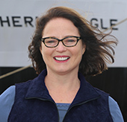
Welcome & Opening Remarks
Mikel Durham, GAPP Chair

Slide 5
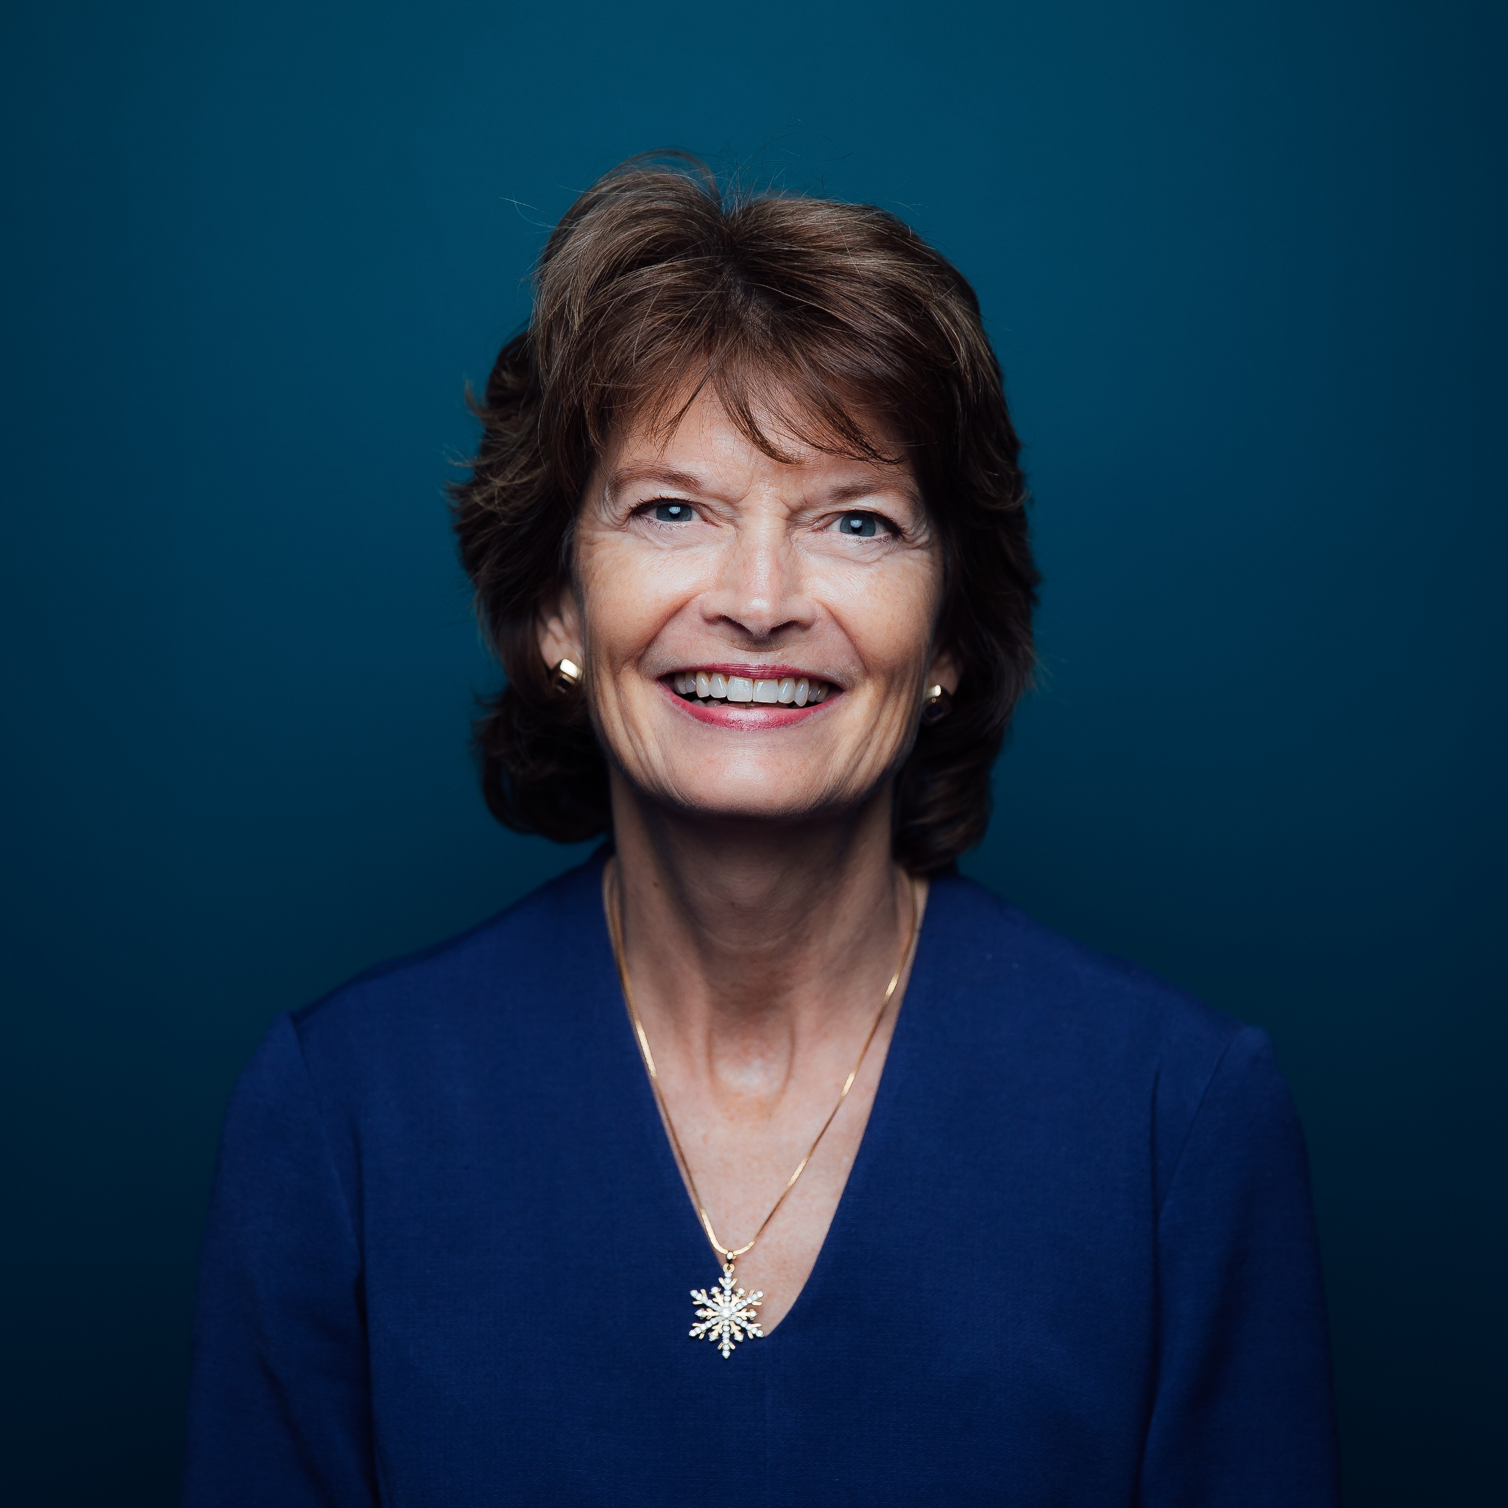
Celebrating Wild Alaska Pollock
U.S. Senator Lisa Murkowski of Alaska

Slide 6
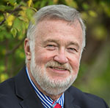
The Importance of Alaska Seafood
Alaska Senator Gary Stevens

Slide 7
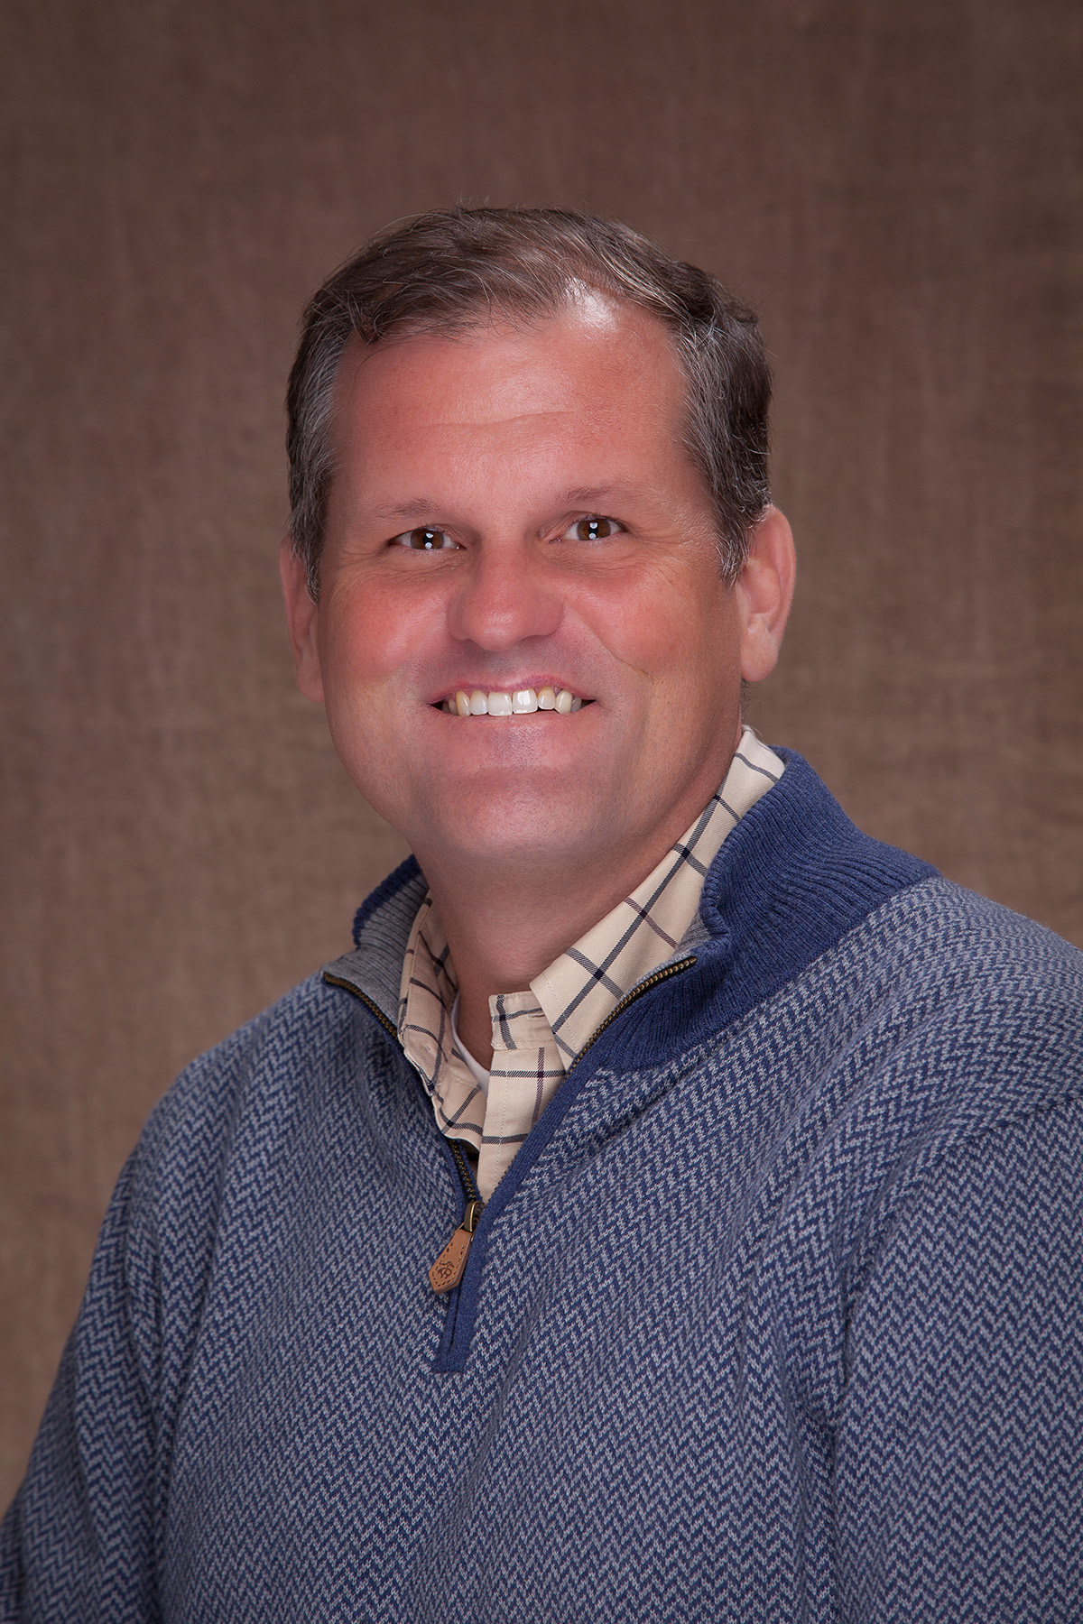
A New GAPP: Celebrating Our Perfect Protein
Craig Morris, GAPP CEO

Slide 8
Thank You to Our Sponsors!

Slide 9
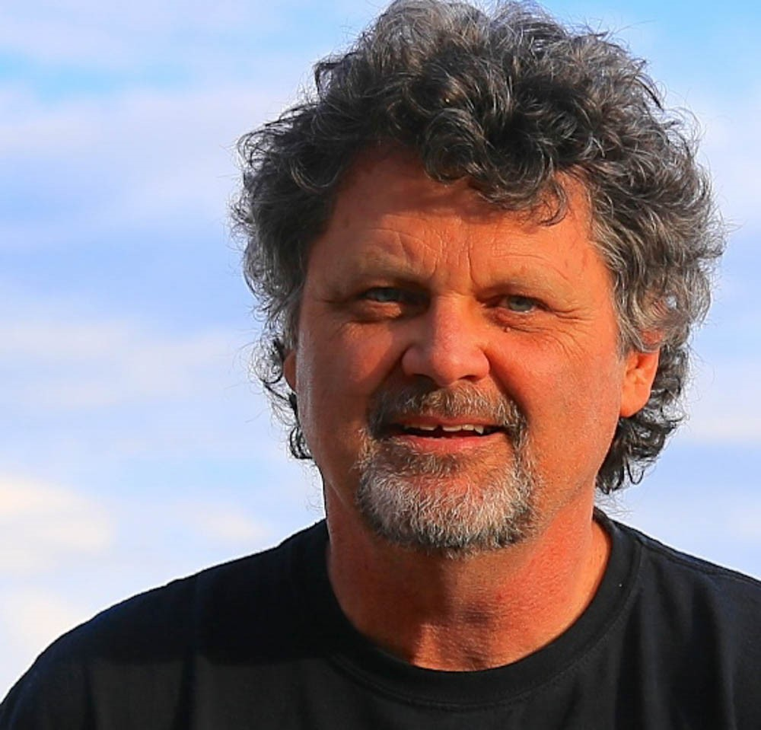
Setting Our Course
Captain Jack Molan, Master of Ceremonies

Slide 10
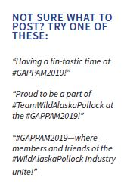
Let’s get social!

Slide 11
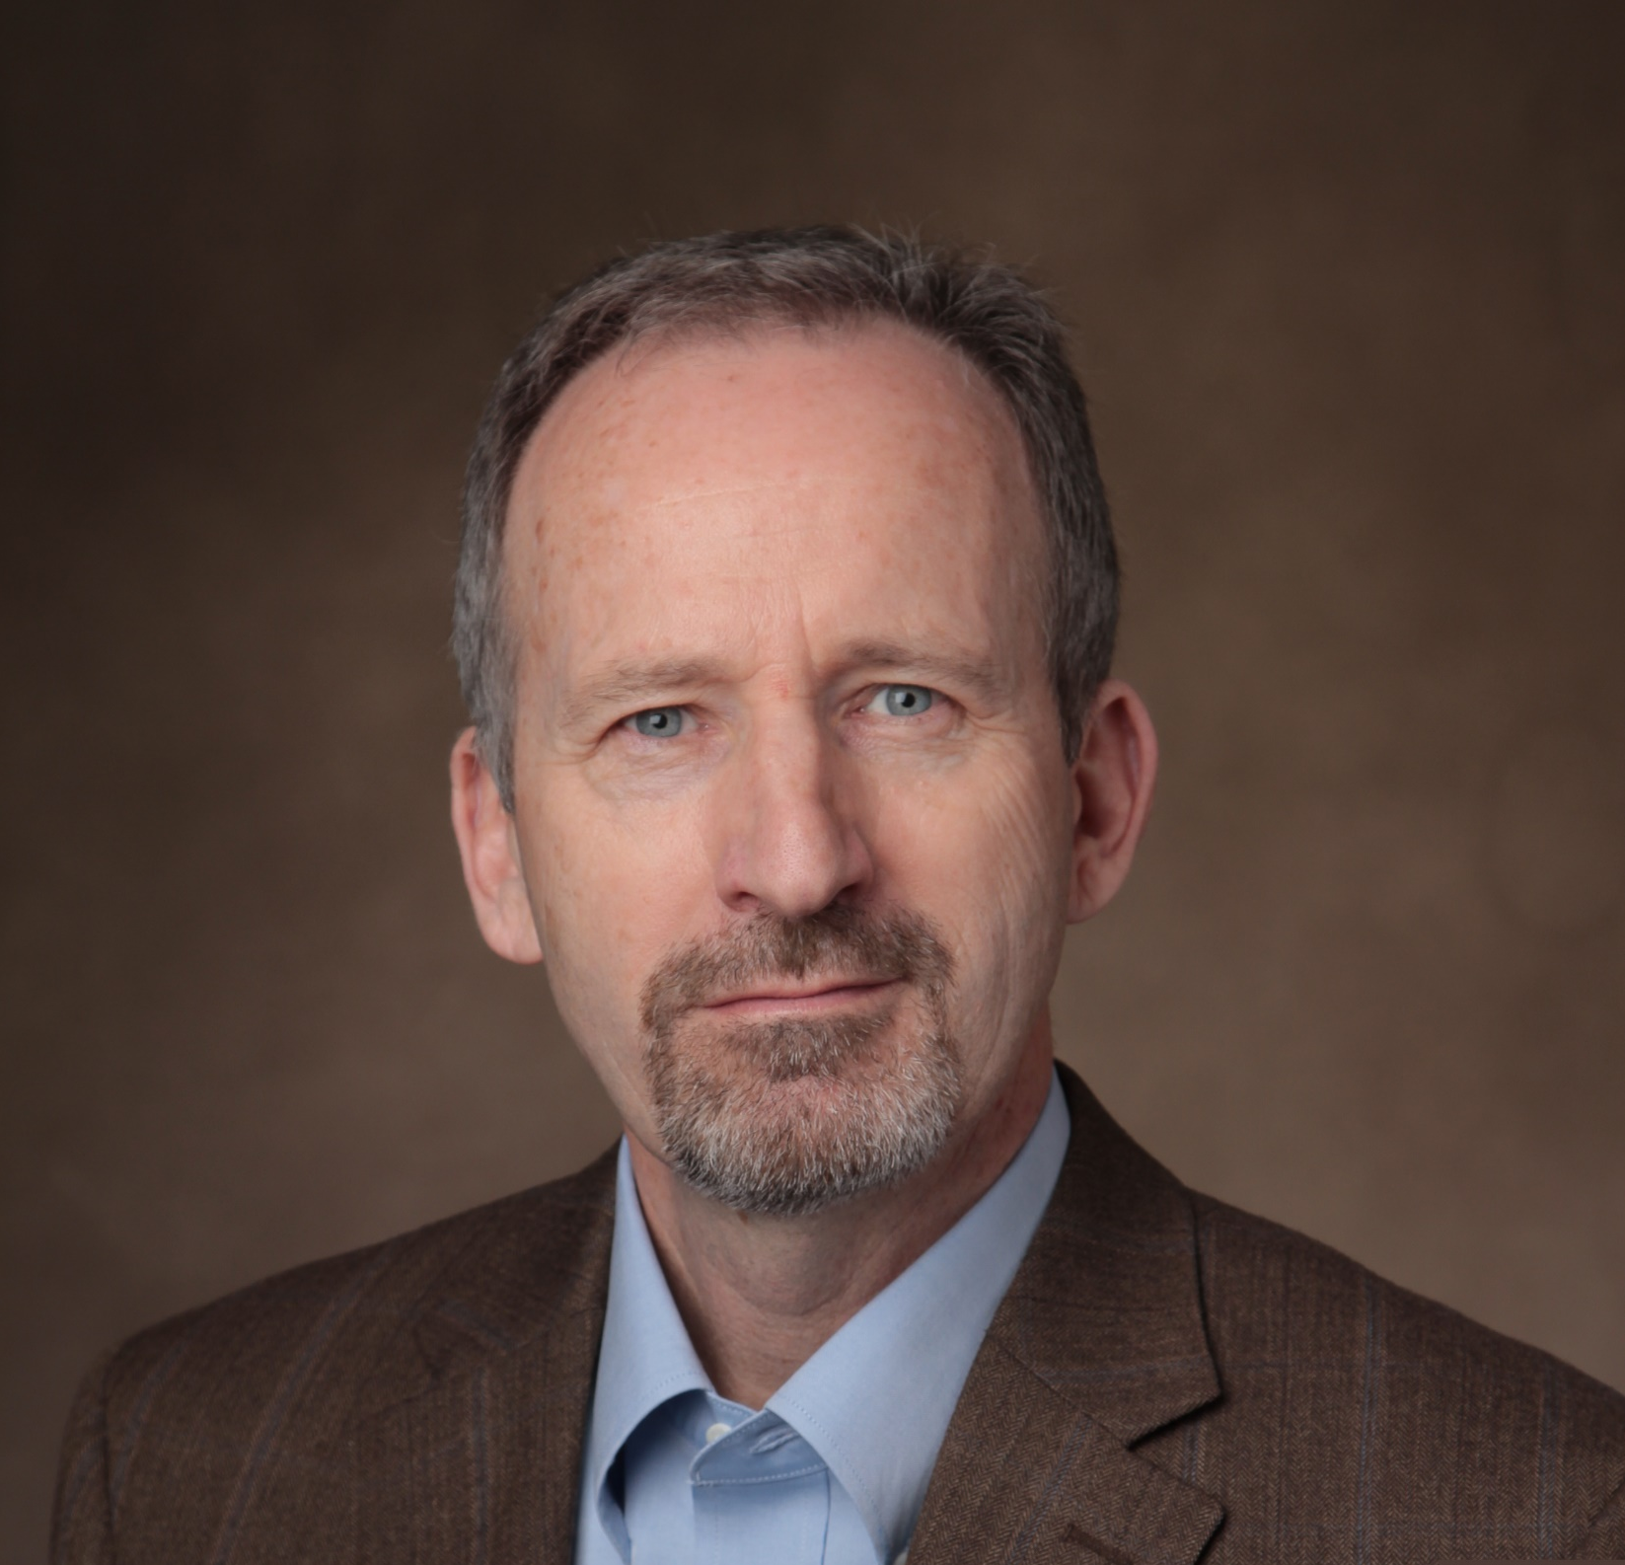
Fantastic Fishery Update
Ron Rogness, GAPP Economic Consultant

Slide 12
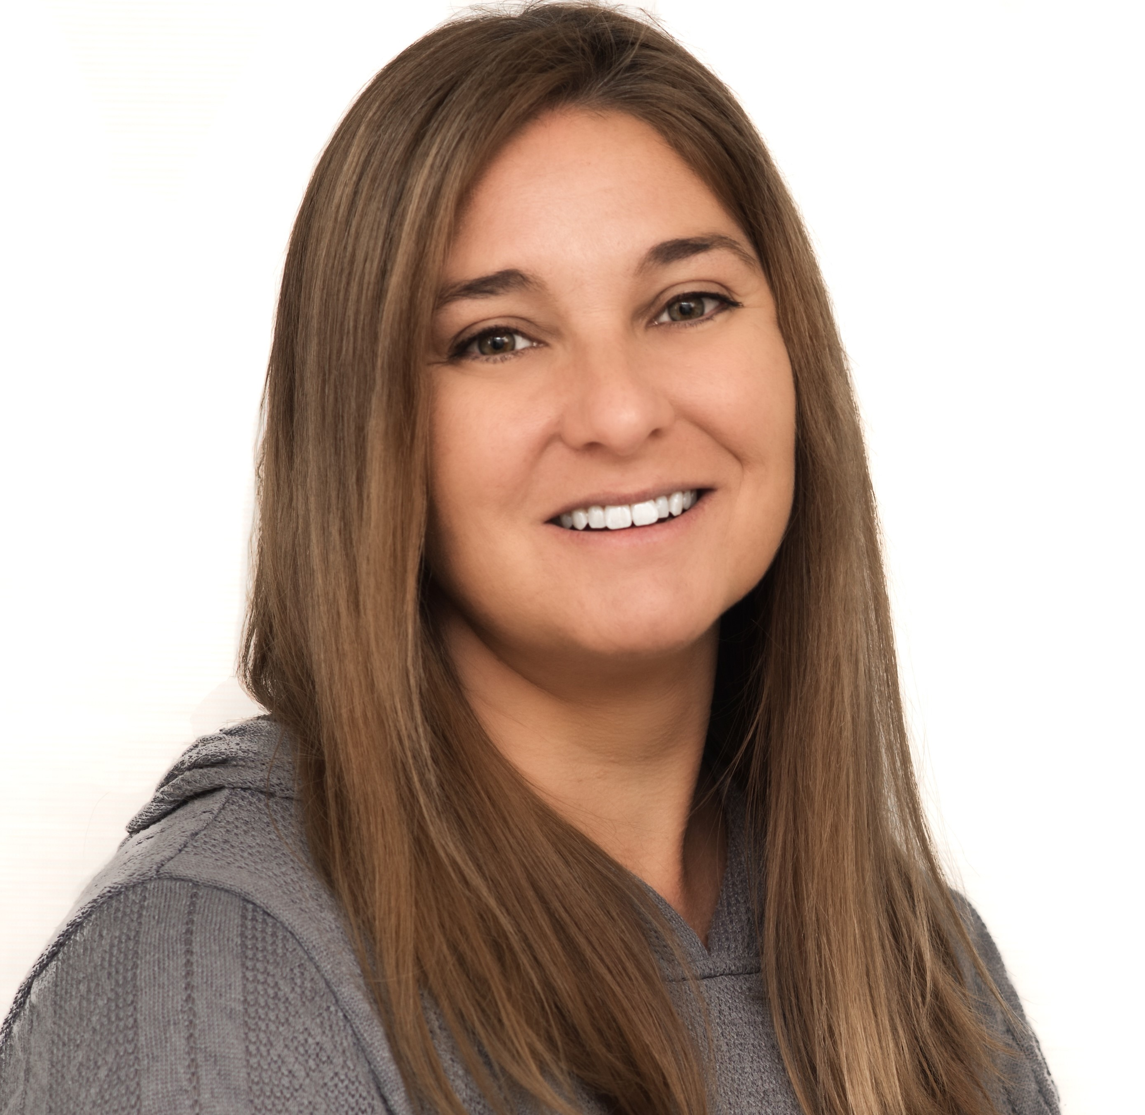
Building a Brand for Wild Alaska Pollock
Mary Elizabeth Germaine, Ketchum

Slide 13
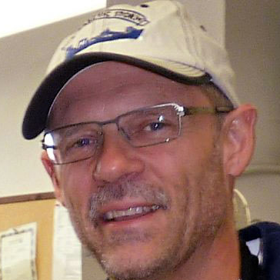
GAPP Top Hand Award Presentation
Doug Christensen, GAPP Treasurer

Slide 14
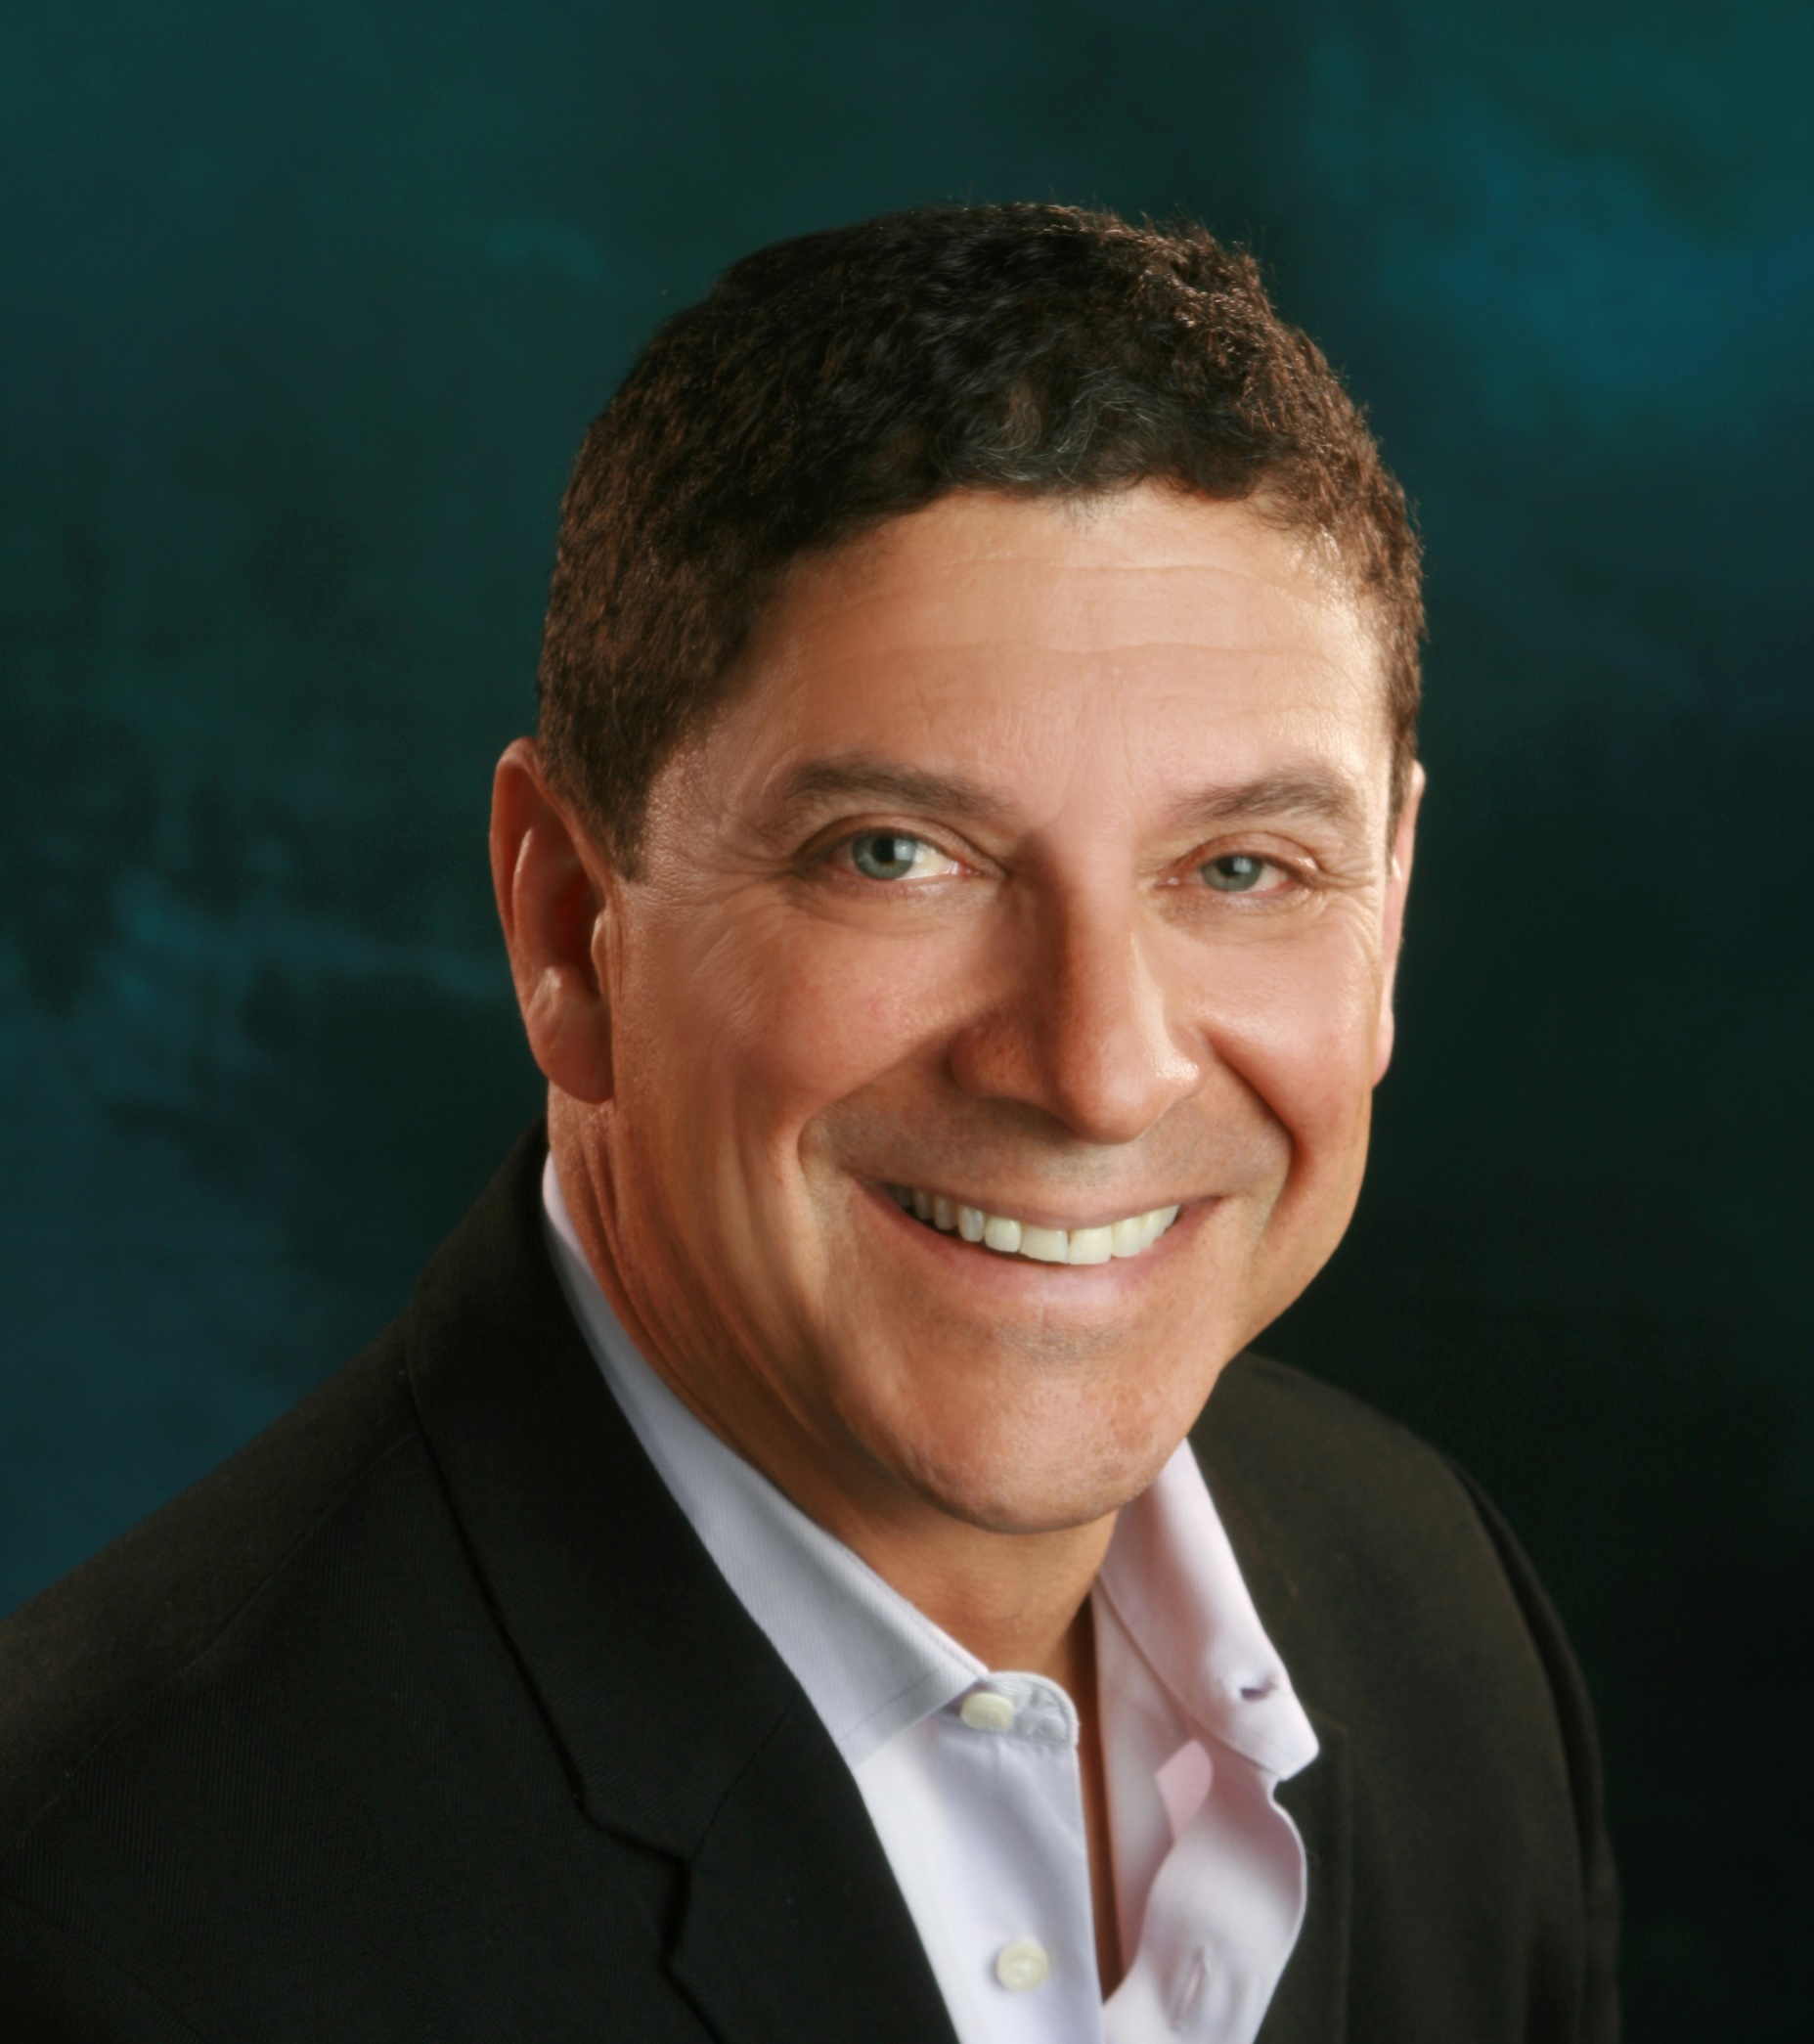
2019 GAPP
Top Hand Award Winner:
Bob Desautel
Global Seas
October 29, 2019 | 2019 WAP Annual Meeting

Slide 15
A Wonderful World of Wild Alaska Pollock Lunch Menu
Cabbage Jicama Slaw with Lime Cilantro Crema and Surimi
Perfect Pollock Portion™ Fillets with Salsa Rojo
Crispy Crunchy Fish Tacos

Slide 16
Lunch Break
Program will resume at 12:50pm

Slide 17
Thank You to Our Sponsors!

Slide 18
A Word From Our Sponsors

Slide 19
Let’s get social!

Slide 20
A Whole New GAPP: GAPP Website Reveal
Tim Garrigan & the GLG Team

Slide 21
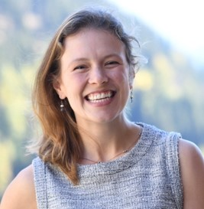
Making Our LCA Successful
Bryan Sheehan & Melissa Zgola; Quantis, Inc.

Slide 22
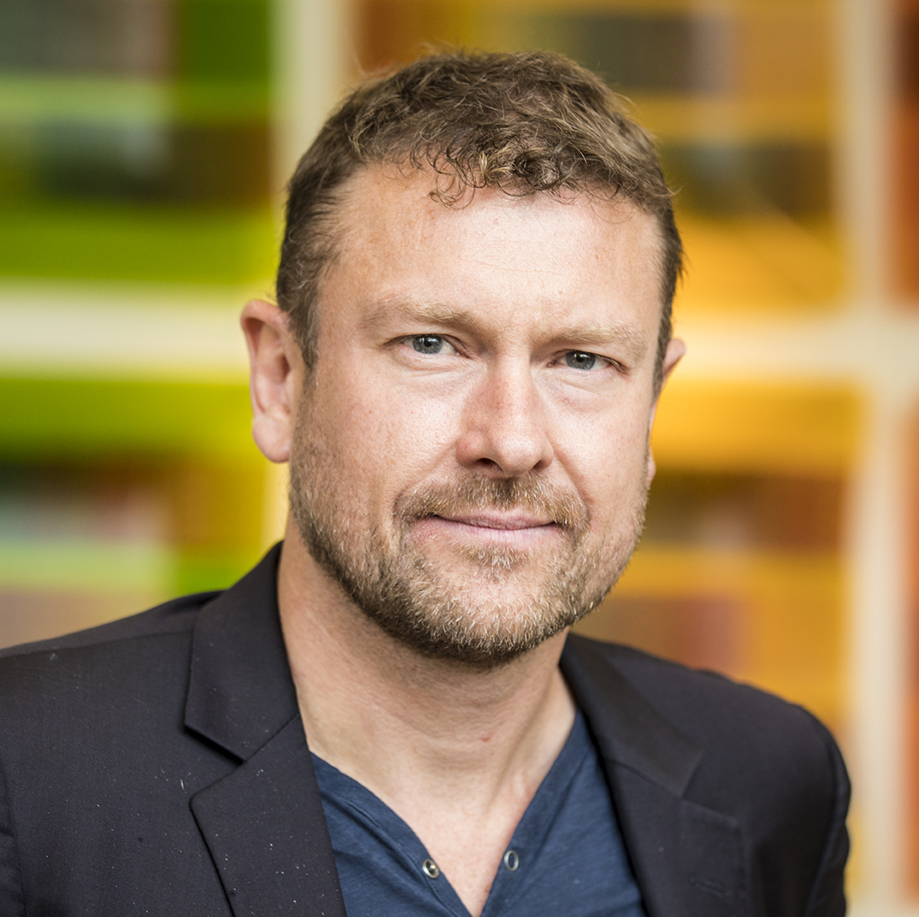
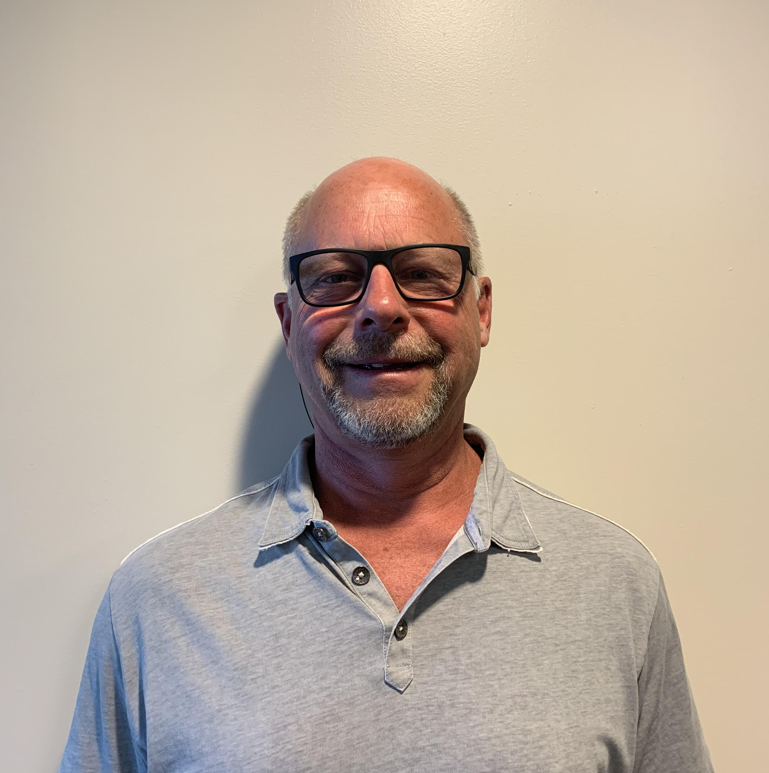
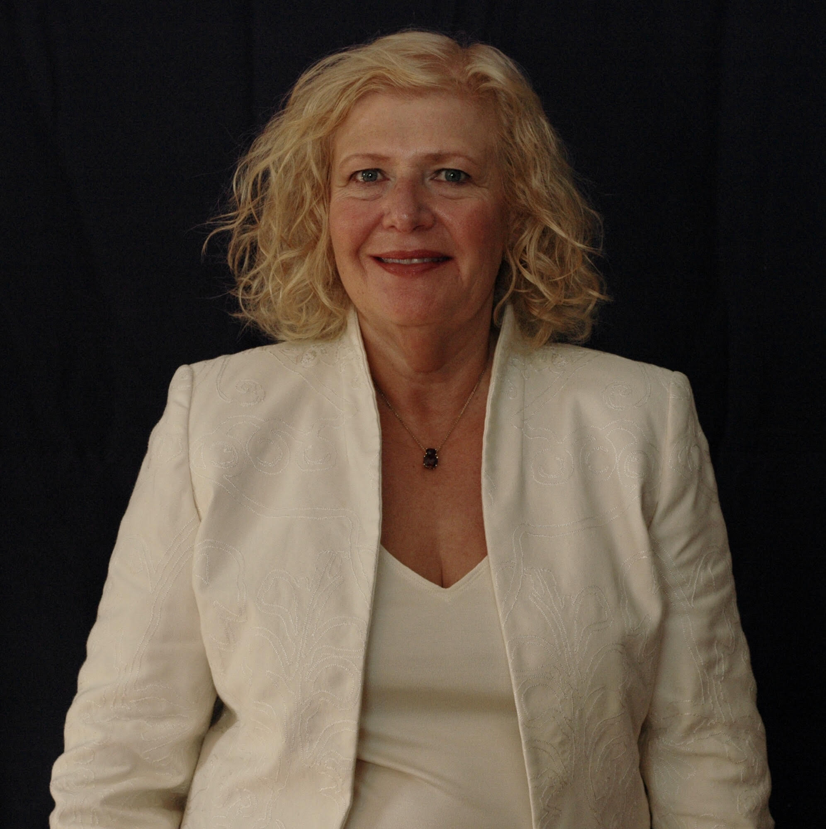
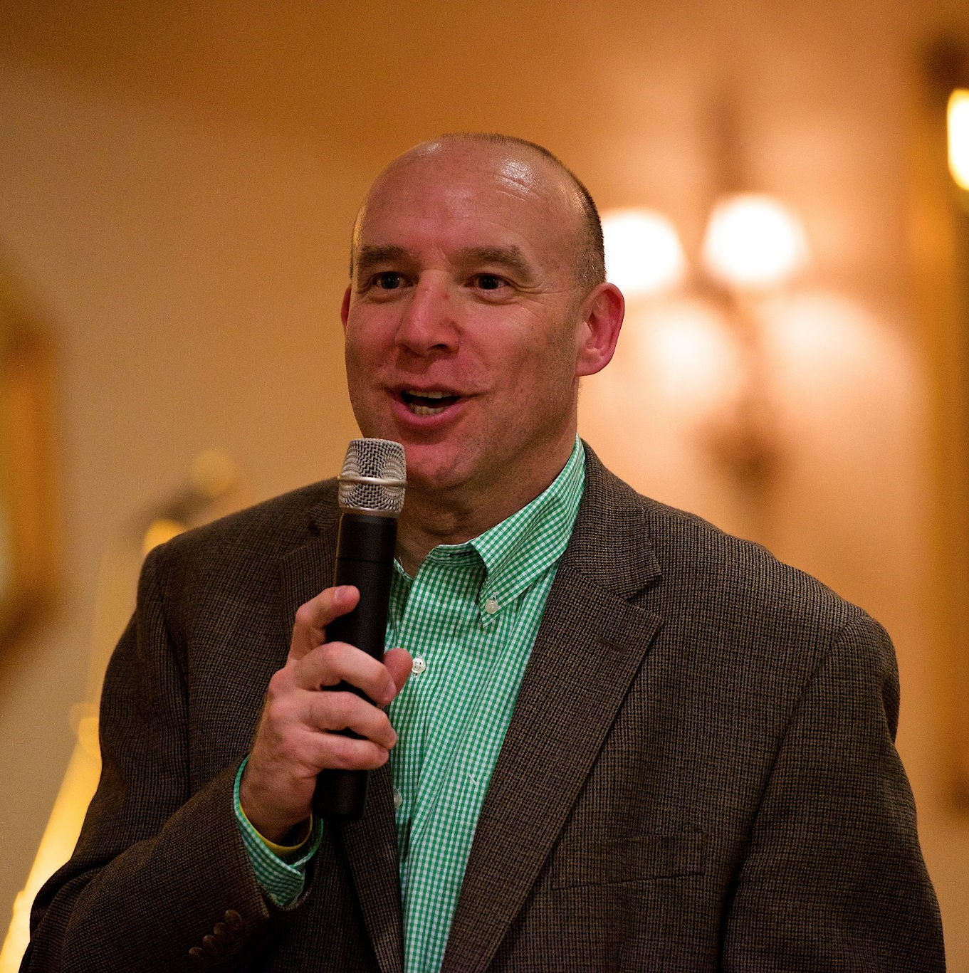
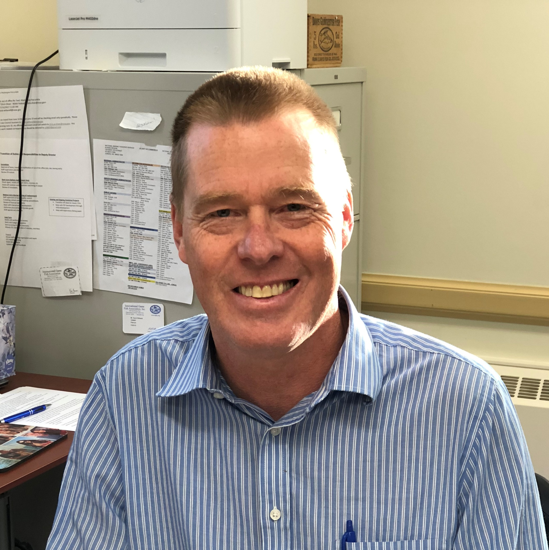
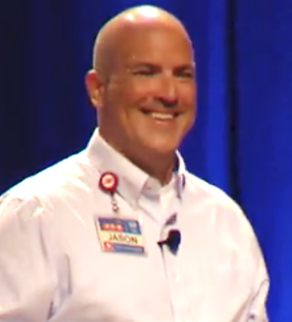
WAP was Sustainable Before it was Sexy
Moderator: Matt Tinning, At-sea Processors Association

Slide 23
Matt Tinning
At-Sea Processors Association
Sharon Ripps
R3 Consulting
Jason Driskell, H-E-B
Karl Bratvold
Starboats
Dave Witherell,
North Pacific Fisheries Management Council
George Chamel II, Council Fire
October 29, 2019 | 2019 WAP Annual Meeting

Slide 24
The Wonderful World of Wild Alaska Pollock Afternoon Break
House-made Kettle Chips & Smoked Wild Alaska Pollock Dip

Slide 25
Afternoon Break
Program will resume at 2:50pm

Slide 26
Thank You to Our Sponsors!

Slide 27
A Word From Our Sponsors

Slide 28
Let’s get social!

Slide 29
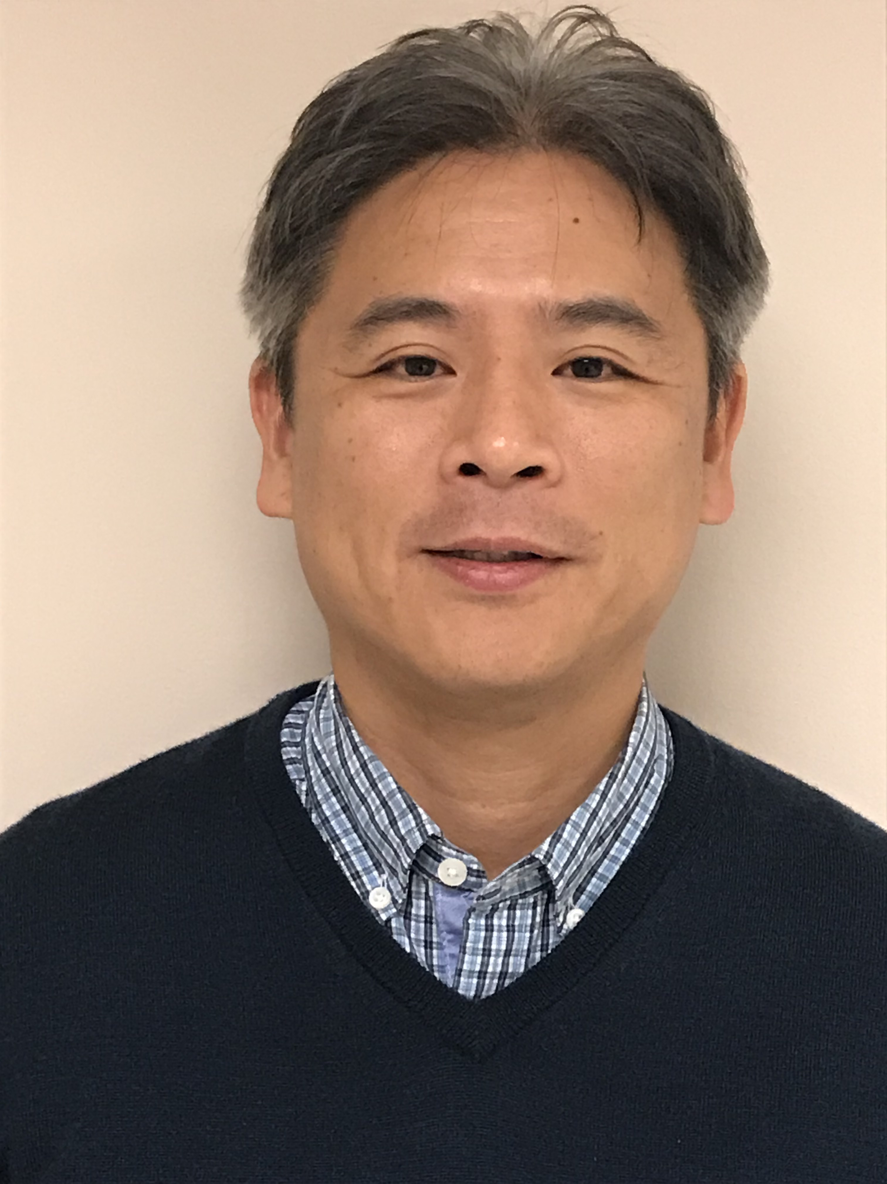
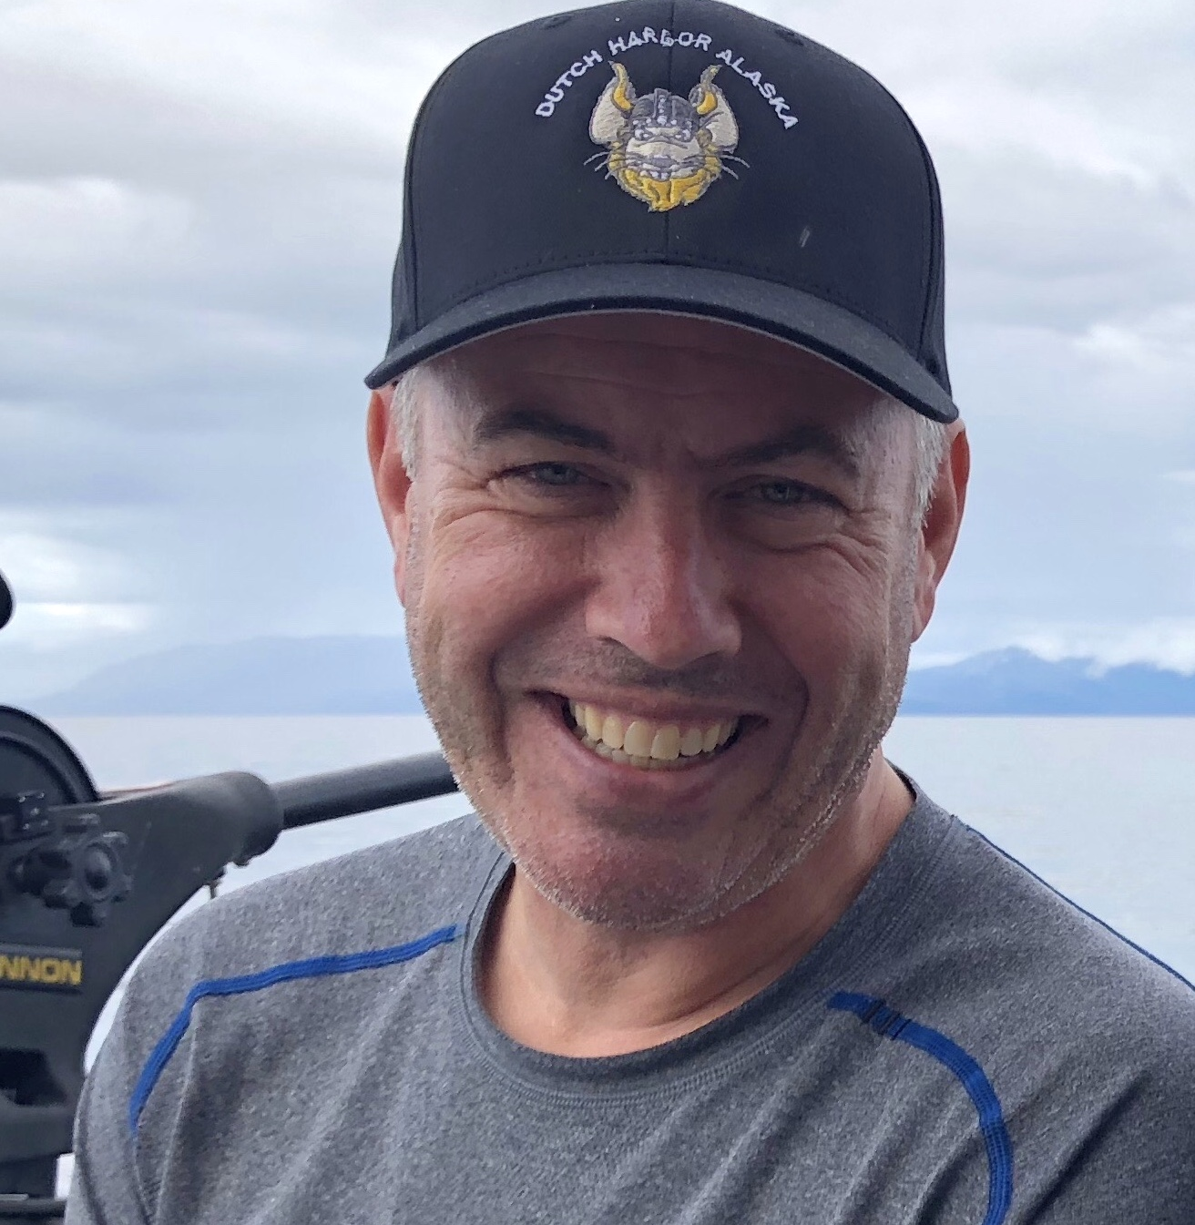
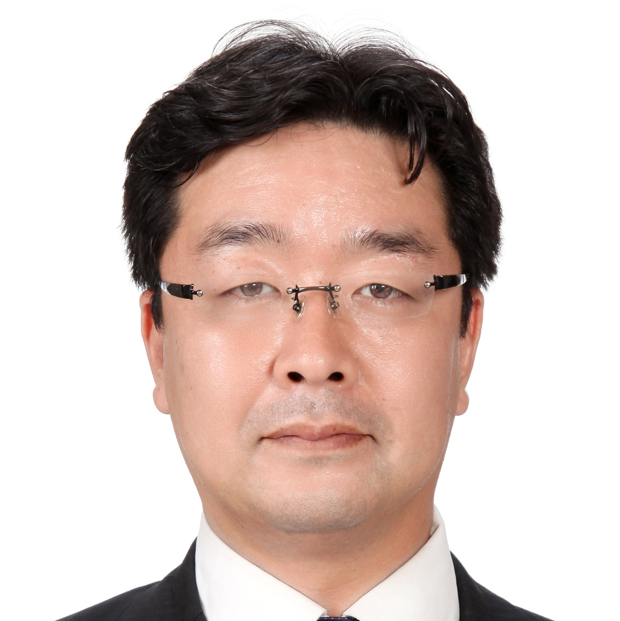
WAP Meet World!
Moderator: Craig Morris, GAPP

Slide 30
Craig Morris,
GAPP
Torunn Halhjem,
Trident Seafoods
Mike Cusack,
American Seafoods
Takashi Matsumoto,
UniSea
Kenji Uchida
Nippon Suisan Kaisha
October 29, 2019 | 2019 WAP Annual Meeting

Slide 31
Keep getting social!

Slide 32
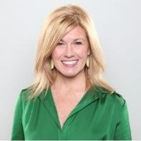
Emerging Food Trends & Purpose-Driven Businesses
Jennifer Cawley, Crossroads

Slide 33
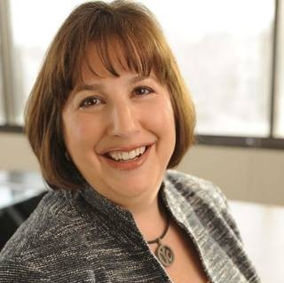
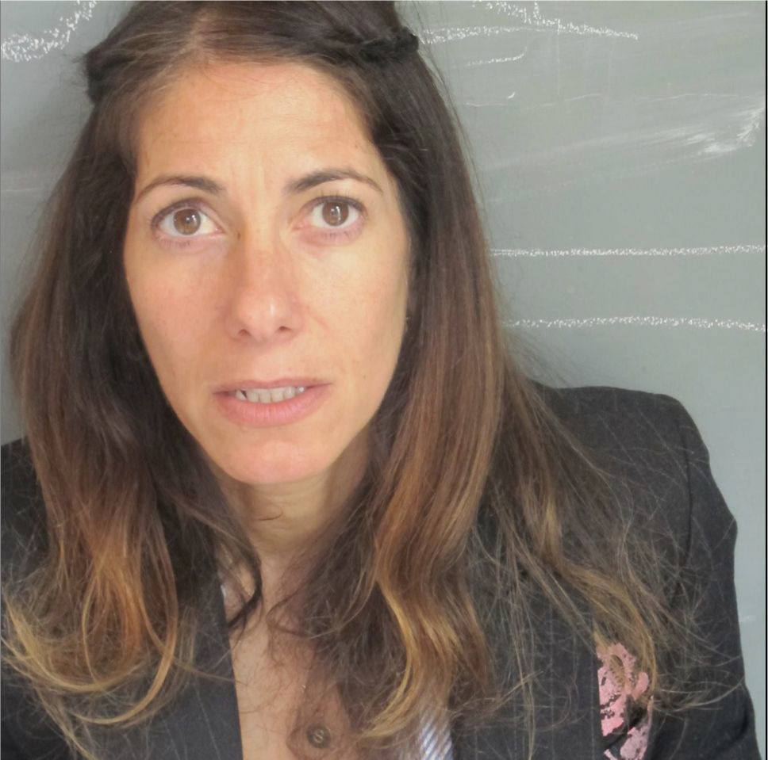
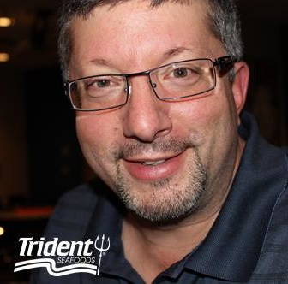
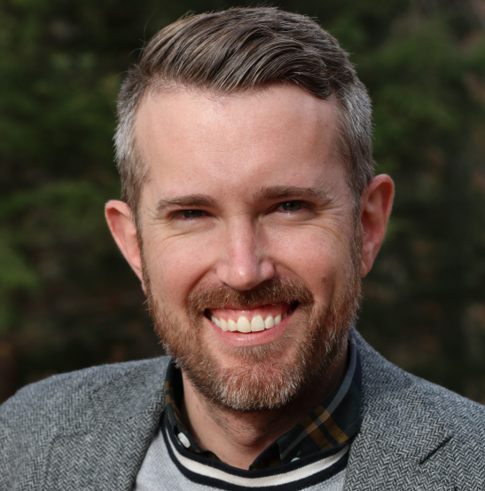
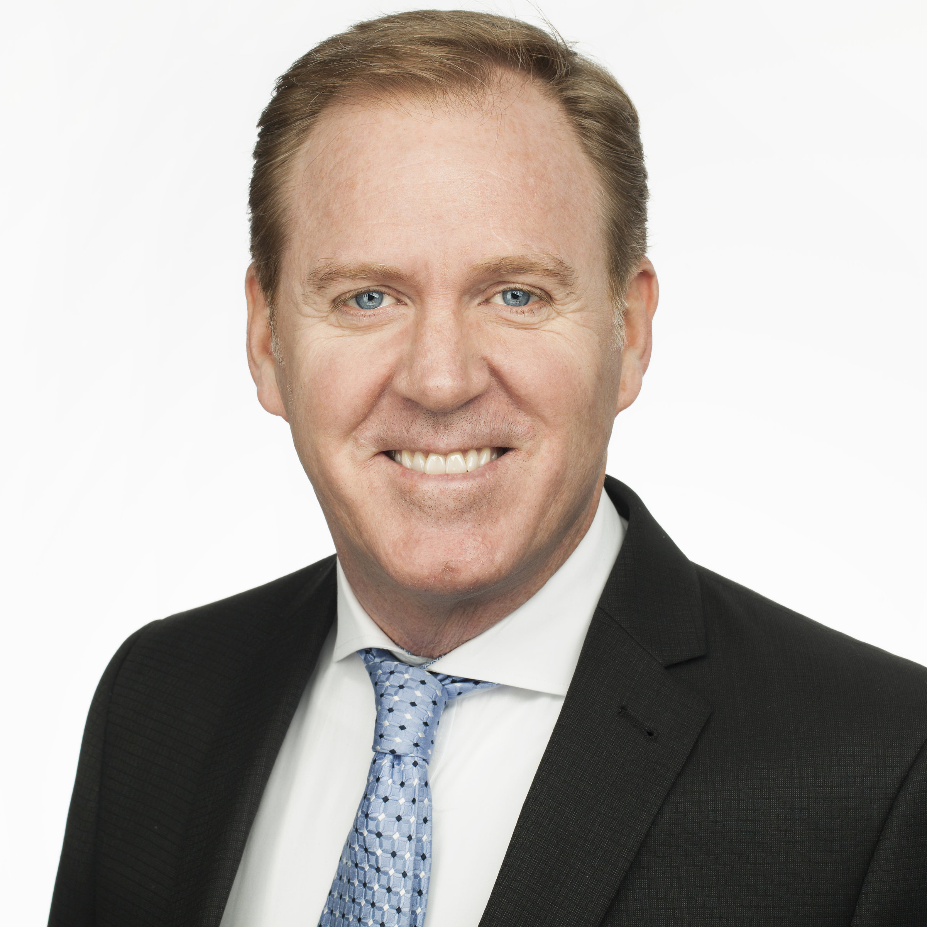
GAPP Brings WAP to New Channels, Forms & Influencers
Moderator: Margery Schelling, American Seafoods

Slide 34
Margery Schelling,
American Seafoods
John Salle,
Trident Seafoods
Craig Morris,
GAPP
Oberon Sinclair,
My Young Auntie
Gavin Kennedy,
Gorton’s Seafood
October 29, 2019 | 2019 WAP Annual Meeting

Slide 35
Closing Remarks
Craig Morris, GAPP Chief Executive Officer

Slide 36
Thank You to Our Sponsors!

Slide 37
The Wonderful World of Wild Alaska Pollock Reception
Alaska Wild Wings with Celery & Blue Cheese Dressing
Wild Alaska Pollock Roe Sushi with Roe Mayo Drizzle
Southwest Style Wild Alaska Pollock Croquettes
Seared Black Cod on Crisp Taro Root with Avocado and Pineapple
Hot Wild Alaska Pollock “Crab” Dip
Raw Bar featuring: Smoked Salmon, King Crab Legs & Claws, Oysters on the Half Shell
Wild Alaska Pollock Protein Noodles Stir Fry Bar

Slide 39
Annual Meeting Reception
Eat, drink, and be merry!

Slide 40
Thank You!

