Slide 1
GAPP Partnership Webinar
July 11th, 2022

Slide 2
Today’s Agenda
1. | Who is GAPP?
2. | Amazing Wild Alaska Pollock
3. | Partnership Program Overview
4. | Focus this Round
5. | How to Apply
6. | Benefits of Partnering with GAPP

Slide 3
Who is GAPP? Genuine Alaska Pollock Producers

Slide 4
We’re advocates for one of the world’s most sustainable and nutritious seafood products… Wild Alaska Pollock!

Slide 5
GAPP Overview
Overview
The Association of Genuine Alaska Pollock Producers (GAPP) is a nonprofit that advocates for one of the world’s most sustainable and nutritious seafood products, U.S.-caught Wild Alaska Pollock.
Mission
To build demand and awareness for the fish through driving product innovation, conducting research, and creating awareness about product quality and the responsibly managed fishery the product comes from.
Learn more at www.alaskapollock.org.

Slide 6
What do we do?
Marketing & Communications
New Product Partnerships
Data & Insights

Slide 7
So, what’s so amazing about Wild Alaska Pollock?

Slide 8
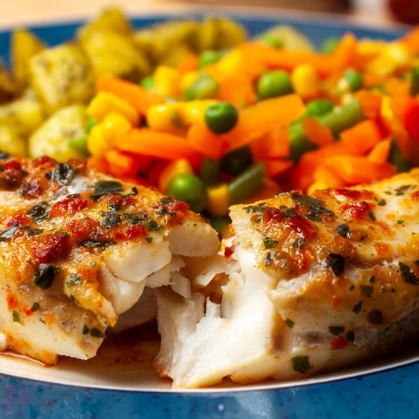
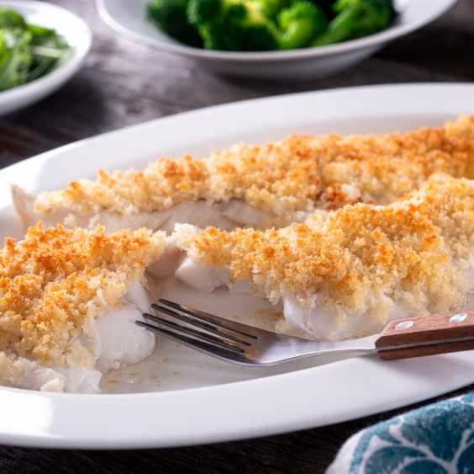
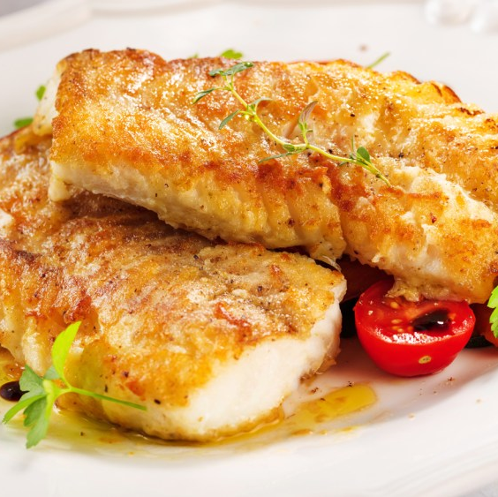
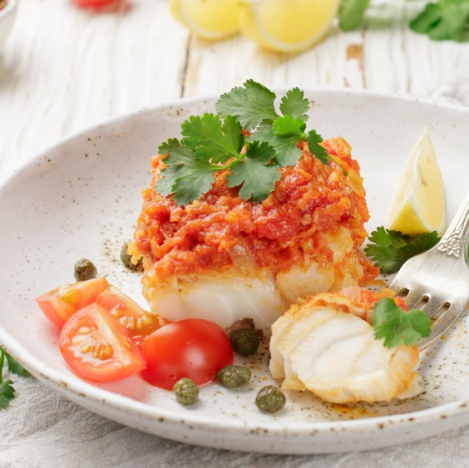
The World’s Best Whitefish
Taste
Nutrition
Wild-Caught/Alaska Origin
Sustainability
Wild Alaska Pollock is a low-fat, protein-rich, great tasting and versatile white fish
.
A true superfish: low-fat, protein-rich, heart-healthy, high in vitamin B-12 and loaded with omega-3 fatty acids.
Raised and caught in its natural habitat. Caught and frozen while still at sea to preserve freshness, taste, and nutrition.
Wild Alaska Pollock is one of the most abundant certified-sustainable fish in the world, making it one of the best protein choices for the planet.

Slide 9
Among the Most Climate Friendly Proteins on the Planet (Fillet)

Slide 10
Among the Most Climate Friendly Proteins on the Planet (Surimi)

Slide 11
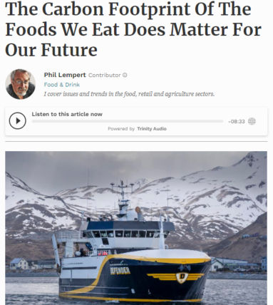
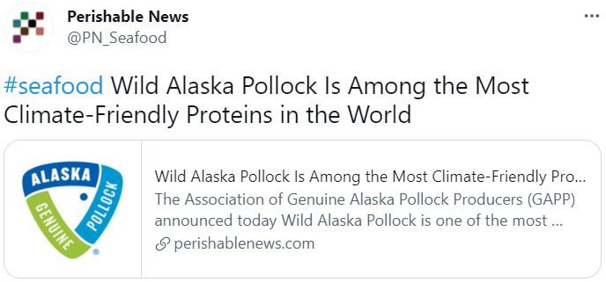
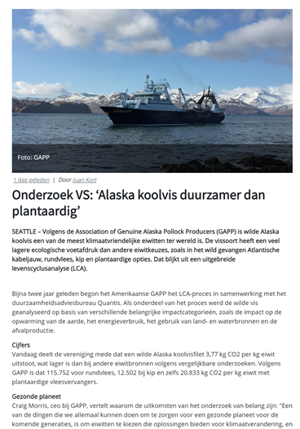
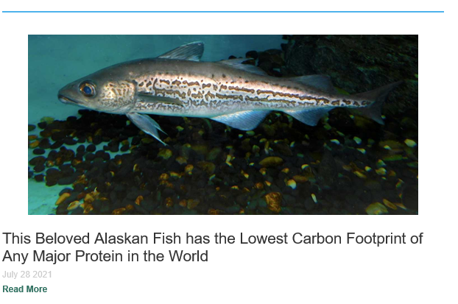
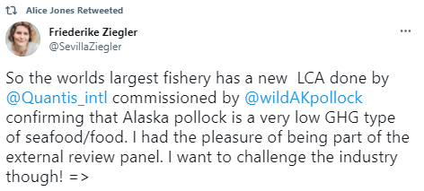
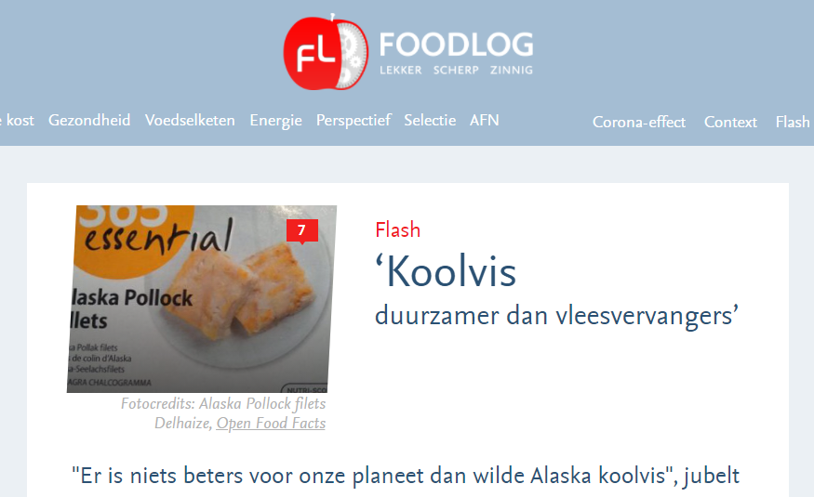
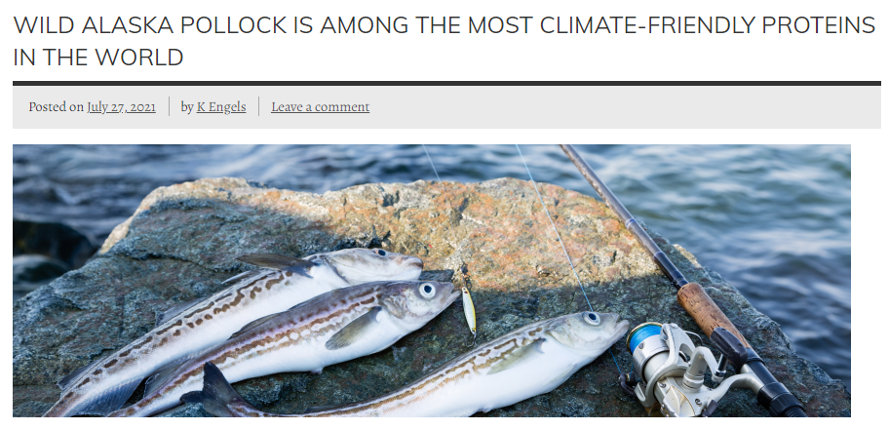
The Secret is Out! Wild Alaska Pollock in the News

Slide 12
Partnership Program Overview

Slide 13
Partnership Program
Designed to increase awareness of Wild Alaska Pollock & elevate the species
Goal is to introduce the species to new consumers through new forms and channels
This is an opportunity to get matching dollars (up to 1-1)
Looking for innovative and break through ideas – all product forms included
Gain learning & share that learning within the Wild Alaska Pollock Community
Proposals Due: August 12th
Board Decisions: Mid September
In Market: Q4 2022 through 2023

Slide 14
Focus this Round

Slide 15
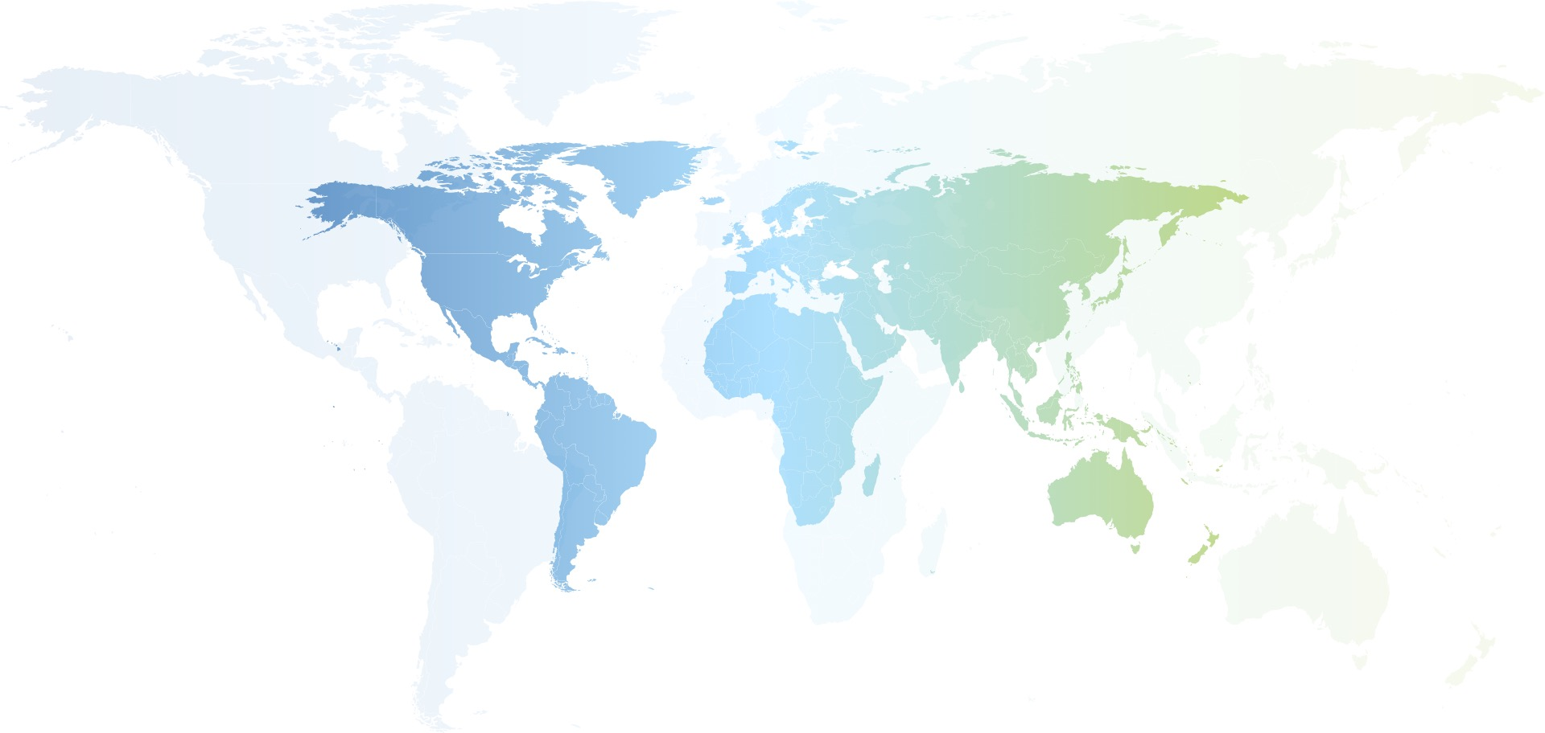
Global Perspective
We welcome proposals from every country
2040 Markets: Spain, Malaysia, Poland, France, Germany, Japan, South Korea, United Arab Emirates

Slide 16
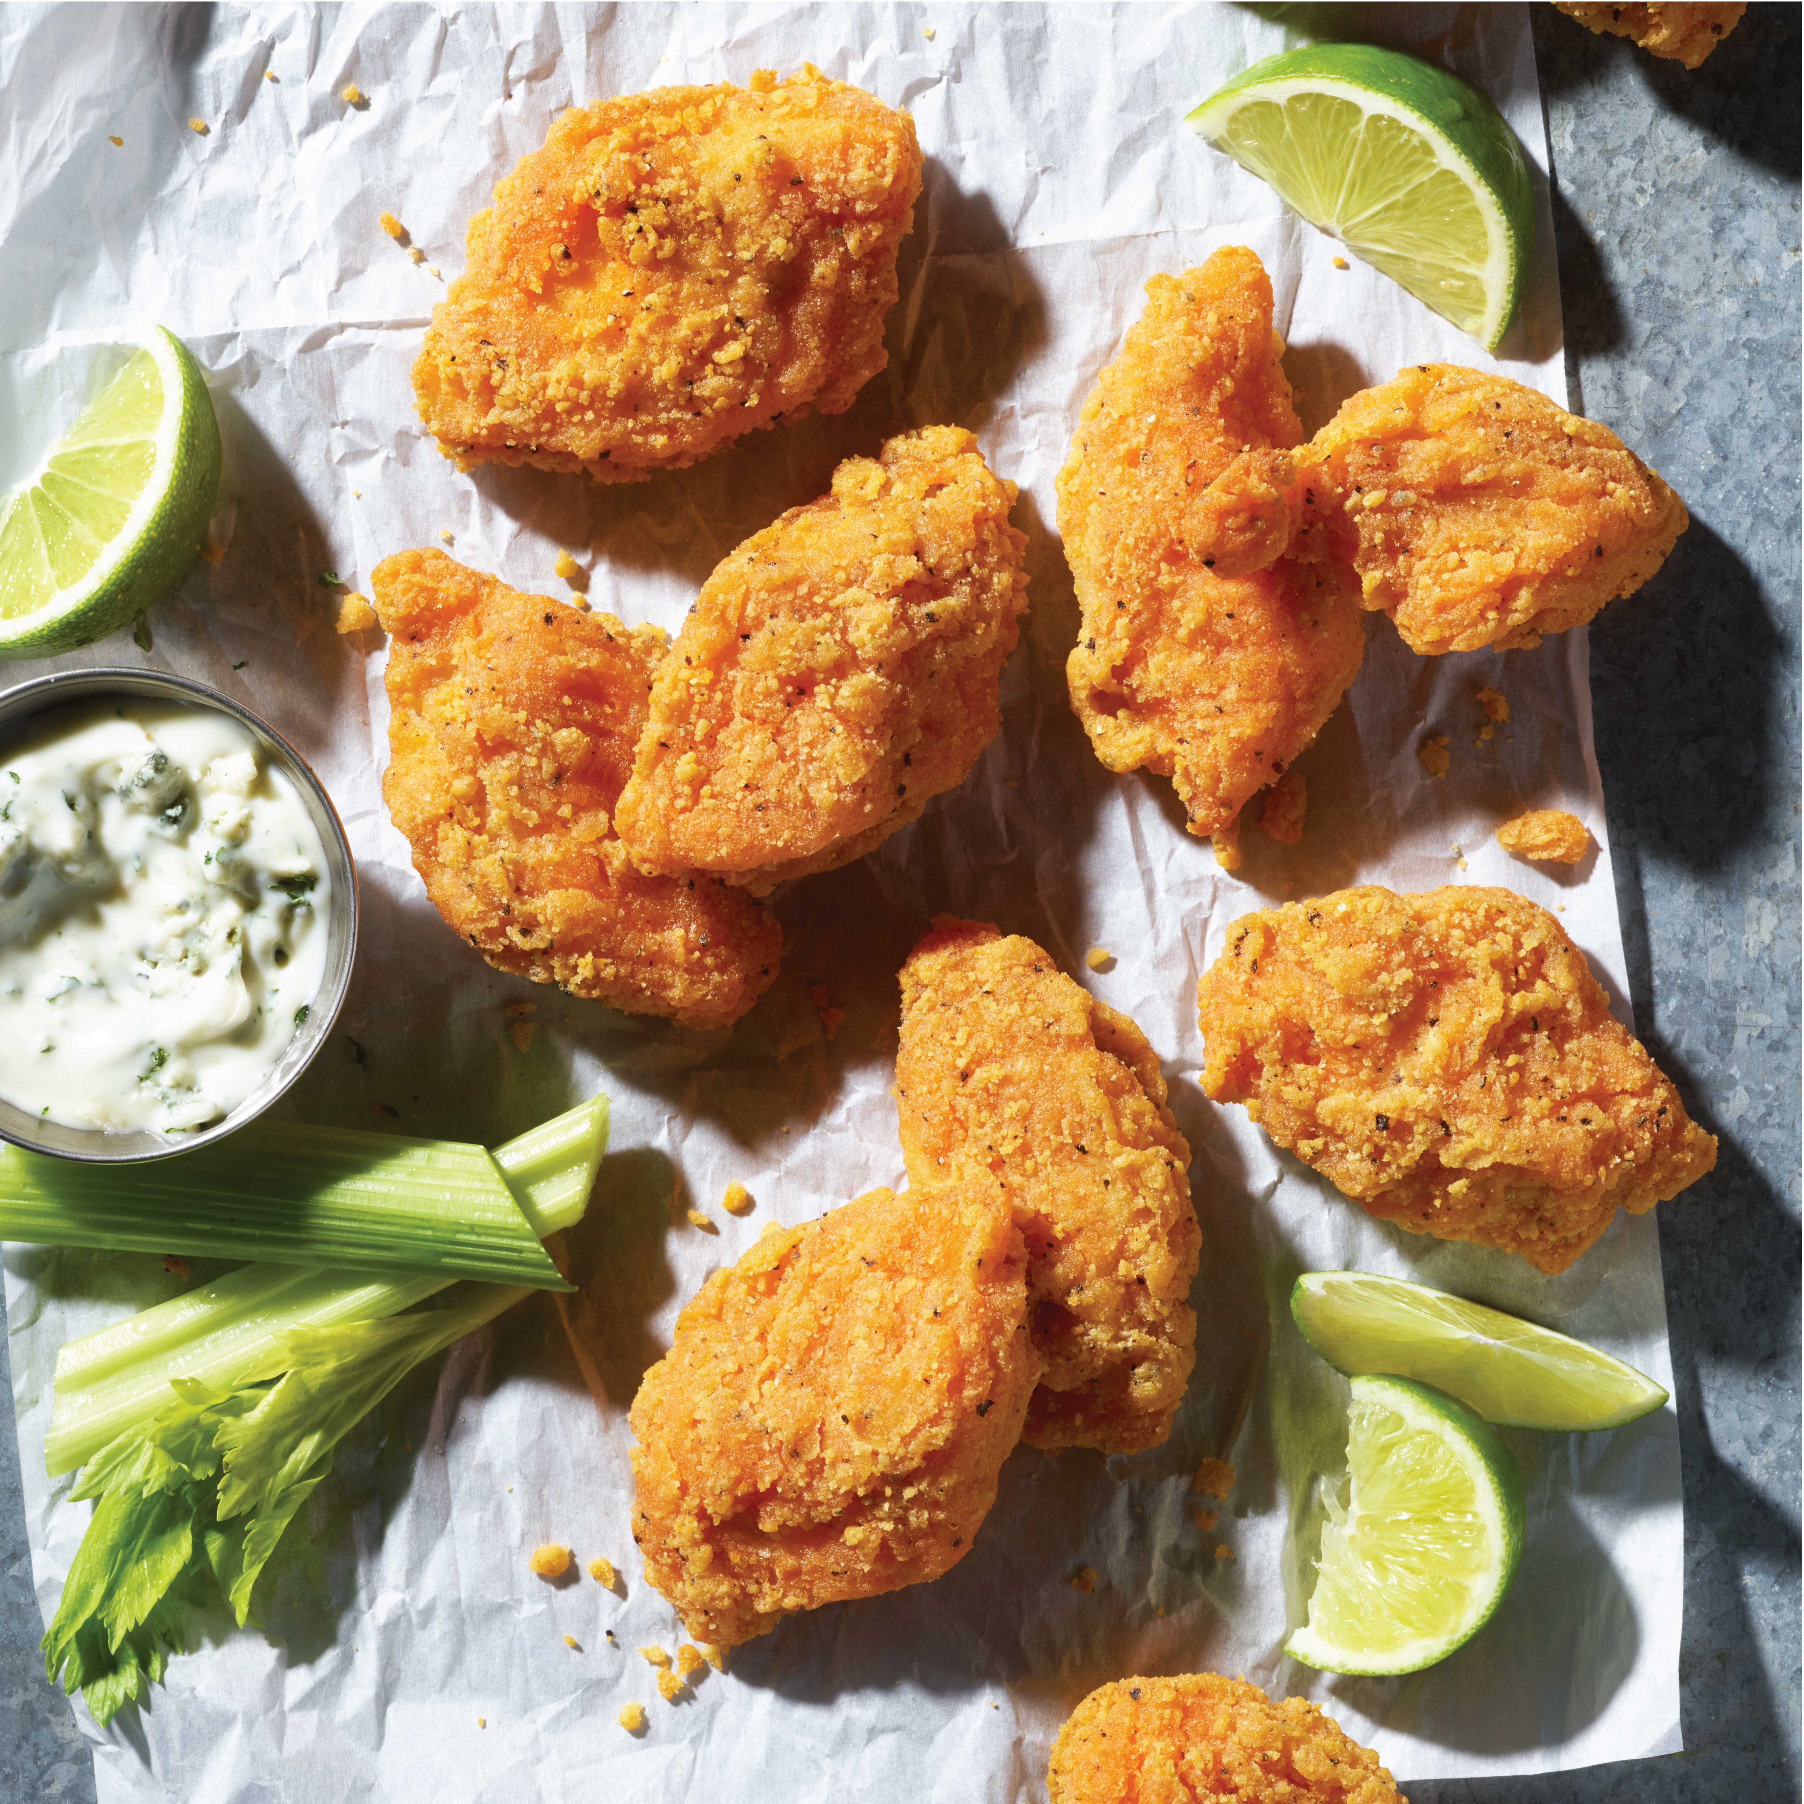
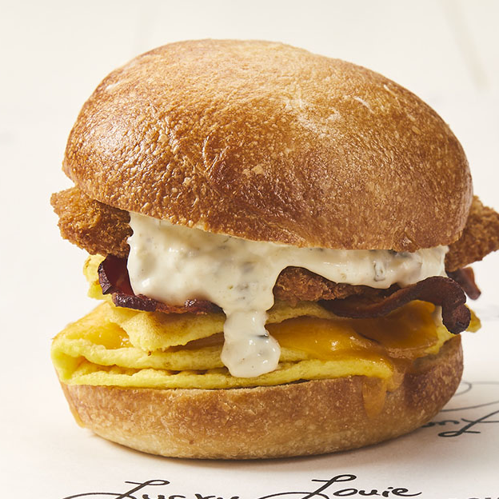
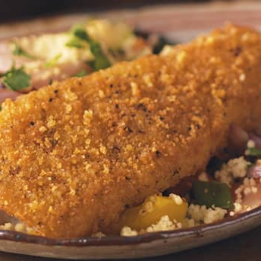
We Love Our Base Business and Will Continue to Support It
“Wild Alaska Pollock” on the menu, POS, packaging and all marketing communication
Spend resources to increase awareness and demand through campaigns, social and influencer programs
Continue to drive great taste and imagery

Slide 17
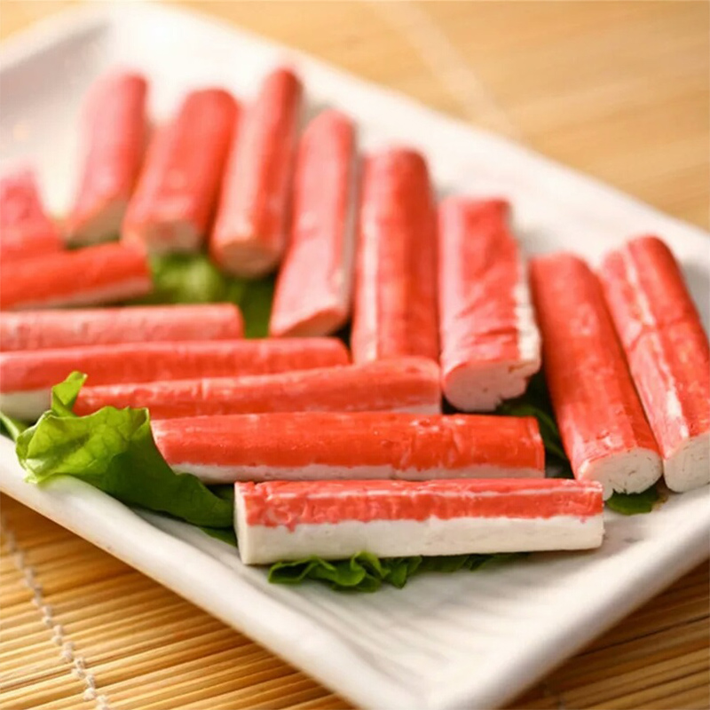
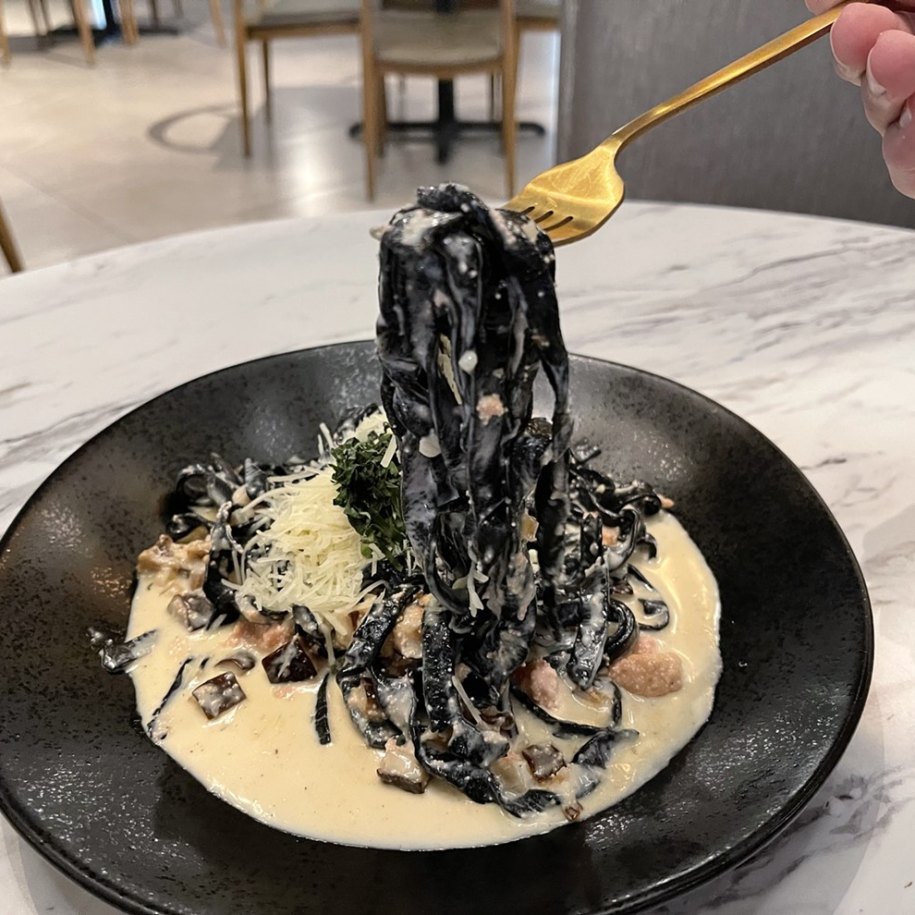
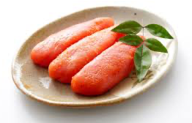
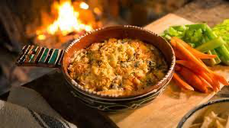
We Are Also Looking to Expand Product Formats
IQF/Fillet
Surimi
Roe
Innovation

Slide 18
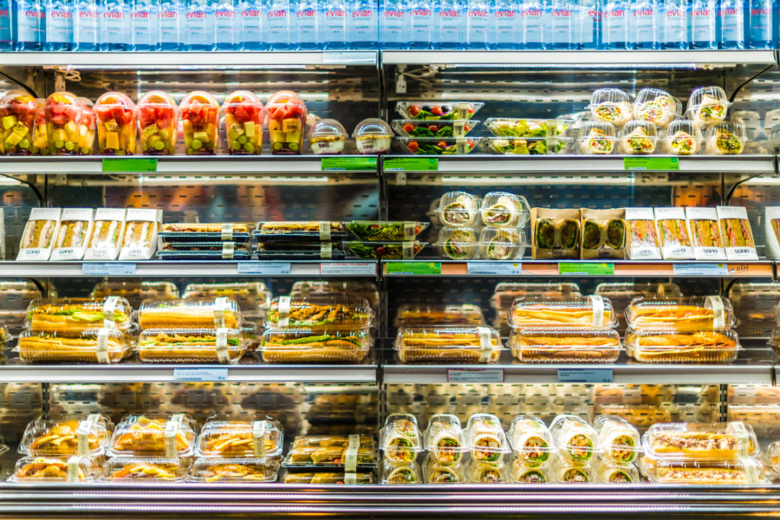
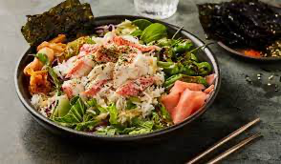
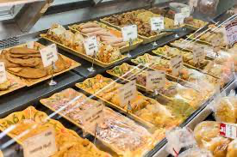
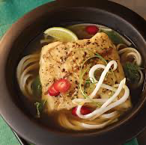
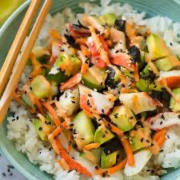
Growth Channels - Areas that Elevate & Increase Awareness
Casual Restaurants
Corporate Restaurants / Institutions
Chilled / Deli

Slide 19
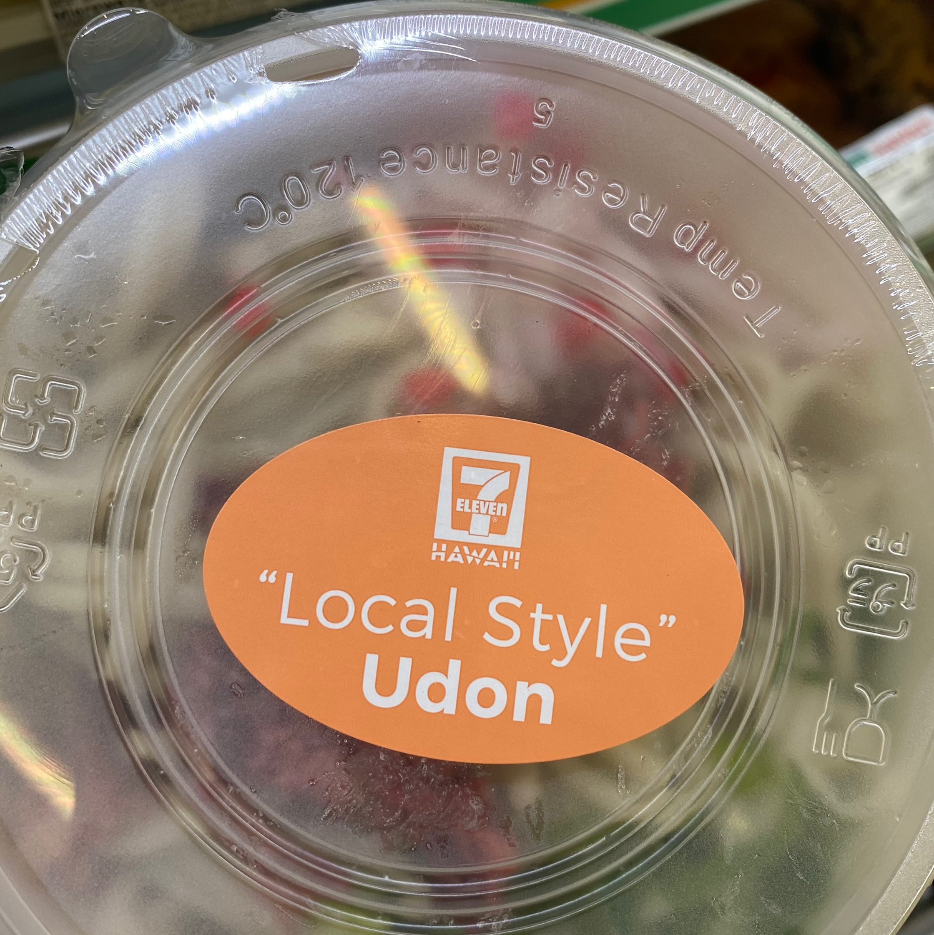
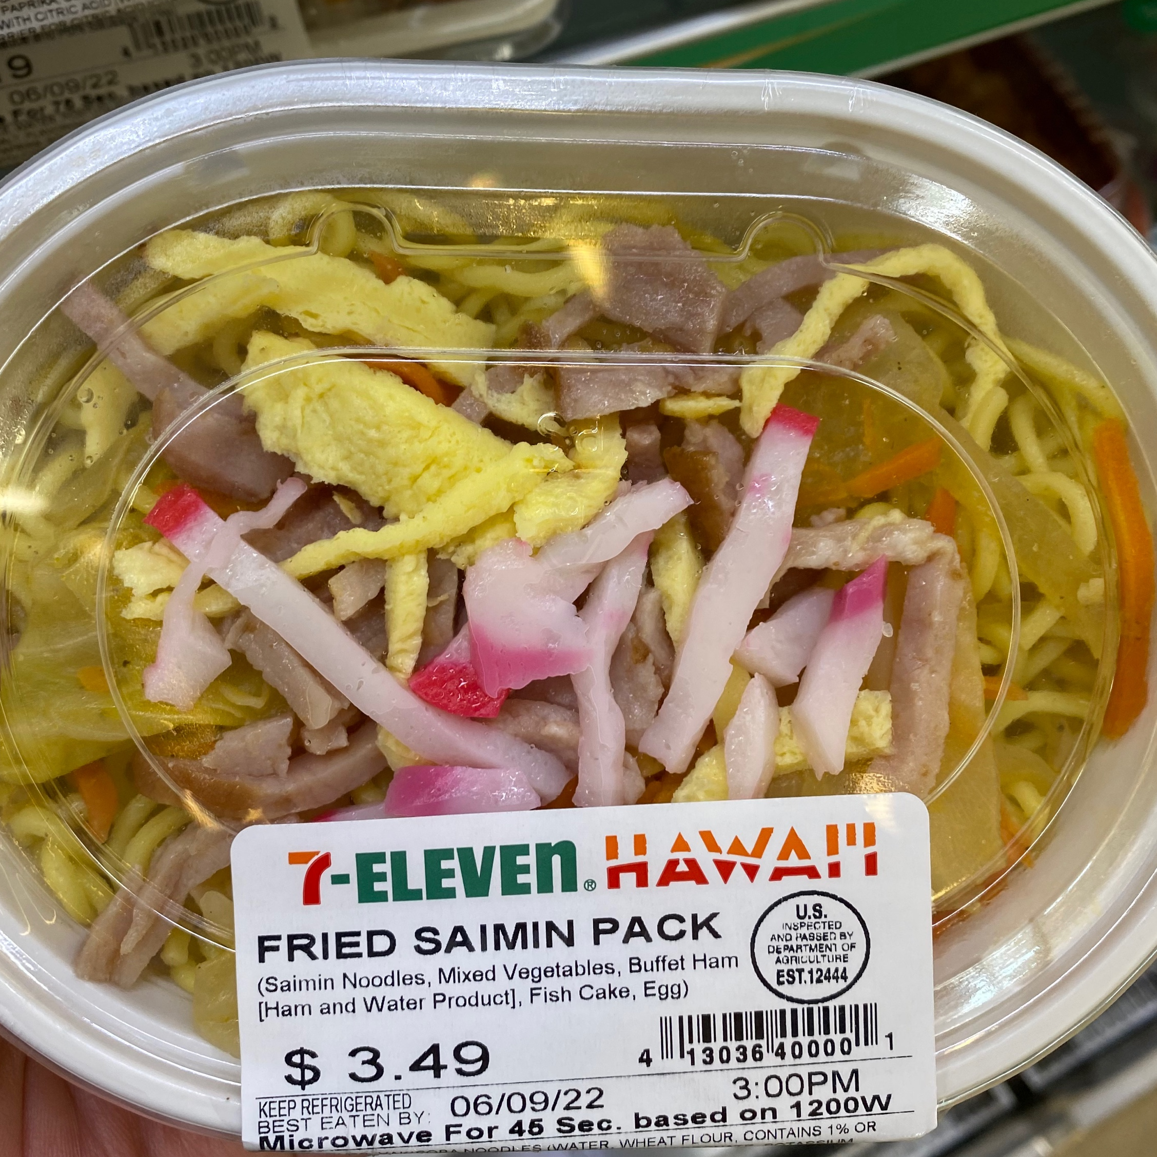
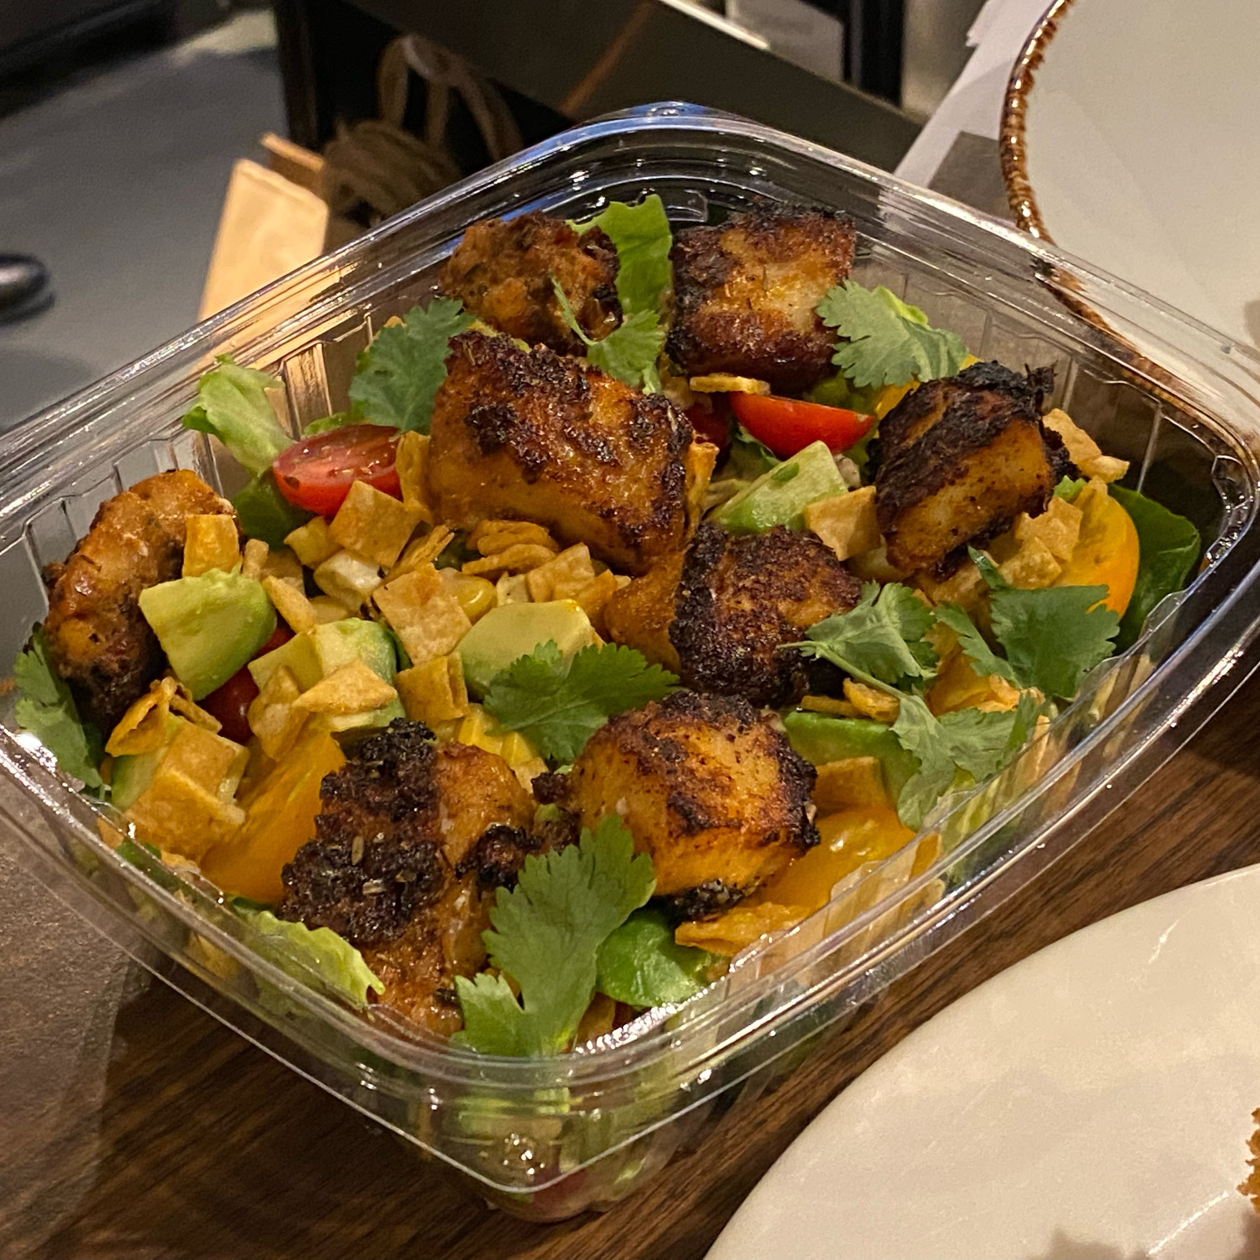
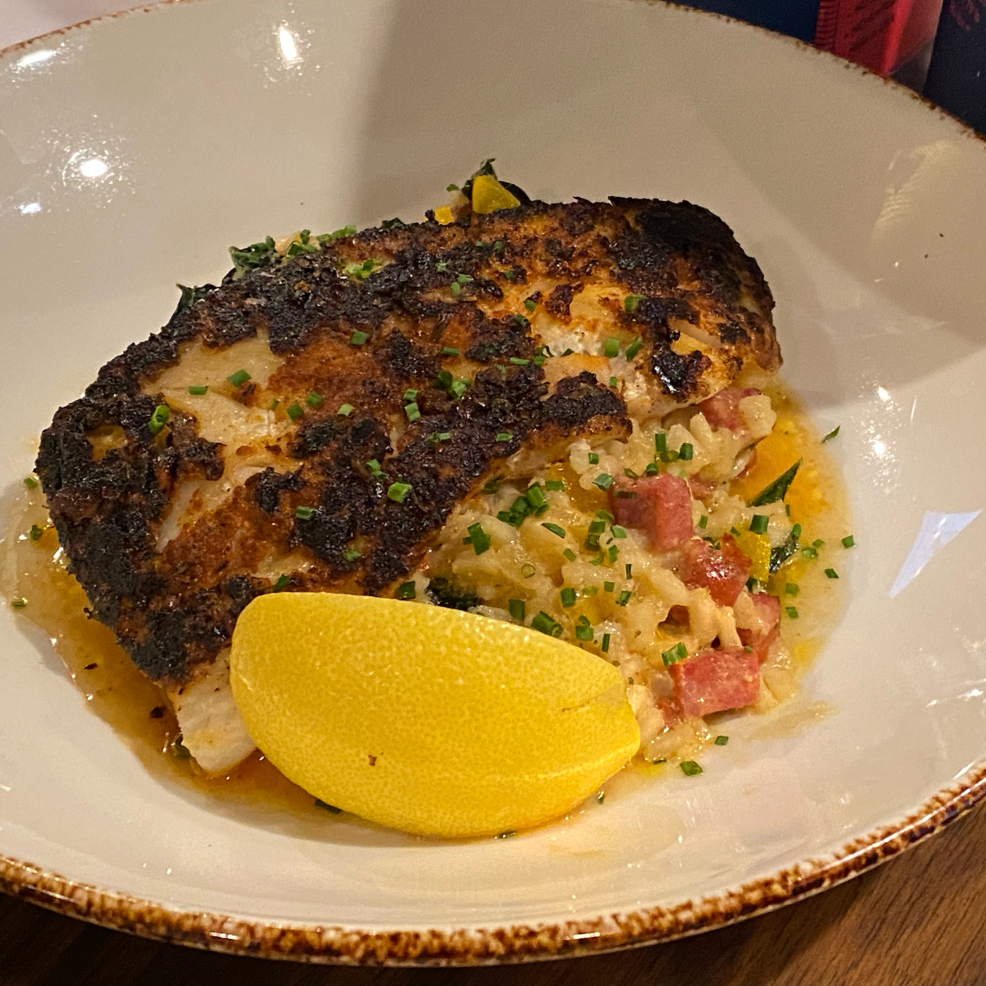
Examples of Great Programs
Partnered with Hawaiian based surimi fishcake family business to relaunch business, expand and innovate
Partnered for Wild Alaska Pollock on Climatarian Menu and comprehensive marketing plan

Slide 20
What are we looking for?
Communication:
Build awareness of Wild Alaska Pollock
Help us tell the story of Wild Alaska Pollock & its many benefits
Support through social, influencers, etc.
New Products
Support new product launches
Continue to drive awareness and demand for some of the lesser-known forms
New Channels
New aisles in grocery
Out of home/restaurants

Slide 21
How Do You Apply?

Slide 22
We’ve Made this Easy… for You!
Key Information
Key Information/Overview on GAPP Website
https://www.alaskapollock.org/about-us/programs
Full Program Details/RFP
Program Submission Form (Attachment A)
Sample Report Metrics (Attachment B)

Slide 23
Submission Form
1.
The Basics
2.
Source
& Region
3.
Description
& Objectives
4.
Metrics &
Measurement
Project Name
Key Dates
Spend in U.S. Dollars
Product
Supplier
Market/region
Overview of proposal
SMART Goals
Key metrics
Demonstrate ROI for spend & industry

Slide 24
Benefits of Partnering with GAPP

Slide 25
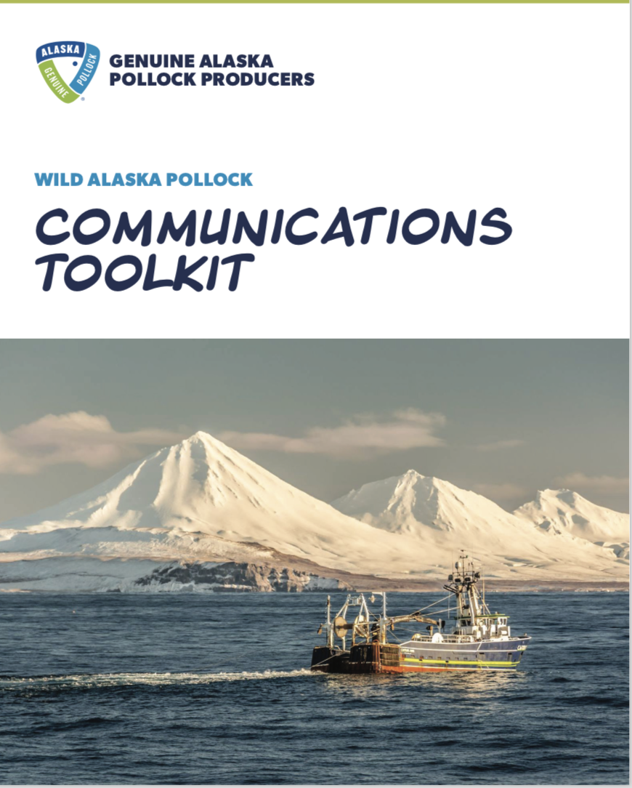
We Want You to Leverage Our Expertise
Research
Communication/Toolkits
Social Partner
Awareness and Usage Studies
Global Nutrition Research
Annual Trackers
2040 Growth Markets
Provide guidance and expertise
Create and disseminate content
Partner on all communication

Slide 26
What Do We Want from Partners?
All Partners will be required to sign a Memorandum of Understanding (MOU)
Provide quarterly updates on programs
Alignment on key Wild Alaska Pollock messaging
Summary report that includes key learning and performance

Slide 27
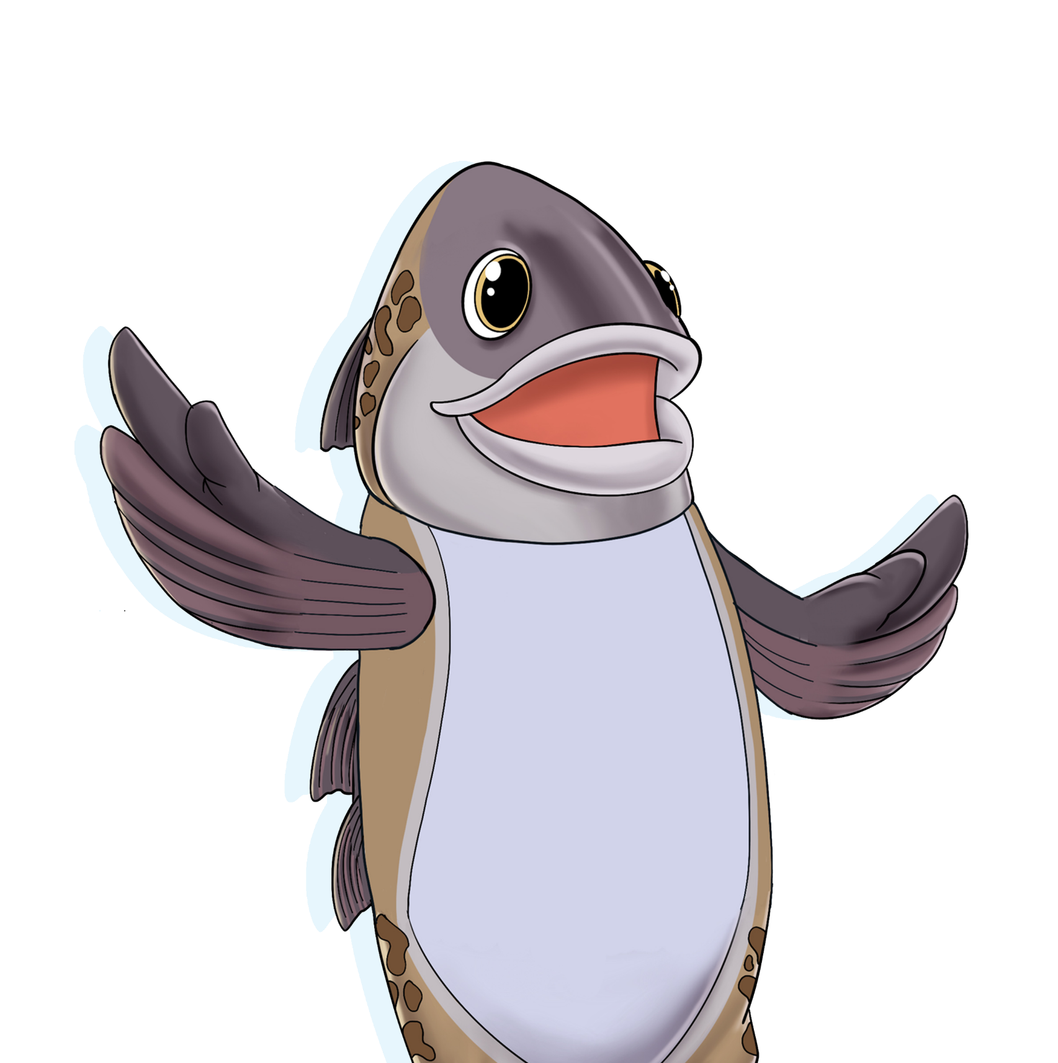
Excited about Wild Alaska Pollock? We are too!
Questions?

Slide 28
Thank You
For any additional questions or to submit a proposal, please reach out to Christine Durkin at Christine.durkin@alaskapollock.org

