Slide 1
Driving Demand and Telling the Wild Alaska Pollock Story
UPDATED: November 2019

Slide 2
Section Overview
0
Executive Summary
(Including approach and key strategic insights)
1
Consumer Insight
(Understanding the landscape)
2
The State of the Fish
(Perception of Wild Alaska Pollock)
3
Increasing Purchase
(Driving demand of Wild Alaska Pollock)
4
A Communications Roadmap
(Best ways for getting the story out)

Slide 3
Executive Summary

Slide 4
Our Approach

Slide 5
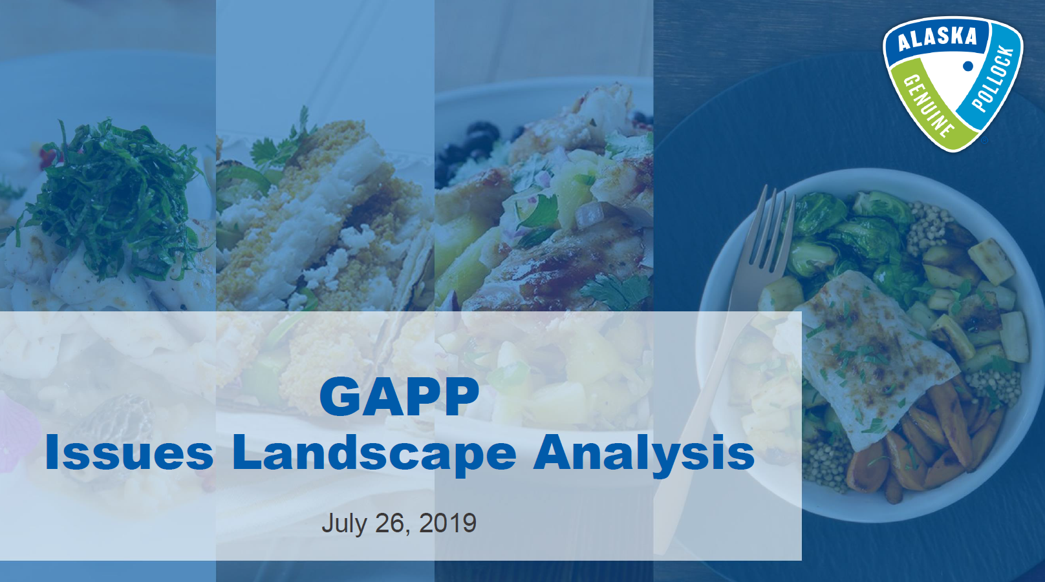
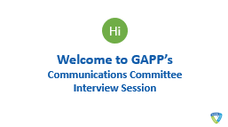
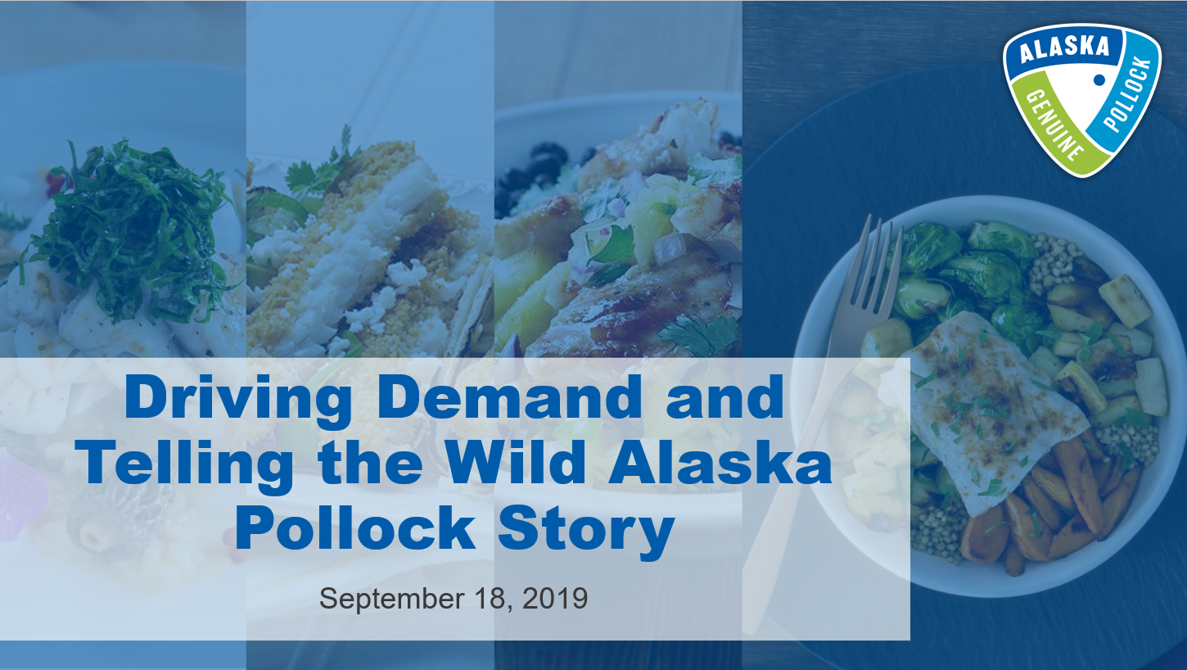
Overview of GAPP research to-date
Overview of earned and social media landscape
In-depth discussions with key internal & external stakeholders
A nationally-representative online survey among seafood consumers
Online focus group sessions among Wild Alaska Pollock’s core audience

Slide 6
Objectives and methodologies
Overview of earned and social media landscape
In-depth discussions with key internal & external stakeholders
A nationally-representative online survey among seafood consumers
Online focus group sessions among Wild Alaska Pollock’s core audience
OBJECTIVE
The issues landscape analysis was used to uncover the news and media position of Wild Alaska Pollock and its competitors, the wider social media conversations emerging in the category, the industry trends that impact WAP, and wider audience trends.
The purpose of the stakeholder interviews was to obtain insight on the Wild Alaska Pollock industry overall, competitors, and demand for Wild Alaska Pollock.
The survey was used to understand people’s key habits and behaviors with seafood, identify attitudes and perceptions of Wild Alaska Pollock, uncover drivers of demand of Wild Alaska Pollock and understand how to connect and engage consumers
Online focus groups were used to allow GAPP to understand how their target consumers think and speak about the category, view Wild Alaska Pollock, and broader motivations that will feed into the wider narrative development and strategy.
METHODOLOGY
An online survey was fielded in the United States among a nationally-representative sample of adults aged 18 years or older. Following this, a drivers of demand analysis using predictive analytics methods was conducted to understand which seafood attributes and key messages are most likely to drive Wild Alaska Pollock demand overall.
The focus groups were conducted over the course of 2-3 days led by a Ketchum Analytics moderator. Each session was 90-minutes in duration and participants were recorded on webcam as they were asked their opinions of Wild Alaska Pollock, key language that resonates in communicating Wild Alaska Pollock and any barriers to consumption.
This consisted of a observation of key news themes, social topics and industry reports. This context aims to help communications understand the broader landscape and ways to connect given shifts in the industry.
For these interviews, a series of stakeholders across restaurants, suppliers, etc. were asked about their perception of the industry, Wild Alaska Pollock, competitors, etc.

Slide 7
Core questions research sought to answer
What are consumers’ seafood behaviors & habits?
What do consumers think about Wild Alaska Pollock?
What will drive purchase of Wild Alaska Pollock?
What are the best ways to get Wild Alaska Pollock’s story out?
Who are the best audiences to engage with to tell the Wild Alaska Pollock story?

Slide 8
The Big Picture

Slide 9
What have we learned?
1
2
3
Unfamiliarity and cost are the greatest barriers in people buying seafood.
Given its usually higher cost, preparing fish can be daunting for many – they don’t want to ruin their investment due to poor preparation and lack cooking confidence.
Improvements in frozen food technology has improved previous stigmas against frozen food – consumers like it for its accessibility, freshness and convenience.
Wild Alaska Pollock
is a food solution that ticks all the boxes
4
5
6
7
Simply put, people expect their fish to be easy, tasty and heathy.
Knowing how their fish was caught and where it was captured fuels greater comfort and trust in their fish selection.
As consumer tastes evolve, people want access to a protein that is versatile as an ingredient as well as format-wise.
Sustainability is part of Wild Alaska Pollock’s diverse story, and it matters to consumers –especially Future Wild Alaska Pollock Advocates.

Slide 10
There’s an audience excited about Wild Alaska Pollock: Future Wild Alaska Pollock Advocates
Future Wild Alaska Pollock Advocates are more likely than the general population to be…
Millennial.
36% of Future Wild Alaska Pollock Advocates are Millennials, compared to 25% of the general population.
Parents.
27% of Future Wild Alaska Pollock Advocates are parents, compared to 29% of the general population.
Affluent.
62% of Future Wild Alaska Pollock Advocates earn above $50k in HHI, compared to 48% of the general population.
Educated.
70% of Future Wild Alaska Pollock Advocates have at least some college education, compared to 59% of the general population.
Strong Purchase Power.
72% are likely to buy Wild Alaska Pollock in fast food, 62% in sit down restaurants and 64% in grocery, which is significantly higher than the general population
Nuances to consider for Future Wild Alaska Pollock Advocates
Sustainability matters.
More than any other group, this audience is highly impacted by sustainability messaging, particularly knowing it is “the most abundant certified-sustainable fish in the world,” “it is sustainably managed and harvested” and “has a lower carbon footprint.”
Quality over
cost.
This audience differs from the general population in that they value that their fish is “enjoyed by the whole family” and is made from “100% whole fillets.” Whereas, most people would put cost and easy preparation ahead of this.
Showcase the diversity.
More than most people, this audience is heavily influenced to buy Wild Alaska Pollock if they know its in their “favorite ethnic and cultural dishes.”
Distinguish the difference.
Future Wild Alaska Pollock Advocates indicate they’d buy more Wild Alaska Pollock if they knew it was different than “other variations of Pollock (e.g. Atlantic Pollock)”.

Slide 11
So what?
1
Fish is confusing to consumers.
A blend of fish unfamiliarity, high costs and a lack of comfort in cooking seafood fosters fish insecurity among consumers.
Fuel consumer confidence in fish.
With no competitor fish being the clear leader in easy preparation, even small ways of building knowledge and confidence matter.
2
People just want fish to be tasty, healthy & easy.
When it comes to buying seafood, taste, healthfulness and easy preparation are the values that matter most.
Tell people how Wild Alaska Pollock delivers on this.
Wild Alaska Pollock ticks all the boxes in being tasty, healthy and easy – consumers just need to know this and associate it more closely with Wild Alaska Pollock.
3
They trust fish more if it’s wild and sourced.
As consumers see “wild-caught” and provenance claims on packaging and menus, their comfort and trust in the fish product increases.
Play up ‘wild’ and ‘Alaska’ messaging.
Wild Alaska Pollock needs to amplify its ‘wild caught’ messaging and own the Alaska provenance, as this sourced location eluded positive connotations with consumers.
Wild Alaska Pollock’s versatility & sustainability are standout selling points.
The hidden story of Wild Alaska Pollock’s sustainability and versatility of formats are not as clearly told and attributed to Wild Alaska Pollock, despite it being a core differentiator and high selling point.
4
Tell audiences the untold stories of how Wild Alaska Pollock is versatile & sustainable.
Convey a clearer depiction of Wild Alaska Pollock’s sustainable abundance and versatile formats. This is especially key to attract and obtain the dollars of the fish’s future advocates.

Slide 12
Motivating consumers to buy Wild Alaska Pollock across business channels
THE MOST IMPORTANT MESSAGES TO COMMUNICATE BY BUSINESS CHANNEL
Taste
Texture
Health
Provenance
Versatile
Sustainable
Preparation
Debunk the mystery of what is in QSR fish & highlight all its Alaska glory.
Fresh tasting
Mild
Mild-tasting
Delicious whitefish
Flaky
High in protein
Low fat
Heart healthy
Product of Alaska
From the Bering Sea
Locally sourced
Versatile
Good as an ingredient
Whole family will enjoy
Good as center of plate
Trendy and in-demand
Variety of tastes and cooking methods
Wild-caught
Sustainable
Lower carbon footprint than beef, chicken, pork and most other land-based proteins
QSR
FISH COUNTER
Fresh tasting
Mild
Mild-tasting
Delicious whitefish
Flaky
High in protein
Low fat
Heart healthy
Product of Alaska
From the Bering Sea
Locally sourced
Versatile
Easy to prepare
Quick to cook
Convenient
Whole family will enjoy
Wild-caught
Sustainable
Traceable
Lower carbon footprint than beef, chicken, pork and most other land-based proteins
(Provide ideas/recipes for preparation)
(Provide suggested pairings)
Hone in on taste, texture & sourcing, and fuel them with preparation & pairing tips.
GROCERY
FROZEN AISLE
Promise convenience without sacrificing fresh, wild, Alaskan seafood.
Give all the details on how this tasty fish is prepared.
Fresh tasting
Mild
Mild-tasting
Delicious whitefish
Flaky
Product of Alaska
From the Bering Sea
Locally sourced
Versatile
Whole family will enjoy
Variety of tastes and cooking methods
(Explain in menu how the fish was prepared)
FULL SERVICE

Slide 13
Our Consumer Insight Understanding the consumer landscape

Slide 14
Lack of familiarity is the #2 deterrent to people buying seafood, just behind cost.
What prevents you from purchasing and/or ordering fish?
0
Q25. What prevents you from purchasing and/or ordering fish? Base: aware of fish: 902

Slide 15
People want tasty, healthy, easy to prepare seafood, that isn’t expensive.
Importance of Seafood Attributes
General Population | Attributes
68% | Great tasting
64% | Fresh tasting
54% | Heart healthy
54% | Affordable
50% | Easy to prepare
49% | Whole family will enjoy
49% | High in protein
48% | Made from 100% whole fillets
42% | Good as center of the plate
42% | Sustainable
41% | Versatile
41% | Product of the U.S.
40% | Quick to cook
37% | Good as an ingredient
Q8. Below is a list of attributes that people may use to describe seafood. For each, please rate how important that attribute is to you when purchasing and/or ordering seafood. Base: 1,026

Slide 16
Although they are eating fish, they aren’t comfortable cooking it on their own.
60%
are not comfortable cooking and preparing fish dishes
2 in 3
consumers (65%)
typically prepare and eat fish at home
48% do this once every two weeks or more
Nearly half
of consumers (49%)
eat fish often*
(vs 23% sometimes* and 28% not often*)
(B7B: 0-7 on a 10-pt scale)
S6. How often do you eat seafood? *Often= once a week, once every two weeks; *Sometimes= once a month; *Not Often= once every few month, once every six months Base: 1,026
S8. In what setting do you typically eat seafood? Please select all that apply. Base: 1,026
S9. How often do you eat and/or purchase seafood within the following settings? Please select all that apply. Base: 1,026
Q10. I am comfortable cooking and preparing fish dishes - How much do you agree with each statement? Base: 1,026

Slide 17
And no fish is clearly leading the way in being simple and easy to cook.
Q9. Now, thinking about the attributes associated with seafood, please tell us how well you feel each one describes [FISH] using a 0 to 10 scale. Base: Salmon: 406 Cod: 380 Tilapia: 380 Haddock: 379 Wild Alaska Pollock: 491 Sole: 376

Slide 18
Key Implication
Communicate how Wild Alaska Pollock delivers on taste, health and easy of preparation across formats – without the deterrents of being intimidating or expensive which keep people from buying seafood.

Slide 19
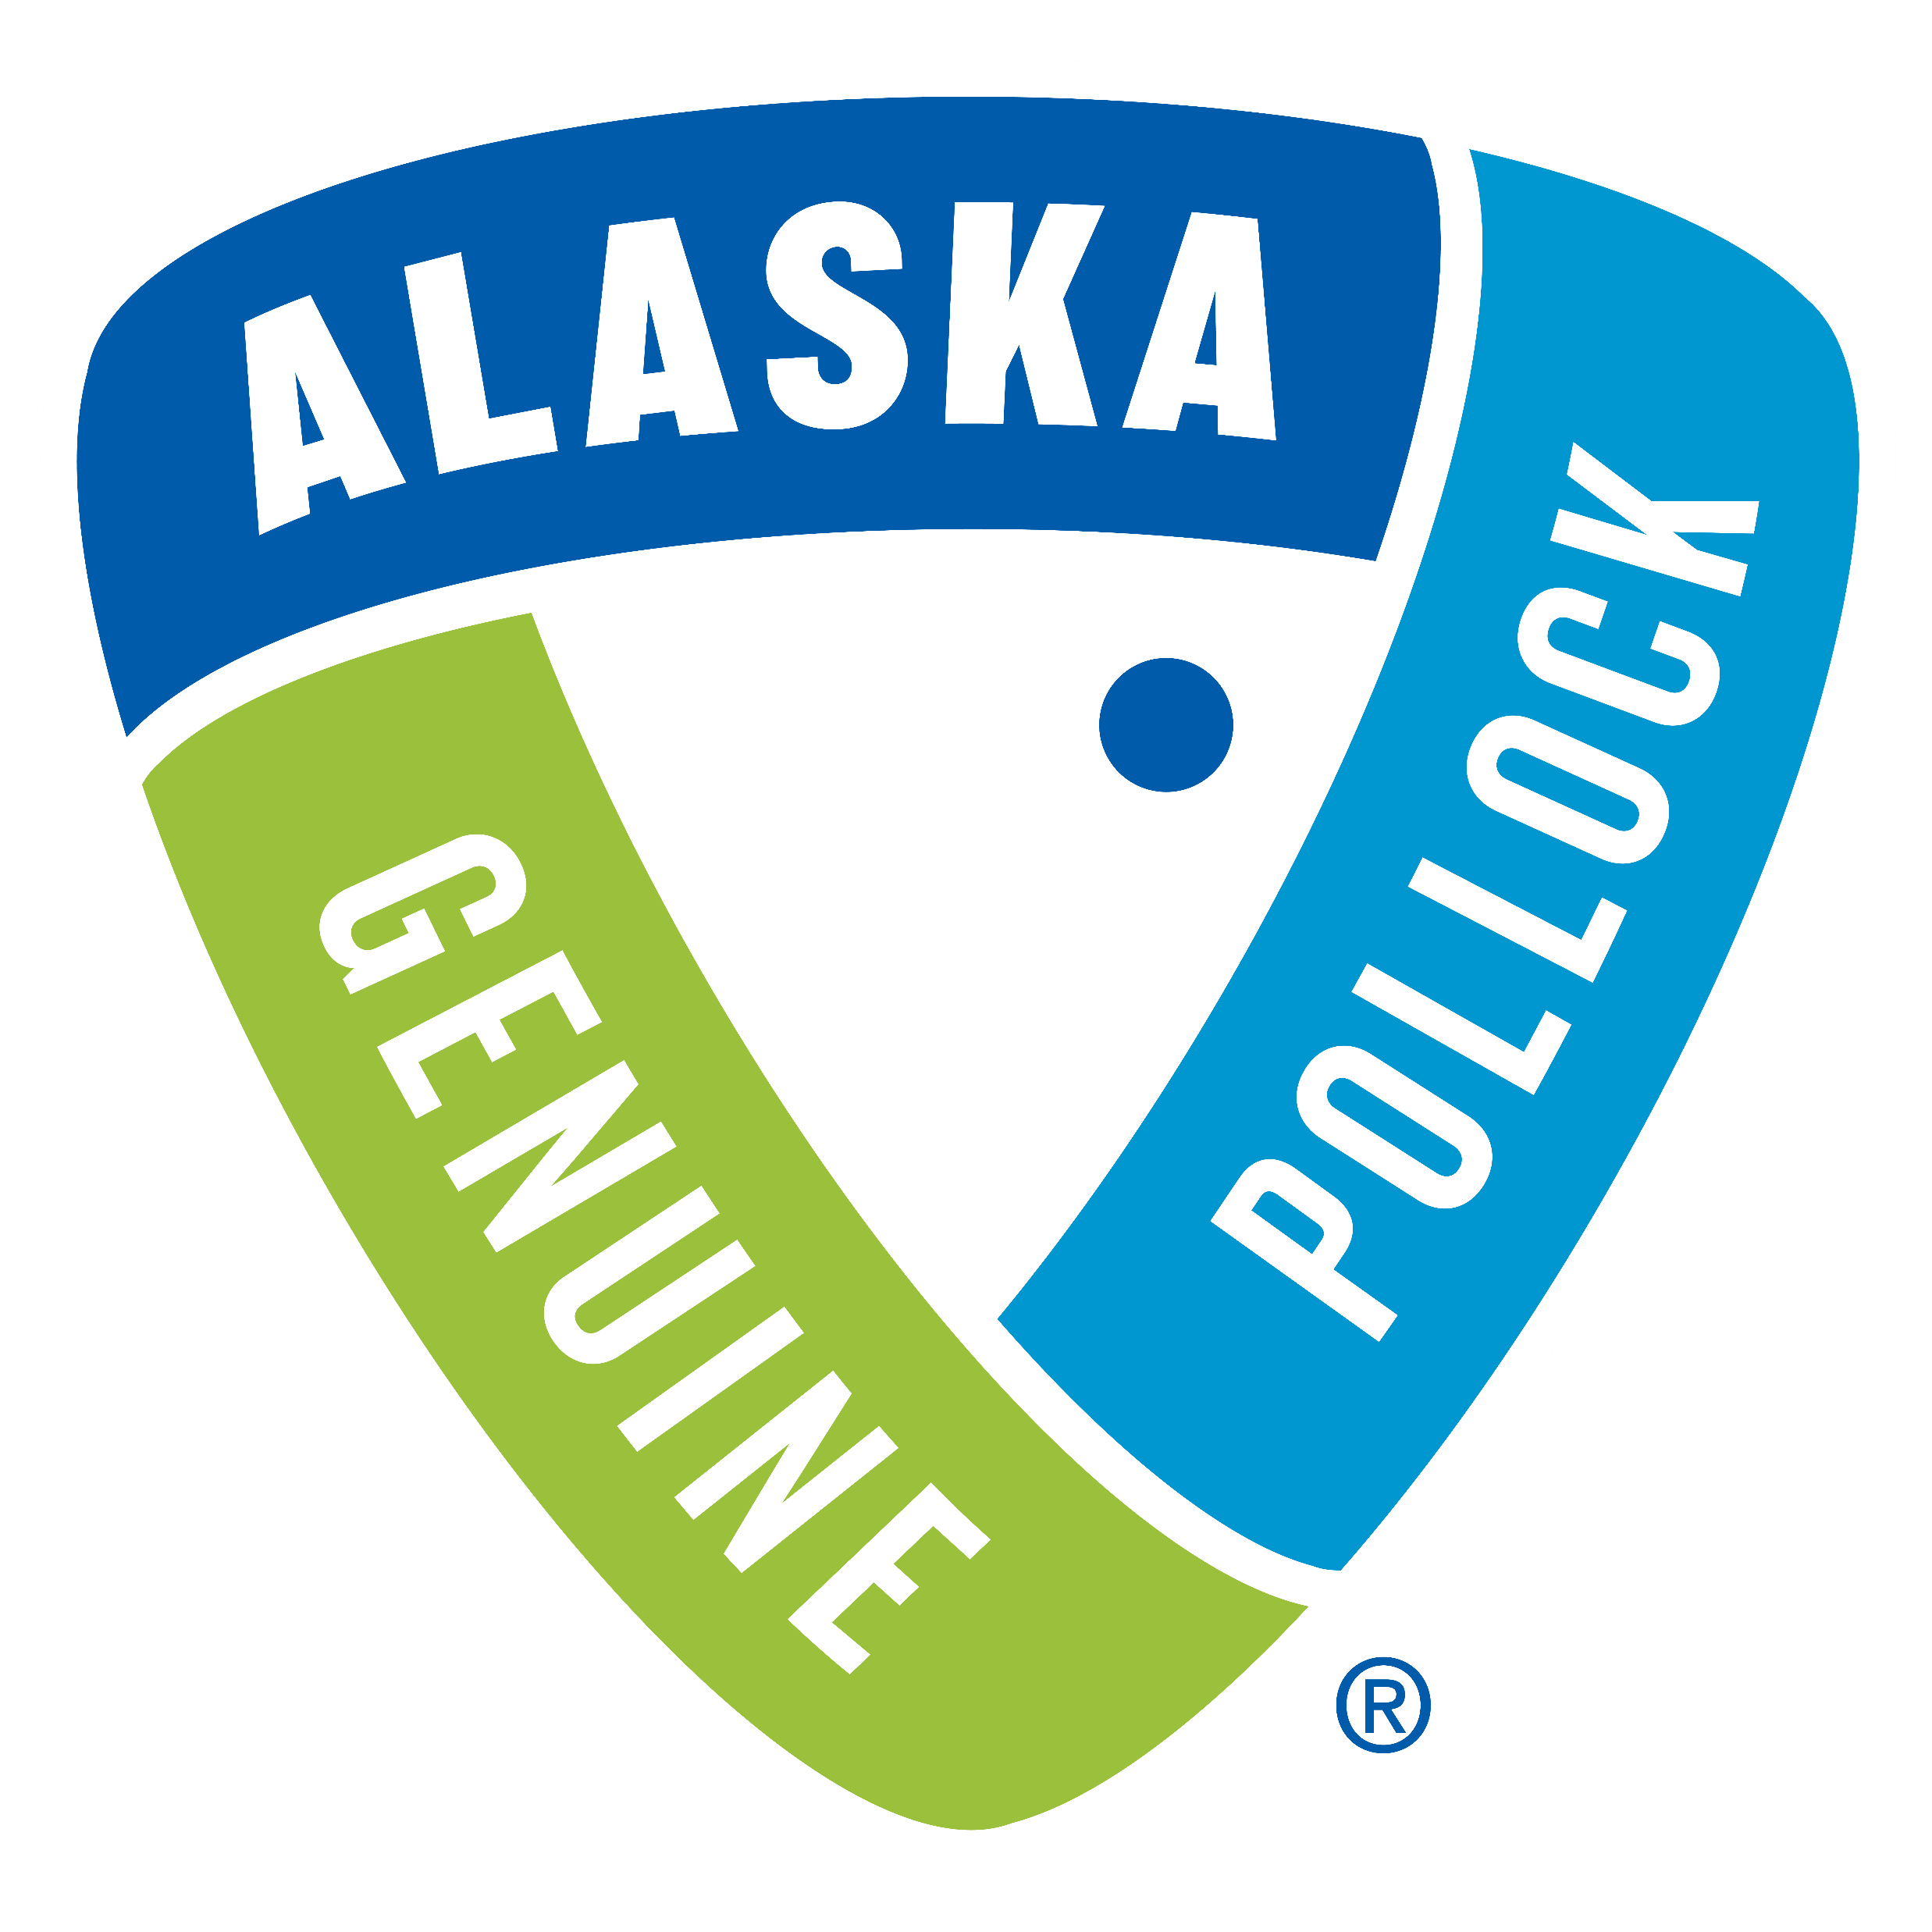
The State of the Fish Perception of Wild Alaska Pollock

Slide 20
Wild Alaska Pollock’s gets some recognition for its taste, health and provenance.
Wild Alaska Pollock Performance on Seafood Attributes
Attributes | General Population
Product of Alaska | 54%
Heart healthy | 53%
Product of the U.S. | 52%
High in protein | 52%
Fresh tasting | 52%
Great tasting | 52%
Wild-caught | 51%
Good as the center of plate | 51%
Made from 100% whole fillets | 50%
Versatile | 49%
Easy to prepare | 49%
Quick to cook | 49%
Whole family will enjoy | 48%
Low-fat | 47%
Good as an ingredient | 47%
Affordable | 46%
Q9. Now, thinking about the attributes associated with seafood, please tell us how well you feel each one describes Wild Alaska Pollock using a 0 to 10 scale. Base: 491

Slide 21
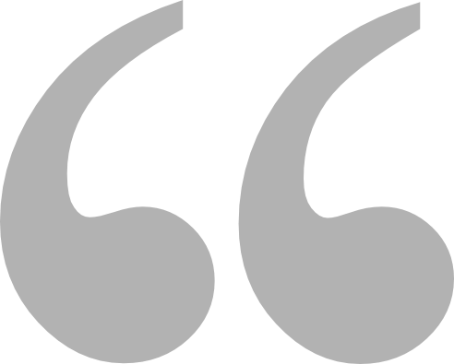
When talking about taste, consumers specifically want to know its “mild” and “flaky”.
(Quotes provided from participants during GAPP focus groups)
I like the lean and mild descriptions because when I eat fish, I want the toppings and flavors to come out.” –Male, focus groups
I am more about flavor first, so mild white fish stood out.” –Male, focus groups
Usually I am looking for a mild white fish because it is a crowd pleaser and easy to put with different dressings and sauces.” –Female, focus groups
High in protein and flaky. I think that is the texture of white fish in general.” –Male, focus groups
I like the words flaky and mild. I like my fish to be flaky.” –Male, focus groups
I do like mild and flaky. If I am not sure about what type of fish it was, that’s what I would look for.” –Female, focus groups

Slide 22
When communicating health benefits, consumers care about it being protein-rich, low-fat and heart healthy.
(Quotes provided from participants during GAPP focus groups)
54
49
%
For me to pick fish in fast food, I’d want to see fresh tasting, high in protein, and low fat.”–Male, focus groups
%
say “heart healthy” is an important attribute when purchasing and/or ordering seafood.
say “high in protein” is an important attribute when purchasing and/or ordering seafood.
High in protein and flaky. I think that is the texture of white fish in general.” –Male, focus groups

Slide 23
The specificity of the Alaska provenance eludes high quality & builds trust among consumers
(Quotes provided from participants during GAPP focus groups)
I think Alaska to me sounds like the best choice. When I think of Alaska, I think of fishing and ice and Eskimos and good quality fish.” –Male, focus groups
I like product of Alaska. To me it is more consistent. It might be further away, but it drives consistency on how it is packed and sourced. Alaska just helps clarify and take away some questions.” –Male, focus groups
Product of Alaska and from the Bering sea makes me think of deadliest catch and its high-quality fish.” –Male, focus groups
Alaska because it is more specific. If it is not frozen and coming from Alaska than I can get fresher fish in Florida.” –Female, focus groups

Slide 24
But beyond taste, health & provenance, few know how easy and versatile Wild Alaska Pollock is.
Wild Alaska Pollock Performance on Seafood Attributes
Attributes | General Population
Product of Alaska | 54%
Heart healthy | 53%
Product of the U.S. | 52%
High in protein | 52%
Fresh tasting | 52%
Great tasting | 52%
Wild-caught | 51%
Good as the center of plate | 51%
Made from 100% whole fillets | 50%
Versatile | 49%
Easy to prepare | 49%
Quick to cook | 49%
Whole family will enjoy | 48%
Low-fat | 47%
Good as an ingredient | 47%
Affordable | 46%
Q9. Now, thinking about the attributes associated with seafood, please tell us how well you feel each one describes Wild Alaska Pollock using a 0 to 10 scale. Base: 491

Slide 25
Communicating Wild Alaska Pollock’s easy, versatility is a key purchase motivator.
86
50
40
%
%
%
of Future Wild Alaska Pollock Advocates say “If I knew it could be made beyond being battered and fried.”
say “easy to prepare” is an important attribute when purchasing and/or ordering seafood.
say “quick to cook” is an important attribute when purchasing and/or ordering seafood.
To get me to buy this fish, I’d want to know it is versatile, 100% whole fillet and its good as the center of the plate.”–Male, focus groups
I am a sucker for convenience, so I like the frozen fillet packs of fish and vegetables, and you just put it in the oven.” –Male, focus groups
I am a mom so I’m usually looking for meals that are quick to cook for my son.”–Female, focus groups
Q8. Below is a list of attributes that people may use to describe seafood. For each, please rate how important that attribute is to you when purchasing and/or ordering seafood. Base: 1,026

Slide 26
And Wild Alaska Pollock’s unique sustainability story also matters in getting consumers to buy.
93%
of Future Wild Alaska Pollock Advocates say the message
“Wild Alaska Pollock is the most abundant certified-sustainable fish in the world”
would have positive impact on their likelihood to purchase and/or order Wild Alaska Pollock
42%
of consumers say
sustainability
is an important attribute
when purchasing
and/or
ordering seafood.
What stands out to me is knowing that its not grown in a fishery in conjunction with it being sustainable, that’s important to me. To know its sustainable and wild, that’s cool.—Male, focus groups

Slide 27
Key Implication
The Wild Alaska Pollock is getting some credit from consumers on its taste, health and Alaska provenance, however there’s greater opportunity for Wild Alaska Pollock to communicate how it is versatile and sustainable fish, which are key purchase motivators, outside of the table stakes of taste, health and easy preparation.

Slide 28
Increasing Purchase Driving demand of Wild Alaska Pollock

Slide 29
Industry experts believe the stigma against frozen fish can negatively impact Wild Alaska Pollock demand.
(Quotes provided from industry experts during GAPP stakeholder interview research)
So, frozen fish got a bad name over the
past hundred years. But fresh frozen fish is really good and modern ways of freezing are making that difference. –Industry expert
When they are freezing and thawing and
refreezing the quality becomes inferior, so that gives it a bad reputation. –Industry expert
The way it is produced makes it look funky.
They need to explain to customers why the fish looks the way it does. The way that it is frozen makes it look strange. –Industry expert
It got a bad reputation because of the poor
way it used to be frozen, we didn’t have the advancements back then, so it would have a smell and look a little funny. –Industry expert
Quotes come from industry stakeholder interviews conducted in August - September 2019

Slide 30
But GAPP’s audience actually prefers frozen fish due to its convenience.
(Quotes provided from participants during GAPP focus groups)
I like frozen fish for the convenience. I am not a seafood snob so I cant tell the difference. My only concern is weather they say once frozen or twice frozen. How many times is a fish normally frozen? –Male, focus groups
I like frozen only once, especially based on the fact it is from Alaska and doesn’t go through multiple freeze cycles, so it doesn’t lose its taste. –Male, focus groups
Frozen doesn’t bother me because someone at the grocery store told me it is better. Most of the time the fish is frozen immediately when it is caught to be delivered to the Midwest. If it is not frozen right away it might be more questionable. –Male, focus groups
I don’t buy twice frozen because of bacteria– I don’t want parasites. The frozen at sea is interesting. When I do buy frozen I look at once frozen or frozen at sea –Female, focus groups

Slide 31
And importantly, ‘frozen’ doesn’t alienate consumers as long as it gives them access to fresh-tasting, convenient fish.
Consumer Comfort with Frozen Labeling on Packages
62%
are comfortable eating fish that are once-
frozen
58%
are comfortable eating fish that are frozen at sea
55%
are comfortable eating fish that are individually quick frozen
37%
are comfortable eating fish that are twice-frozen
Q21. Once-Frozen means once the fish is caught at sea, it is filleted and then frozen. Which of the following statements applies based on the above? Base: 1,026
Q22. Twice-Frozen means the fish is caught at sea, filleted and frozen at sea. The fish is then shipped to a processing plant, thawed for reprocessing, and frozen a second time. Which of the following statements applies based on the above? Base: 1,026
Q23. Individually Quick Frozen (IQF) means the fish is fast-frozen in a matter of minutes or hours as individual units. Which of the following statements applies based on the above? Base: 1,026
Q24. Frozen at Sea means the fish is harvested at sea and then filleted and frozen within hours of catch. Which of the following statements applies based on the above? Base: 1,026

Slide 32
Wild Alaska Pollock has a very motivating story that consumers, particularly Millennials, want to hear.
(Definition provided in online survey)
“Wild Alaska Pollock is a delicious, mild-tasting whitefish, that is versatile and nutritious. It’s superior quality, sustainability and traceability have made it the most popular wild seafood in the world. Caught in the icy-cold waters of Alaska by U.S. fishermen and frozen only once.”
56%
of Future Wild Alaska Pollock Advocates say they will
seek out more information about Wild Alaska Pollock
Q11. How likely are you to do the following? Base: 1,026
Q13. Now knowing that about Wild Alaska Pollock, how likely are you to do the following? Base: 1,026
*Aware = a lot/some/a little/only know the name *Familiar = a lot/some/a little

Slide 33
Wild Alaska Pollock’s sustainability story matters for our target audience.
Sustainability messages with high likelihood to drive purchase and/or ordering of Wild Alaska Pollock
93%
of Future Wild Alaska Pollock Advocates say the message
“Wild Alaska Pollock is the most abundant certified-sustainable fish in the world”
would have positive impact on their likelihood to purchase and/or order Wild Alaska Pollock
93%
of Future Wild Alaska Pollock Advocates say the message
“Wild Alaska Pollock is a smart seafood choice because it is sustainably managed and responsibly harvested under scientifically-based U.S. regulations”
would have positive impact on their likelihood to purchase and/or order Wild Alaska Pollock
90%
of Future Wild Alaska Pollock Advocates say the message
“Wild Alaska Pollock has a lower carbon footprint than beef, chicken, pork and most other land-based proteins”
would have positive impact on their likelihood to purchase and/or order Wild Alaska Pollock
Q14. How much of an impact do the following statements have in your likelihood to consider purchasing and/or ordering Wild Alaska Pollock? Base: 1,026

Slide 34
And its versatility as a fish is a driver for purchase among GAPP’s core audience & general market.
Purchase Impact Statements
(Total respondents; T3B: 8-10 on a 10-pt scale)
86%
of Future Wild Alaska Pollock Advocates say
If I knew it was good as the center of the plate it would positively impact their likelihood to purchase and/or order Wild Alaska Pollock
86%
of Future Wild Alaska Pollock Advocates say
If I knew it could be made beyond being battered and fried it would positively impact their likelihood to purchase and/or order Wild Alaska Pollock
83%
of Future Wild Alaska Pollock Advocates say
If I knew it could it was good as an ingredient it would positively impact their likelihood to purchase and/or order Wild Alaska Pollock
38% of the general population agree
38% of the general population agree
36% of the general population agree
Q14. How much of an impact do the following statements have in your likelihood to consider purchasing and/or ordering Wild Alaska Pollock? Base: 1,026

Slide 35
Key Implication
Wild Alaska Pollock has laid some groundwork messaging in terms of taste, health and provenance recognition inherent in the Wild Alaska Pollock name. There’s prime opportunity to drive purchase, particularly among Future Wild Alaska Pollock Advocates, by better telling Wild Alaska Pollock’s sustainability and versatility stories.

Slide 36
A Communications Roadmap Best ways for getting the story out

Slide 37
Consumers are looking for culinary inspiration & understanding of Wild Alaska Pollock’s health value.
What types of stories would make you more interested in Wild Alaska Pollock?
38%
of consumers say they would eat more Wild Alaska Pollock if they knew it could be made beyond being battered and fried
of consumers say they would eat more Wild Alaska Pollock if they knew it was healthy source of high protein, low in fat and cholesterol, and a natural source of omega-3 fatty acids
43%
95%
of Future Wild Alaska Pollock Advocates agree
85%
of Future Wild Alaska Pollock Advocates say they would eat more Wild Alaska Pollock if they were provided with ideas/recipes for preparation
Q14. How much of an impact do the following statements have in your likelihood to consider purchasing and/or ordering Wild Alaska Pollock? Base: 1,026
Q31. What types of stories would make you more interested in Wild Alaska Pollock? Base: 1,026

Slide 38
Grocery stores & the fish market display are where they’d most like recipe guidance.
(Quotes provided from participants during GAPP focus groups)
I would look for a recipe if I saw a new fish. No specific words come to mind but some cool recipes. –Male, focus groups
If I saw a fish I was unfamiliar with, I would be looking at recipes and what I can do with it. What can I cook with it. How long or how fast it will take. –Female, focus groups
If it was a new fish, recipes on the display case would interest me. If it is used in fancy recipes. –Female, focus groups

Slide 39
Partnering with prominent chefs and authentic peer promotion (e.g. encouraging sharing) are the ways to influence audiences.
Top Cooking Inspiration Sources
Top Types of Seafood News Sources
34%
say chefs & restaurateurs have the most influence in inspiring seafood cooking & preparation
37%
Cooking shows on TV
34%
Recipes
36%
Tips from family & friends
31%
News stories
34%
Recipe books
31%
say family & friends have the most influence in inspiring seafood cooking & preparation
30%
Personal stories
27%
Cooking videos online and social media
22%
Chefs & restaurant owners
Q30. Where do you typically find your cooking inspiration? Base: 1,026
Q33. In your opinion, who has the most influence in inspiring seafood cooking and preparation? Base: 1,026
Q29. What types of news regarding seafood do you pay the most attention to when it comes to seafood? Base: 1,026

Slide 40
And engaging food videos are particularly favorable among younger audiences.
Where would you like to learn more about Wild Alaska Pollock?
43%
of Millennials would buy and/or order Wild Alaska Pollock if they were provided with ideas/recipes
Q32. Where would you like to learn more about Wild Alaska Pollock? Base: 1,026
Q14. How much of an impact do the following statements have in your likelihood to consider purchasing and/or ordering Wild Alaska Pollock? Base: 1,026

Slide 41
Key Implication
Currently, Wild Alaska Pollock isn’t appearing in the places where audiences, particularly younger, are. As Wild Alaska Pollock’s narrative is developed, ensuring messaging and content is engaging, inspiring and displayed across multiple channels is key to getting consumer attention.

Slide 42
Thank you!

