Slide 1
Wild Alaska Pollock Life Cycle Assessment

Slide 2
GAPP LCA Initiative Objectives
Provide internal knowledge to GAPP as to the environmental impacts of Wild Alaska Pollock products across several key impact categories.
Enable GAPP members to provide their customers with credible environmental impact information on five Wild Alaska Pollock products (credibility established through use of ISO standards and peer review).
Identify improvement opportunities to further reduce environmental impacts.
Gain a deeper understanding of where the environmental impact of Wild Alaska Pollock products fall on the animal protein continuum.

Slide 3
Scope
Three years: 2016, 2017, and 2018
Products: Fillets, surimi, roe, fish meal and fish oil
Destinations: Products delivered to three destinations (East Coast US, Rotterdam NE, Busan SK)
Impacts: Represented as industry-wide, but we did not obtain or use GOA data. An analysis of GOA data suggested inclusion of GOA data would not materially affect results, although inclusion of data in future studies could lower or change the estimates of impacts.
Analysis: Estimates separate impacts for shore-based, catcher-processors, and motherships, but results are reported only across all sectors.

Slide 4
Sources of data in analysis
Inputs – Surveys (separate surveys sent to MS/SB processors, catcher processors, and catcher vessels)
Catch by sector – NOAA Fisheries Catch and Landing Reports
Production – Surveys and NOAA reports
Data gaps – Secondary sources (e.g. Ecoinvent)
Ecoinvent - Recognized as one of the most complete background LCA databases available, from quantitative (number of included processes) and qualitative (quality of the validation processes, data completeness, etc.) perspectives.

Slide 5
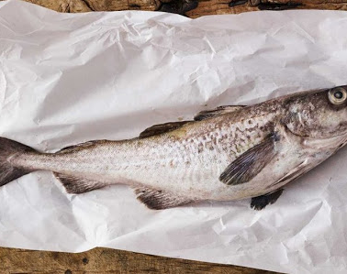
Kg of Protein vs. Kg of Product
Why are we communicating Kg of protein?
Companies and commodity groups have made the announcement both ways, but here’s why we’re reporting impacts per Kg of protein:
Kg of protein and is a more common comparison (denominator) and is more impactful.
There continues to be growing interest in protein from consumers so we believe presenting the data this way is more on trend.
Ketchum recommended we communicate on a KG protein basis.
Groups who publish on a kg of product basis tend to have higher carbon footprints.
Most scientific research is published on a kg of protein basis.

Slide 6
Carbon impacts of Wild Alaska Pollock products per KG protein
Source: Life Cycle Assessment of Wild Alaska Pollock ISO LCA Report, Quantis (2021)

Slide 7
Carbon impacts of Wild Alaska Pollock products in comparison to other proteins
*Quantis International, Life Cycle Assessment of Wild Alaska Pollock: ISO LCA Report (2021)
**Monterey Bay Aquarium/Dalhousie University Seafood Carbon Emissions Tool; measured as kg CO2-eq per kg of protein based on midpoints for reported range (as of July 14, 2021)
***Comparative environmental LCA of the Impossible Burger® with conventional ground beef burger, Quantis International (2019)

Slide 8
Considerations when comparing carbon footprints of proteins
Results are significantly affected by how impacts are apportioned across products.
Reported impacts for other proteins can vary widely by source of data.
Land use can be a major factor for other proteins.
Consider stage of product when making comparisons – e.g. U.C. Santa Cruz study reports breaded and surimi seafood products have 2 to 2.5 times impacts of raw materials.
Even with that, Wild Alaska Pollock has a lower carbon footprint than any other protein even on an as consumed basis.

